Slide 1
Increase Your Commission

Slide 2
A) The WHY- Chart of annual and cumulative income difference-monthly scorecard

Slide 3
Sales Volume | 2.25 | 2.5 | 2.75 | 3.0
$10,000,000 | $225,000 | $250,000 | $275,000 | $300,000 | $75K
$50,000,000 | $1,125,000 | $1,250,000 | $1,375,000 | $1,500,000 | $375K
$100,000,000 | $2,250,000 | $2,500,000 | $2,750,000 | $3,000,000 | $750K
$250,000,000 | $5,625,000 | $6,250,000 | $6,875,000 | $7,500,000 | $1.875M
$500,000,000 | $11,250,000 | $12,500,000 | $13,750,000 | $15,000,000 | $3.75M

Slide 4
B) Split the difference 6 to 5.5 vs to 5
$350,000 House
6%
Commission Rate
$21,000
5.75%
Commission Rate
$20,125
5.5%
Commission Rate
$19,250
5.25%
Commission Rate
$18,375
5%
Commission Rate
$17,500
20 transactions at 6% average - | $420,000 x .5 = $210,000
20 transactions at 5.75% average - | $402,500 x .5 = $201,250
20 transactions at 5.5% average - | $385,000 x .5 = $192,500 | $35,000
20 transactions at 5.25% average - | $367,000 x .5 = $183,750
20 transactions at 5% average - | $350,000 x .5 = $175,000
4

Slide 5
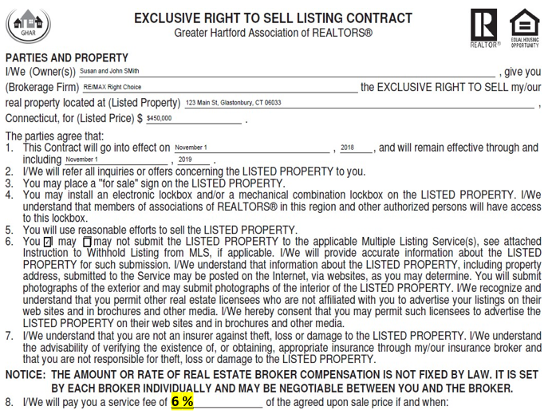
C) Have the commission pre-filled out at 6 or higher

Slide 6
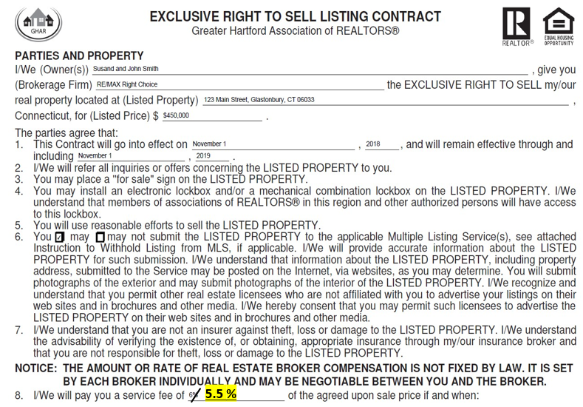
D) Pre-fill in listing % and cross out

Slide 7
E) Expired should be higher commission

Slide 8
F) Styles that take longer should be higher commission

Slide 9
G) Locations that take longer should be higher
Highway Noise/ Suggest your clients do a drive-by prior to scheduling a showing.
Days on Market: 183
Buyer’s Agent Compensation: 2.50 % of sale price
Main Road (Route 198)
Days on Market: 236
Buyer’s Agent Compensation: 2.50 %
Power lines allowed up to the home site.
DOM: 188
Buyer’s Agent Compensation: 2.50 % of sale price

Slide 10
H) Corporate Relocation and Banks
Mr. and Mrs. Seller -
Why do you think, on average, corporate relocation and bank homes sell quicker?

Slide 11
It is a known fact they make the condition pristine, they price based on market comps, and they offer a higher commission than you typically see in the market. Historically they have offered 6, 6.5, or 7% commission.

Slide 12
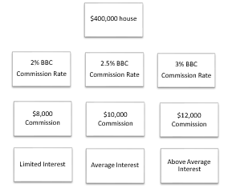
I) Agents will not show your listing without you knowing it
12

Slide 13
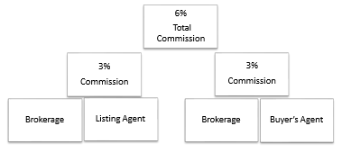
J) Explain how the commission gets broken down

Slide 14
K) My Value Proposition
Mr. and Mrs. Seller -
My statistics will show that, on average, most of my clients get more for their homes on a list to sales price ratio than what other sellers receive.

Slide 15
Why? It's about competence, negotiating power, industry reputation, and exposure and marketing. Agents want to show my homes and work with me.

Slide 16
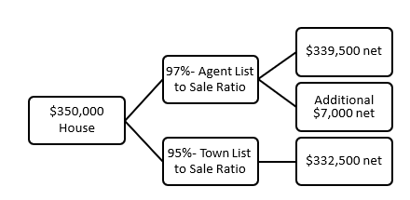
L) List to sales price ratio - if market is 5% and you
are 3%

Slide 17
M) Bottom Line
Mr. and Mrs. Seller -
What is more important to you - what you invest in the fee you pay or what you walk away with when the sale is completed?
Mr. and Mrs. Seller -
If the other agent could truly net you as much money as I can and offered a better value with a lesser commission, wouldn't they have all the listings?

Slide 18
5% commission rate: $17,500
5.5% commission rate: $19,250
COMMISSION DIFFERENCE: $19,250 - $17,500 = $1,750
$339,500 - $332,500: $7,000 - $1750 = $4250 net gain for the seller 6% commission rate: $21,000 - $17,500 = $3500 net difference
$339,500 - $332,500: $7,000 - $3,500 = $3,500 net gain for the seller

Slide 19
N) Ask what the net price goal is so you can focus on the bottom line vs. the commission
For Example:
Net Price Goal: $330,000
Your average list to sales price ratio 97%
Your average commission (6%) plus conveyance taxes is 7%
$330,000 ÷ 97% = $340,206 ÷ 93% = $365,813
If your list to price ratio was 95% vs. 97%
Your average commission (5%) plus conveyance taxes is 6%
$330,000 ÷ 95% = $347,368 ÷ 94% = $369,540
You have to sell the house for $3,727 higher to net the same dollars: $369,540 - $365, 813 = $3,727 difference
19

Slide 20
O) The seller controls 4 major things:
Asking price
Condition
The agent that represents them
The commission being offered

Slide 21
P) Why do sellers come to us- Our Success
RE/MAX IS THE #1 REAL ESTATE BRAND IN THE WORLD

Slide 23
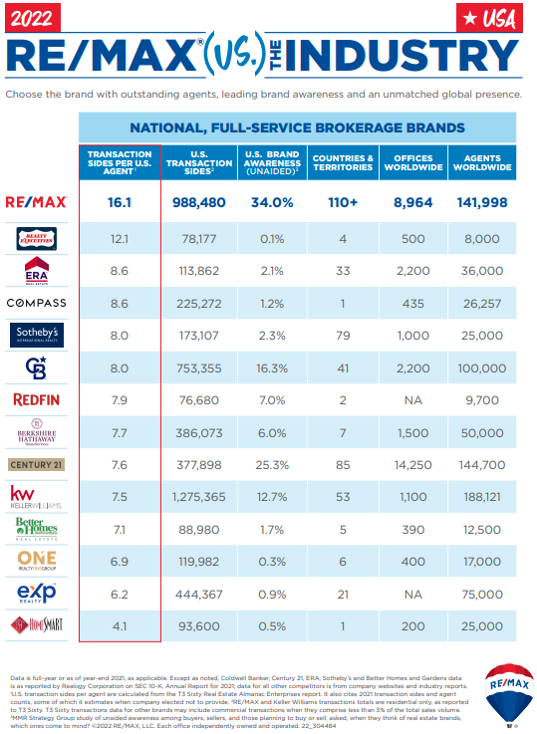
RE/MAX out produces other brands by 2 to 1 in North America and has been #1 in US home sales since 1999.
RE/MAX By The Numbers

Slide 24
Our Results
#1 Firm in Connecticut Transactions Per Agent
 | Total Transactions Per Agent
RE/MAX Right Choice | 17.7
RE/MAX Home Team | 15.7
Executive Real Estate Inc | 13.1
YellowBrick Real Estate LLC | 12.2
Keller Williams Legacy Partners | 12.0
Showcase Realty, Inc | 10.8
Calcagni Real Estate | 9.8
 | Total Transactions Per Agent
Real Living Wareck D’Ostilio | 9.0
William Raveis Real Estate | 8.9
Coldwell Banker Corporate | 8.7
Pearce Real Estate | 8.4
Century 21 All Points Realty | 8.4
Keller Williams Realty - Trumbull | 8.3
William Pitt Sotheby’s Corp | 8.1
Keller Williams Realty | 8.1
**Firms with 40+ agents

Slide 25
Our firm on average outperforms other firms by double or triple
We are celebrating our 35th year in business

Slide 26
Q) 98% SUCCESS selling their property when a seller took my absolute advice
Pricing
Commission
Condition

Slide 27
R) Experience Matters
Mr. and Mrs. Seller –
The one thing you cannot measure in advance, which I think is what ultimately matters the most to your bottom line, is my success in both getting a sale completed and the amount of money my sellers' clients receive from that sale.
Our abilities are all different, but with me, your real estate fee may be higher, but your net proceeds will be higher also.
27

Slide 28
S) 1% Separating Us
Mr. and Mrs. Seller -
Is the one percent separating us on commission the only hurdle we have to signing the listing agreement tonight?
28

Slide 29
If I can prove I can add greater value than the 1%, will you sign a listing/marketing agreement at my usual and fair commission rate?

Slide 30
HANDLING COMMISSION RATE OBJECTIONS

Slide 31
I) “Will you reduce your commission
A) First: Show gratitude
Always thank them for considering your services. They are obviously interested in hiring you, and you appreciate their time in meeting with you.
For example, “Thank you for asking about my commission Mr. Seller. I’m so glad that you value my services and you invited me to discuss listing your house for sale. I would be honored to assist you with it.”

Slide 32
B) Second: Compliment them. Instead of being upset they are asking for a commission discount, point out how their skill is a commonality.
For example, “I can see you are also a great negotiator. We are going to enjoy working together.”

Slide 33
C) Third: Ask for more information to find out what the specific commission objection is. Find out what they want, and most importantly, why. Guide the conversation gently to get to the bottom of their concerns.
For example, “When you say ‘lower commission’, what type of reduction are you asking for?”

Slide 34
D) Fourth: Address their reasoning. If their request is because they think you make money hand-over-fist, be prepared to educate them how you pay the other brokerage, your broker split, Uncle Sam, your marketing expenses, office overhead (including MLS and Realtor® dues), and you get to keep the small slice of pie that’s left to feed your family.

Slide 35
Some people simply are not familiar with how self-employment works, so you can educate them tactfully.
For example: “Before I pay anyone, I have to pay Uncle Sam. If you can make that expense disappear, I’ll work for free.” (We all know we can not avoid paying our IRS taxes)

Slide 36
E) If their commission objection is because they are comparing your service to bargain discount partial-service companies, you’ll have to point out how your services are superior. Review your marketing plan and the many things you will do for them, that other brokerages may not, or you can compare your services to an affluent, upscale department store that they can relate to.
For example, “When you shop at Neiman-Marcus, you can relax because everything is done for you, and first class too, right? They can’t offer all of those wonderful luxurious services for Wal-Mart prices.” (That will infuse a bit of humor too)

Slide 37
F) If they are asking to pay a lower commission because they have very little equity to spare, or are on the verge of a short sale, that may require some creative solutions. Address their concerns with authentic, sincere resolutions.

Slide 38
G) Then again, next time they ask that dreaded commission objection, there’s always the simple style approach revered by seasoned agents: “No. Any other questions?

Slide 39
II) “Will you cut your commissions, other agents will?”
A) “You know, you’re right, there are some agents out there that will and I’m a little concerned...can I tell you why?” (Yes)
Because for most of my clients this is either their most valuable possession or one of their most valuable possessions and
“If an agent is willing to discount their fee when negotiating with you what are they going to do at the negotiating table when a lot more than 1% could be at stake?

Slide 40
Or
“If the other agent can’t defend the money he/she gets paid to earn a living, how do you think he/she will protect your money when they are negotiating on your behalf?”
(The more conviction you have the less you will get objections like this - If you sound hesitant; your prospect will begin looking for ways to debate your commission)

Slide 41
B) “If they will reduce their price at the listing table, what will they do at the negotiating table? It will be tough and professional on both my fee and your price, particularly at the negotiating table.”

Slide 42
C) “Commissions aren’t as negotiable with agents that sell homes daily. They are only negotiable with realtors who don’t believe in the services that they offer.”

Slide 43
D) “No.” (then stay quiet and let silence do the heavy lifting)

Slide 44
F) “I’m sorry I’m not permitted to reduce that amount.”
G) “My commission is not negotiable.”

Slide 45
H) “No, You see I don’t know how to discount what I do or the services I provide. What would you like me to eliminate?
I) “Let me ask you, have you ever purchased an item in the past based primarily on price and later found out the value and quality was not nearly as good as you thought?” (wait for response)

Slide 46
K) “I work unlimited hours, sometimes 12-16 hours a day for my clients to find the right buyers and negotiate the best deal for my clients. I don't compromise on my service, and I don't sell your house short.
That's the kind of agent you want representing you, isn't it?”

Slide 47
(If No): "OK, I will respect your decision on that. If your house doesn't sell, or if you're not happy with the results, can I be the first agent you call?
Great, then grab a pen and write my number down where you'll have it handy.” (Try for control here to see if they are real - then give them your information).

Slide 48
III) When negotiating offers, repairs or at closing the seller may say “I need more money from the sale, can you help by cutting your commission?”
A) “Unfortunately, my commission is not a part of this negotiation. But if you want to push back, let’s push back against the buyers in a counter offer.”
Or
B) “Let’s take it back to the buyers to see what they say.”

Slide 49
C) “So, what you’re saying is that after I’ve done my job in bringing you a ready, willing and able buyer, you’d like me to reduce the amount that I get paid for it.”
D) “Here’s why that is difficult: If you’re boss asked you to do your job and you did it perfectly, but then withheld $2,000 out of your paycheck since the company was having a bad month, how would you feel?”

Slide 50
E) “When we first spoke you told me that you wanted to move because
. . . (Insert motivation here – ie. larger house, closer to family, job, and etc.)
If that is still the case, then you have a decision to make about what is more important to you.
My job is to get your home sold, but you have to make the choices about your personal decisions, and then I follow your direction since I work for you.
So, you need to decide whether this extra money is more important than. . .(repeat motivation – ie. being closer to family)
. . . to you?”

Slide 51
IV) Buyer agent: Would you be willing to reduce the commission you receive
No
The good news is that you don’t have to pay me a commission. The agent that represents the seller of the home you ultimately purchase will share a portion of their commission with me for finding a buyer to purchase the home. So you don’t have to pay me a thing!

Slide 52
Concluding Thoughts
You don’t have to be great to start,
but you have to start to be great.
~ Joe Sabah

