Slide 2
Greatness is Within

Slide 3
My Success Formula

Slide 4
Terms You Need to Know

Slide 5
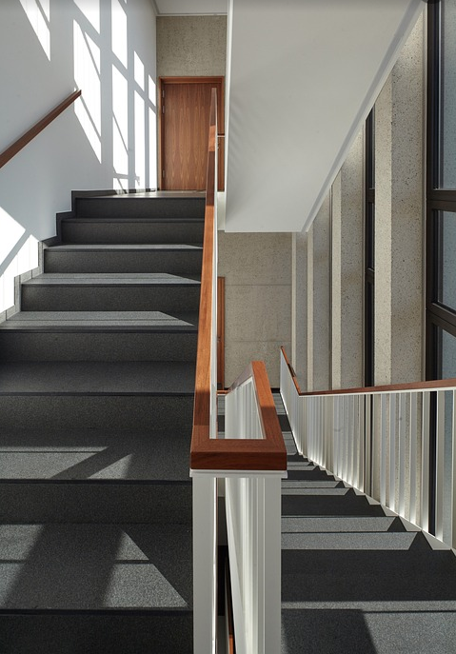
Core Area
The areas that service the building and are not exclusively rented by any individual tenant (common areas) plus vertical penetrations in an office building (e.g., stairways, equipment runs, elevator shafts, etc.). The core area is measured in square feet and is typically expressed as a percentage of net rentable area. The range is 5-20% for typical office buildings and can be computed for an entire building or a single floor.

Slide 6
Load Factor

Slide 7
Load Factor (Cont.)
Example:
If the rentable building area is 2,300 SF and the tenant’s usable area is 2,000 SF, then what is the load factor that a landlord can allocate to the tenant space?
The higher this number is, the more rentable space is lost to common and unusable areas. Tenant benefits from leasing space in a building with a lower Load Factor.

Slide 8
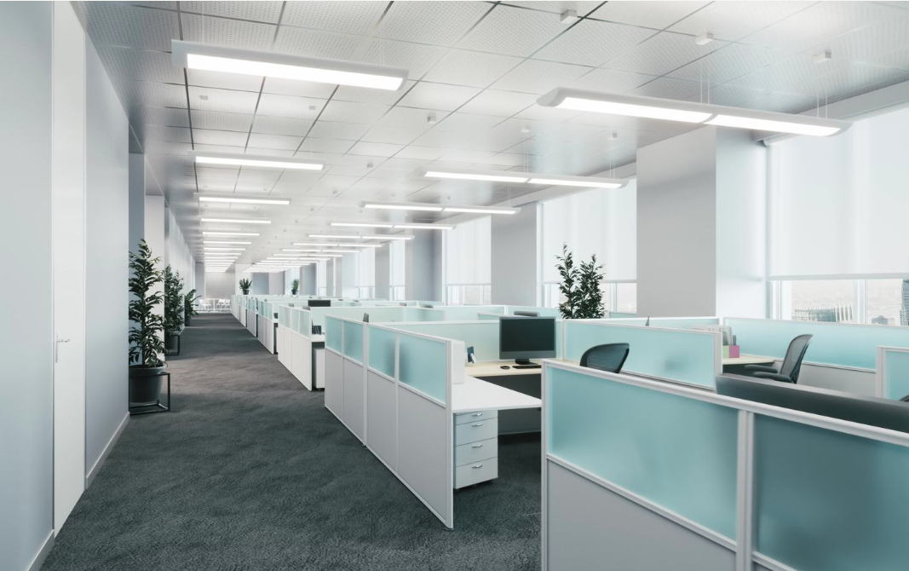
Usable Square Feet
The space that is exclusive to a specific tenant.

Slide 9
Rentable Square Feet
The amount of square footage on which the tenant pays rent.

Slide 10
Operating Expenses
Costs the owner pays to operate and maintain a building. These expenses include property taxes, insurance, utilities, maintenance, repairs, management, legal and accounting services.
It does not include mortgage payments (debt service), cost recovery or capital expenditures.
Operating expenses recur annually.

Slide 11
Common Charges
Otherwise known as building operating costs.
T = Taxes
I = Insurance
M = Maintenance (also known as Common Area Maintenance or CAM)
Common charges generally range from $2.50 –$15.00 per SF, depending on type of building, amount of common area and landlord philosophy.

Slide 12
Pro-Rata Share
The term Pro-Rata Share means in proportion. It is a method of calculating a tenant's share of a building’s expenses and is calculated as a percentage of the tenant’s square footage divided by the total square footage of the office building or retail center.

Slide 13
Base Rent
The base rent is the starting point for all rents paid for the property, the minimum amount due the landlord.
The type of lease ultimately determines what is paid.
Escalations are based off of the annual base rent and are only one component of the overall cost of leasing a space.

Slide 14
Net Lease
A single net lease is a rental agreement in which the tenant agrees to cover the cost of one of the three primary property expenses: taxes, insurance, or CAM (common area maintenance) costs.

Slide 15
Double Net (NN) Lease
A double net lease is a rental agreement in which the tenant agrees to cover the costs of two of the three primary property expenses: taxes, insurance or CAM (Common Area Maintenance) costs.

Slide 16
Triple Net (NNN) Lease
A lease in which the tenant pays base rent plus their proportionate share of the property tax, insurance and maintenance costs for the property. In a triple net (NNN) lease, you need to clarify who is responsible for roof, structure and parking lot repairs.

Slide 17
Gross Lease
There are two common gross lease types: full service and modified. In a gross lease, most or all of the expenses associated with the property are included in the rent. In some states, the landlord is required to disclose the specific costs associated with the property.

Slide 18
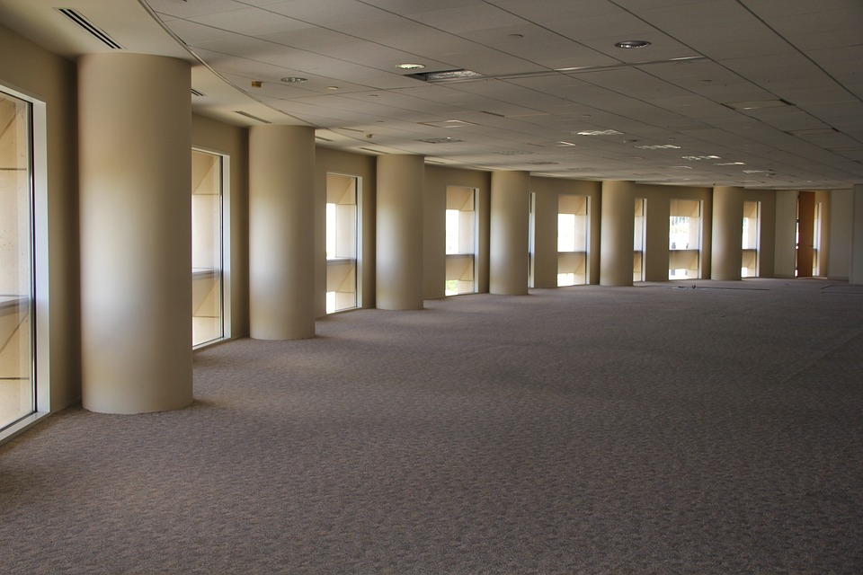
Shell Space
Denotes what the landlord will provide to the tenant. Typically, it includes a floor, exterior walls of the space, windows and a roof but no interior improvements. It may also have some basic HVAC, plumbing and electrical along with an ADA-compliant bathroom.

Slide 19
Tenant Improvement (TI) Allowance/Tenant Improvement (TI) Credit
The dollar amount or work the landlord has agreed to contribute to the tenant’s renovations, upgrades or buildout as an incentive to get the tenant to lease the space.
Examples of tenant improvement allowance packages are:
$20/SF (TI) for 5-year lease
4,000 SF × $20/SF (TI) = $80,000 (TI)
$40/SF (TI) for 10-year lease
4,000 SF × $40/SF (TI) = $160,000 (TI)

Slide 20
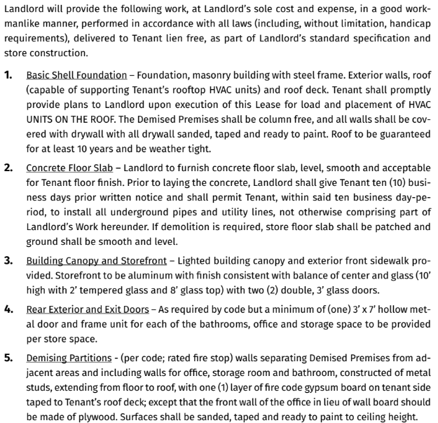
Work Letter
A written document between the landlord and the tenant that specifies what the tenant is receiving in terms of the buildout as part of their lease agreement. The more specific the details of this letter, the better. The work letter should include material specs, allowances, finish specs, time frame, completion date, etc.

Slide 21
Total Rent

Slide 22
Lease Terms
Lease terms vary. Typical terms are 1, 2, 3, 5, 10, 15 or 20 years.

Slide 23
Lease Rate per Square Foot

Slide 24
Working with Tenants –
Questions for a Potential Office Tenant and Sequence

Slide 25
Questions for a Potential Office Tenant
What class of building (A, B, C) do you want to be in?
Where do you want to be located – downtown, Main Street, office park, etc.?
Do you need to be close to a highway, train station or airport?
Do you need to be a certain distance from the decision maker’s home?
Do you need to be a certain distance from the homes of the workforce?
Do you prefer to be in a high-rise, mid-rise or low-rise building?
What, if any, amenities, service and retailers would you like to be close to?

Slide 26
Questions for a Potential Office Tenant (Cont.)
What are your demographic requirements?
Does your budget include CAM charges?
Do you require exclusivity?
Are there any competitors you are trying to avoid?
Do you have any specific requirements for utilities, water or sewer?
How many parking spaces do you require?

Slide 27
Questions for a Potential Office Tenant (Cont.)
Do you require any special ceiling heights? If so, what are the minimum requirements?
Do you have any specific electric requirements?
Do you have any specific plumbing requirements?
Do you have any specific HVAC requirements?
Do you have any specific elevator requirements?
Do you have any building amenity requirements, e.g., gym, cafeteria, etc.?

Slide 28
Questions for a Potential Office Tenant (Cont.)
Do you have any special load factor requirements for any of your equipment? If so, what are the minimum requirements?
What are your hours of operation?
How many private offices do you require?
How many conference rooms do you require?
Do you require parking lot and/or building security?

Slide 29
Representing a Tenant
1. Client identifies an interest in leasing commercial property.
Criteria:
Retail lease of 3,500-5,000 usable sf
Located in Hometown, USA
Lease rate of $15-$20, with all expenses included (gross) plus utilities.

Slide 30
2. Sign an Exclusive Tenant Representation Agreement. If a commission is not being offered by the leasing agent, or the property is not currently on the market, determine if the tenant is willing to pay your fee if you locate something that fits their needs.

Slide 31
3. Search CoStar, LoopNet, CREXI, MLS, etc.

Slide 32
4. Send an email to commercial practitioners expressing your client’s needs to see if they have any properties on or off the market that may fit the criteria.

Slide 33
5. If there is an area in a given town that is of specific interest to your client, drive the area to look for “For Lease” signs by REALTORS® or by owners to identify properties that may fit the criteria.

Slide 34
6. Assemble, review and tour properties to see if they fit the criteria or if there is something else that may be of interest.

Slide 35
7. If there is a property of interest, request detailed information on it for your client. If it is not offered through the MLS, ask for written confirmation of the commission being offered and when it will be paid (e.g., lease execution, occupancy, etc.). Additionally, confirm if a commission will be paid on renewals or options and when those commissions will be paid.

Slide 36
8. Sign non-disclosure or confidentiality agreements, if required.

Slide 37
9. Pull the municipal building field/tax card to see what can be learned about the property.

Slide 38
10. Lease comps can be difficult to access unless you have an active MLS with a detailed commercial section, are a member of CoStar or are friends with some commercial appraisers.

Slide 39
11. Prepare a Letter of Intent (LOI) and submit it to the listing broker or owner. Occasionally, you can ask the listing agent to submit a proposal based on the tenant’s requirements. If both parties choose to engage, the terms of the Letter of Intent will be negotiated at this point.

Slide 40
12. Execute a lease. The execution stage will include additional negotiation. The major difference in this stage of negotiations is that attorneys are usually involved at this point.

Slide 41
13. Financing process starts, if required.

Slide 42
14. Fit out begins, if required.

Slide 43
15. CO issued, if required.

Slide 44
16. You get paid.

Slide 45
Next Session: July 19th
12:00-12:15pm – CJW: Commercial Transactional Questions
12:15-1:00pm – Ed Schultek - Mindset Training: Being a Trusted Advisor (Part1)
Greatness is Within
Peak.Sander.com

