Slide 1
Purchasing Your Home - A Buyer’s Guide to Understanding the Whole Process

Slide 2
The Professional Standard
RE/MAX is the standard by which all real estate brands are measured, and since 1987, our firm has set the standard in Connecticut real estate sales excellence.
We pride ourselves on creating the most professional, highly trained, full-time real estate sales force in the industry. Through our real estate education, transactional coaching and mentoring, and mindset training, we empower our agents to serve their clients and communities as real estate market experts.
As Connecticut’s leader in transactions per agent for 11 consecutive years*, our agents know how to help you navigate the process of purchasing your home in any market.
*Per SmartMLS.

Slide 3
Agent Bio
Insert bio here.

Slide 4
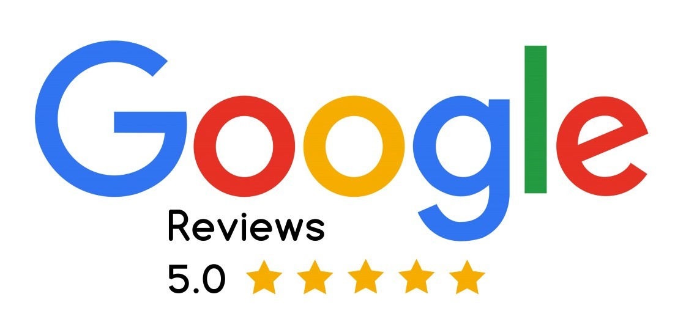
Client Feedback
Include testimonials from clients who have worked with you in the past.

Slide 5
You’ve Decided to Buy a Home
Do I need a Buyer Agent?
Determine a comfortable price range
Shop For and Select a Home
Property Due Diligence
Pricing Offer and Strategy
Write an Offer
Inspections
Appraisal and Mortgage Conditions
Closing

Slide 6
You’ve Decided to Buy a Home
Step
1
Congratulations! This is one of the most important decisions you will make in your lifetime. Not only is it a significant financial investment, the city, the state, the community, and the home one chooses are the fabric upon which lives are built. It is where friends and families are nurtured. It is where love and loss are held dear. It’s where careers are made, roots are planted, and memories are captured.

Slide 7
Do I Need a Buyer Agent
Step
2
Typically, real estate transactions involve two different agents: one who represents the seller and one who represents the buyer. The role of a buyer’s agent is to act as the homebuyer’s trusted advisor and advocate on their real estate journey. Their primary responsibility is to help the buyer find the home that best suits their needs and budget, ticking as many boxes as possible on their wish list.
A buyer’s agent performs several other duties as well, including explaining necessary paperwork, assessing asking prices, drafting and submitting offers on the buyer’s behalf, assisting with negotiations, and coordinating the inspection and closing process. If there are any hiccups along the way, the agent can also play an instrumental role in preventing the transaction from falling apart.

Slide 8
How Are Agents Paid
It depends.
The majority of the time, listing brokerages offer buyer brokerage compensation up front.
If a listing brokerage is not offering buyer brokerage compensation, then the buyer brokerage is paid by the buyer at a negotiated rate.
What happens if does not have the funds to pay for buyer representation?
Two possible options:
The buyer can instruct their agent to only show them homes where buyer broker compensation is being offered by the listing brokerage.
The buyer can request a seller concession to pay for this on behalf of the buyer.

Slide 9
Buyer Representation Contract
What Your REALTOR® Agrees To:
To guide you through the process from start to finish.
Listen to you and find answers to your concerns.
To be an impartial advisor and to assist you in avoiding emotion-based decisions.
Help you locate properties for sale that fit your needs.
Visit each property you are considering to help determine suitability.
Strategize with you and negotiate on your behalf for the best terms.
Refer you to reliable professionals throughout the transaction.
Prepare and explain contracts and forms.
Keep the transaction on schedule according to the agreed timeline to the extent possible.

Slide 10
Buyer Representation Contract
What You Agree To:
Loyalty in working only with your buyer agent throughout the transaction.
Notifying other agents that you are represented.
Being clear and candid in your intentions and communications throughout the process.
Setting up all property viewings through your buyer agent.
Notifying your buyer agent of off-market properties that you may have an interest in.
Relaying concerns and questions to your buyer agent.
Keeping your buyer agent immediately abreast of any issues that may affect financing or closing.

Slide 11
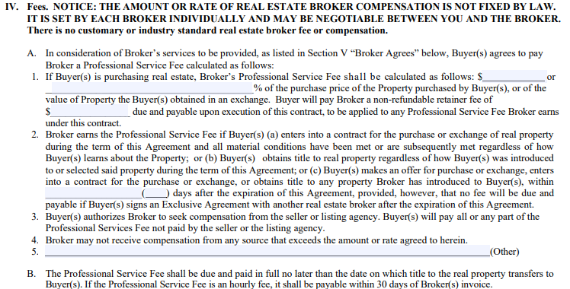

Slide 12
Request for Seller Contribution

Slide 13
Determining a Comfortable Price Range
Step
3
Most home buyers require a mortgage to buy a home. That mortgage determines your monthly payment, how much up-front money you will need to buy a home, and the price range of a home you qualify for.

Slide 14
Evaluating Mortgage Options
Vetting the mortgage company you will be working with is a must. Start by calling on mortgage originators who come recommended by someone who has used them before. If you need a recommendation, I am happy to offer one.
A great mortgage originator will cover the following:
Current rates and what your payment will look like at different home price levels.
How much the mortgage payment will fluctuate if rates rise before closing.
How much you qualify for based on your income, expenses, and credit score.
Different mortgage programs you may qualify for.
Any restrictions there may be in your qualifications.
What the mortgage payment will look like with taxes and insurance included.
Whether you will need to pay for mortgage insurance and how much that will be.
How much money you will need out of pocket to buy a home, including down payment and closing costs, and how much must be sourced/saved money versus gift funds.
Whether a home sale contingency is necessary in your offer.
It is important to keep in in mind that taxes, insurance, mortgage insurance, and condo fees can dramatically affect your monthly payment.

Slide 15
Shop for More Than a Rate
Closing costs, mandatory mortgage insurance, and down payment requirements are all just as important as the interest rate. Therefore, do not just call banks asking about their interest rates without asking about everything else. Not only do rates vary by program and down payment, they are also a byproduct of your credit score and debt-to-income ratios (your ability to repay the mortgage).
Different banks offer different mortgage programs. Therefore, it’s never a bad idea to speak with more than one company to determine the best options.

Slide 16
Pre-Approved or Pre-Qualified
Pre-qualifications and pre-approvals are how mortgage lenders determine whether your mortgage will get approved and how much mortgage you can give.
The terms pre-qualification and pre-approval are NOT interchangeable.
A pre-qualification is a mortgage approval based on self-reported information. It doesn’t verify a buyer’s credit score, income, or money in the bank. It’s an estimate only.
A pre-approval is mortgage approval based on verified data. It uses credit reports, job data, and bank information to confirm how to approve your loan and for how much money.
A pre-approval, as opposed to a pre-qualification, makes your offer strong. It indicates that you are serious about finding and buying a home soon.

Slide 17
Mortgage Insurance
If you are putting less than 20% down when buying the home, you will likely be required to obtain mortgage insurance. Mortgage insurance may be charged up front, monthly, or rolled into your mortgage balance.
Mortgage insurance is different than homeowners insurance in that mortgage insurance protects the lender in the event of your default.
While mortgage insurance is expensive, it does give millions of home buyers the opportunity to buy real estate without the necessity of a 20% down payment.

Slide 18
Shop for a Home
Step
4
Determine Where You Want to Live by Considering the Following:
Qualified Price Range
Property Taxes
School Reports
Crime
Community Services
Commute Times and Access to Transit
Sensory Considerations (Airports, Trains, Farms)

Slide 19
Buyer Representation Search Setup (Agent Specific)
kvCore Marketing and Searches

Slide 20
Zillow – Let’s Get Real
Many home buyers believe that online sites like Zillow offer the best real estate search capabilities, and that is simply not true. Here is what you need to know about Zillow:
Search does not update real-time. You could fall in love with a home on Zillow only to find out that it went Under Agreement last week.
You can’t narrow your search down like you can with other tools. Zillow isn’t in the business of helping you find a home. They are in the business of selling your name to real estate agents.
You are not contacting the listing agent. Many buyers call the agent who is listed on Zillow thinking they are calling the listing agent. The agent Zillow advertises on the listing is the agent who is paying to advertise.
*Zestimates are highly inaccurate. Never write an offer on a home based on Zillow’s opinion of value.
You will be inundated by sales calls. Zillow is in the information sharing business. Therefore, when you shop on Zillow you will be called by many real estate agents and loan officers who pay Zillow for the lead.
*Nationally, the Zestimate has a median error rate of 7.9 percent according to their website. On a $500,000 house, that amounts to a $39,500 variation in value. In some neighborhoods, the Zestimate can be even further off.

Slide 21
Visiting Open Houses
Clarity is Kindness. It is very important to disclose to other real estate agents if you have signed a contract with a buyer agent who will be representing you. Most often, the agent hosting the open house represents the seller. In other words, their fiduciary responsibility is to the seller of the home, and nobody else. Sometimes, however, the agent is hosting the open house with the expectation of finding new buyers that they can represent. By disclosing to the host of the open house that you are represented by a buyer agent, that host will no longer try to sell you their services, and you will be given the opportunity to tour the home.
Helpful hints:
If you know in advance that you will be visiting the open house, please call or text me, and I can call ahead to let the agent know you are represented.
If you like the home and are interested in making an offer, call and text me right away so that there is time to complete due diligence on the property prior to the offer process.
I can send you a list of upcoming open houses prior to each weekend. It is my pleasure to notify the agent hosting the open house to let them know that you will be attending and that you are represented.

Slide 22
Off-Market Properties
Occasionally, buyers find homes that are not listed in the Multiple Listing Service. These are homes that are For Sale but are not marketed on traditional real estate search portals. Here are some potential off-market home opportunities:
Properties that are For Sale By Owner
Family members who are selling
Estate sale
A Co-worker selling a home
Call me if you are interested in seeing or placing an offer on an off-market property.
Gather as much information on the owner as possible, including their name and phone number, and I will reach out to arrange a showing.
Buyer Beware. Sometimes off-market homes are not listed by a real estate agent because the home is priced above market value. That is why it’s so important to work with your buyer agent.

Slide 23
Property Due Diligence
Step
5
Before writing an offer it’s important to research the home thoroughly.
Tax Records
Disclosures
Lead paint records
Condominium Documents
Age, pet, parking restrictions

Slide 24
Pricing & Offer Strategy
Step
6
Prior to writing an offer we will evaluate the pricing of the property, and I will talk to the listing agent to find out what offer terms might help get your offer accepted.
Review comparable properties
Determine if there are competing offers

Slide 25
Bidding Wars
If you are obtaining a mortgage, it’s important to understand that the amount the bank will finance is based on the LOWER of the price or the appraised value.
If maximum financing is necessary, one must be careful not to make an offer above the likely appraisal value for the home.
Sometimes the best deals are the houses that have been sitting on the market for a little bit of time. Often, these sellers are more negotiable in their terms.

Slide 26
Writing the Offer
Step
7
Earnest Money Deposits
Initial deposit (binder)
Down payment
How fast can the lender close?
Inclusions and exclusions
Is a home sale contingency necessary?
Home inspection and/or other inspections
Are seller-paid costs necessary?
Pre-closing repairs

Slide 27
Rejected Offer
If your offer is rejected, your binder deposit will be returned (or not cashed at all). A rejected offer sometimes means that the seller has accepted another offer and sometimes means that they simply are not interested in the terms of your offer.
There are several options we may be able to consider if our offer is rejected:
Re-submitting an offer with different terms
A Back-up offer
Resuming the home search
As your agent, I will converse with the listing agent to find out what the options are if your offer is rejected. I will also ask for verification that the offer was presented to the owner.

Slide 28
Accepted Offer
Once the offer is accepted, we will review all the contingency dates. These are the dates by which we must notify the seller of the property if we are not moving forward on the home. The typical contingency dates include:
Home Inspection
Mortgage
Home Sale
Sometimes the seller has contingency dates too. For example, the seller may have a suitable housing contingency where they must find another home by a certain date or forfeit your offer.

Slide 29
Inspections
Step
8
The home inspection is a great opportunity to get to know the mechanicals of a home. Every home will require maintenance and repairs and the inspection will help you estimate the inevitability of replacing important systems.

Slide 30
Beyond the Home Inspection
There are many potential inspections buyers may consider when purchasing a home. The type of inspections one selects will depend on the property but also on who is buying it.
Lead Paint
Mold
Radon
Well / Water
Septic System
Electrical
Foundation / Structural
Termite
Roof
Pool
The home inspection contingency gives you the opportunity to get to know the property beyond its aesthetics.

Slide 31
Too Many Repairs
Every single home will need some amount of work eventually. However, if a home inspection has you worried about the amount of repairs (or the cost associated with the repairs) that will be needed, there are several options you can take assuming you have negotiated for a home inspection contingency. Here are some of the options:
Accept the property as is.
Ask the seller to make the repairs prior to closing.
Ask the seller to lower the price.
Ask for an extension on the inspection contingency to get a second opinion.
Sometimes there is no choice but to have a repair made prior to closing as some mortgage programs won’t allow the sale if there’s peeling paint, missing handrails, or broken windows.

Slide 32
Home Warranty
A home warranty is a policy that can be purchased which covers the service, repair, or replacement of your major home systems and appliances. It provides a financial buffer in case a big-ticket item malfunctions, and it can extend the protection of manufacturers' warranties after they expire.
The average cost for a home warranty basic coverage varies depending on what the products are and which are added to the policy. In addition to the annual premium, homeowners will usually pay the servicing contractor a fee, much like an insurance deductible.
A Home Warranty is a great option for buyers worried about large system repairs after closing.

Slide 33
Appraisal & Mortgage Conditions
Step
9
Once you are satisfied with the inspection, we will move forward with finalizing the purchase agreement which will be submitted to the mortgage company. The mortgage company will order an appraisal on the home and may ask you for updated mortgage paperwork such as more recent paystubs or bank statements.

Slide 34
The Appraisal
The appraisal is conducted by an independent, third-party appraiser who is evaluating the value of the property on behalf of the bank. Usually, the bank has a great interest in your home as an asset because it’s the collateral for the loan they are granting you. On occasion, homes appraise for less than what a buyer is willing to pay. There are several alternatives a buyer can take when a home does not appraise:
You can put more money down.
Ask the seller to agree to a lower price.
Meet in-between where seller lowers price and buyer puts more down.
Back out of the sale and start the home buying process over.
The appraisal is extremely important if you are financing the purchase of the home. This is why we evaluate the pricing prior to writing an offer.

Slide 35
Preventing Mortgage Declines
There are many ways in which a buyer can unexpectedly be declined for a mortgage because of decisions made during the home buying process. Here are some decisions that should not be made without talking to me and/or your mortgage team first:
Buying a car
Financing furniture (even if it’s free for several years)
Co-signing a debt for a friend or family member
Moving money between accounts
Depositing large sums of money
Changing jobs
Quitting a job
Not paying a bill
The mortgage company will re-evaluate your ability to pay the mortgage multiple times up until closing. Any little change in credit, income, employment, or assets can put you at risk.

Slide 36
Homeowners Insurance
Many buyers wait until the week prior to closing to shop for insurance. The home purchase is too big of an investment to leave the insurance to happenstance. Shop with multiple vendors and shop early in the transaction. Here are some of the factors that will go into determining insurability and the price of insurance:
Age of roof
Age of home
Climate considerations
Proximity to ocean
Flood zones
System mechanicals
Owner’s pets
Owner’s credit worthiness
It is extremely disappointing to get all the way to closing day only to find out that there are no insurance options for the home. Although this is rare, it has happened. Begin your due diligence early.

Slide 37
Closing
Step
10
Of course, this is the best part of the entire transaction. It is the day that the home becomes yours. There are many things that must be done leading up to the closing table.

Slide 38
Final Walk Through
Test all lights
Check garage doors
Turn Heat/AC on and off
Check hot water
Garbage disposal/fans
Check appliances
Look at the windows
Ensure rooms are empty
Make sure shed/garage are empty
Inspect yard and landscaping
Visually look at roof
Test outlets
Turn sinks on and flush toilets
Inspect ceilings, walls, floors
The intent of the walk through is to ensure the home is being delivered as per the agreement.

Slide 39
Closing Documents
Closing Disclosure: Also known as a CD, the Closing Disclosure outlines all the terms of your loan, so you know exactly what you’re getting when you sign your mortgage. By law, home buyers must receive a copy of the Closing Disclosure at least 3 business days before closing.
Loan Application: When you first applied for a loan, you completed an application. Before you close, you’ll receive a new copy of that initial loan application you filled out. You’ll review and sign your original application. Please make sure you also review all the application information to ensure it’s still correct.
The Note: A mortgage note legally binds you to repay the mortgage. The mortgage note includes the amount, interest, payment dates, terms, and information on what will happen if you fail to make payments. The mortgage note is secured with the mortgage, which means that if you default, your house will be sold to repay the debt.
There are several additional documents that will need to be signed at closing as well. This is a partial list of important documents you will become acquainted with.

Slide 40
Closing Documents
Mortgage or Deed of Trust: A mortgage or a deed of trust is a type of security instrument, and which one you’ll encounter depends entirely on the state where you live. The difference becomes important if there’s a mortgage default. If you default on a mortgage, foreclosure usually requires a court order. A deed of trust doesn’t.
The mortgage or deed of trust legally secures your property as collateral for the mortgage. In other words, signing the document means you’re agreeing to use your house as collateral.
This document is recorded along with the deed in the county recorder’s office, which shows the lender owns an interest in the property up to the loan’s outstanding balance. Essentially, it gives the lender the right to foreclose or sell the home at any time if you don’t make your payments.

Slide 41
Closing Documents
Initial Escrow Statement: An initial escrow statement outlines the payments on taxes and insurance that will come from your escrow account during the first year of your mortgage. Your escrow account is used to make payments on your behalf. An escrow account may or may not be required.
Title Commitment: This document shows who owns the home and any liens or other clouds on the title.
Deed: A deed details everything about the property. It transfers the title from the seller to the buyer and is signed by the seller. The deed will be recorded and made public upon closing. Therefore, if anyone were to look up the deed on your home, they would find that you took the title from the previous owner, and now you own the property.

Slide 42
Closing Documents
Initial Escrow Statement: An initial escrow statement outlines the payments on taxes and insurance that will come from your escrow account during the first year of your mortgage. Your escrow account is used to make payments on your behalf. An escrow account may or may not be required.
Title Commitment: This document shows who owns the home and any liens or other clouds on the title.
Deed: A deed details everything about the property. It transfers the title from the seller to the buyer and is signed by the seller. The deed will be recorded and made public upon closing. Therefore, if anyone were to look up the deed on your home, they would find that you took the title from the previous owner, and now you own the property.

Slide 43
Every Closing is a New Chapter

Slide 44
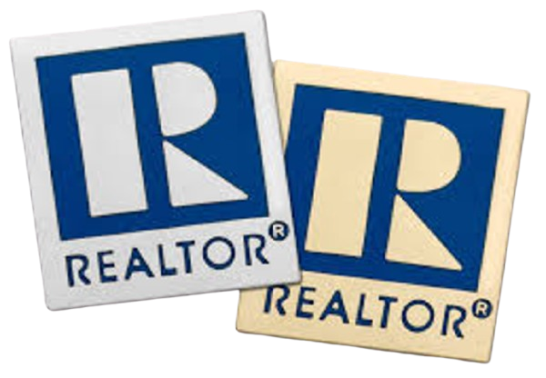
Working with a REALTOR® gives buyers, sellers, and investors many advantages they need to succeed in today’s real estate market. One of those advantages is the assurance that REALTORS® subscribe to a strict Code of Ethics which provides clients with the highest degree of professionalism, ethics, and service. Adopted by the National Association of REALTORS® (NAR) in 1913, NAR was only the second trade or business group in the U.S. to adopt mandatory ethical standards for its members.
Not all real estate licensees are REALTORS®. Only those who are a member of NAR can use the term REALTOR® and subscribe to the Code of Ethics as a condition of NAR membership. REALTORS® are the most trusted resource for real estate information and have access to advanced educational opportunities and training in real estate specialties, bringing value to buyers, sellers, and investors.

Slide 45
Thank You
I appreciate that you have entrusted me with this important life decision. I will work diligently to ensure that you understand the process fully, and I’ll guide you through each of the important steps along the way.
Your dream home is awaiting you. Let’s go find it.

Slide 46
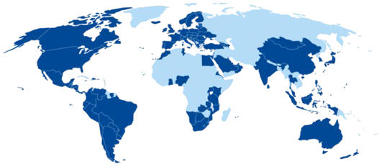
WE MAY BE LOCATED IN CONNECTICUT BUT RE/MAX IS WORLDWIDE!
110+
COUNTRIES
&
TERRITORIES
9,000+
OFFICES
140,000+
AGENTS
650,000+
LISITNGS

