Slide 2
Valuation
There are three (3) primary ways appraisers value commercial real estate:
Sales comparison method: similar to what happens in residential real estate, comparing recent sales of comparable properties.
Cost method: based on the building cost plus the value of the land.
Income method: there are two (2) primary methods, direct capitalization and discounted cash flow. The course focuses on the direct capitalization method.

Slide 3
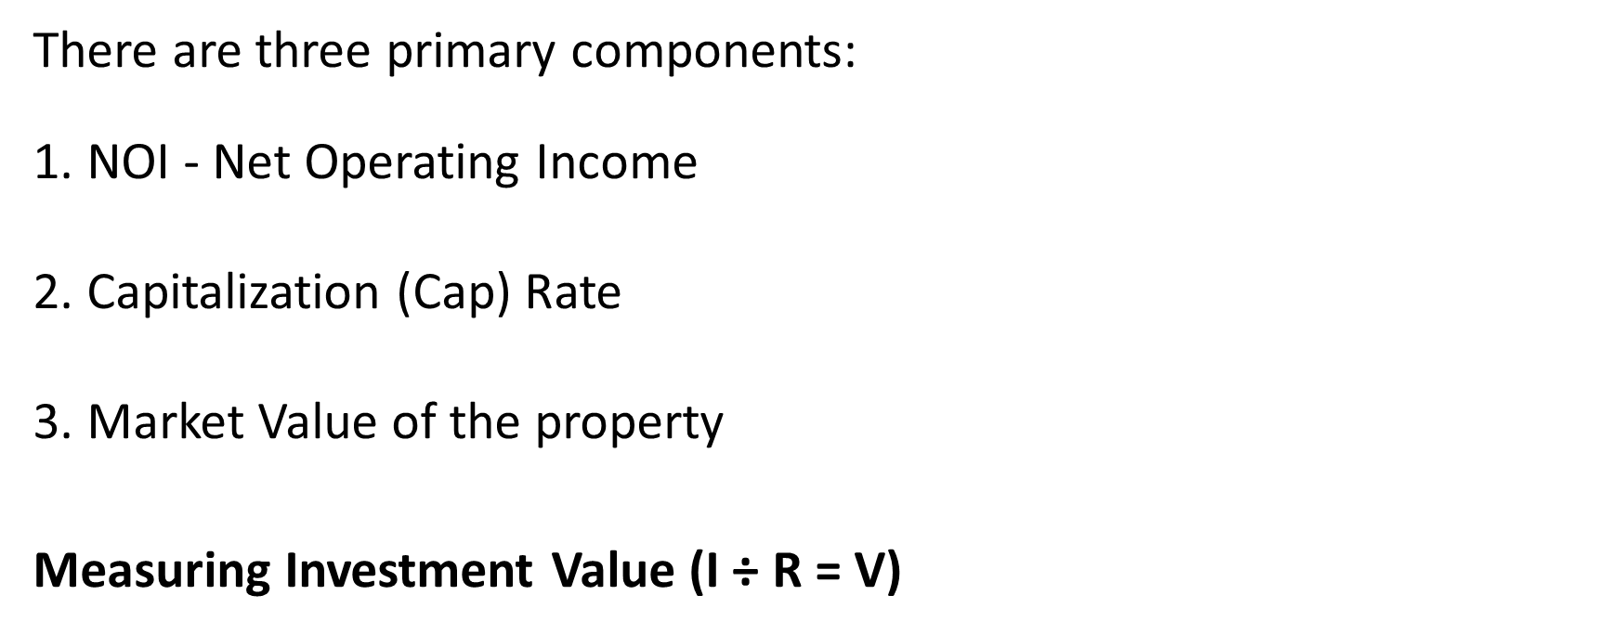

Slide 4
Things to Understand About Net Operating Income (NOI):
Based on historical data for existing buildings. Standard analysis includes two years of data.
Based on future projections for new buildings.
Includes the following expenses:
Utilities
Landscaping and snow removal
Property management
Repairs and maintenance
Refuse / Trash
Property taxes

Slide 5
Insurance
HVAC property supplies
Reserves for short-term capital expenditures maintenance
Advertising
d. Excludes the following expenses:
Loan origination fees
Mortgage payments
Income and capital gains taxes
Depreciation
Tenant improvements
Leasing commission

Slide 6
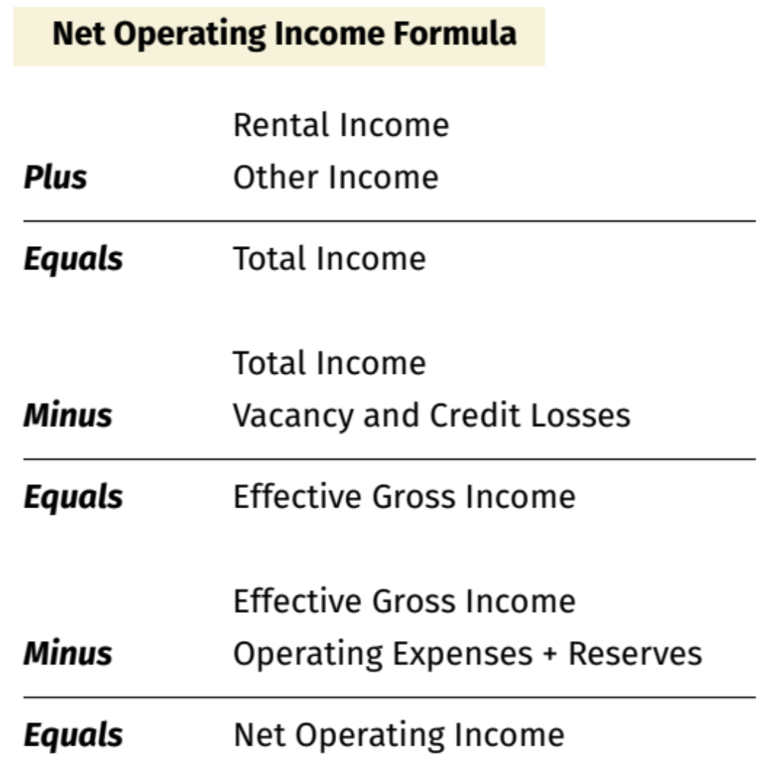

Slide 7
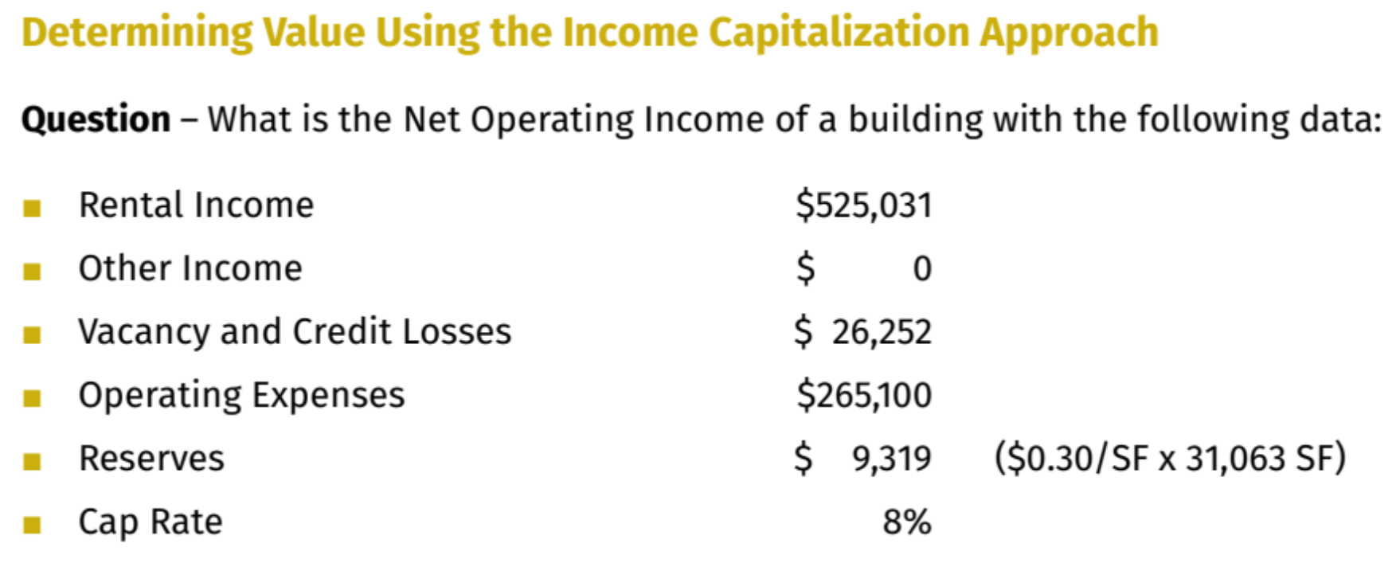

Slide 8
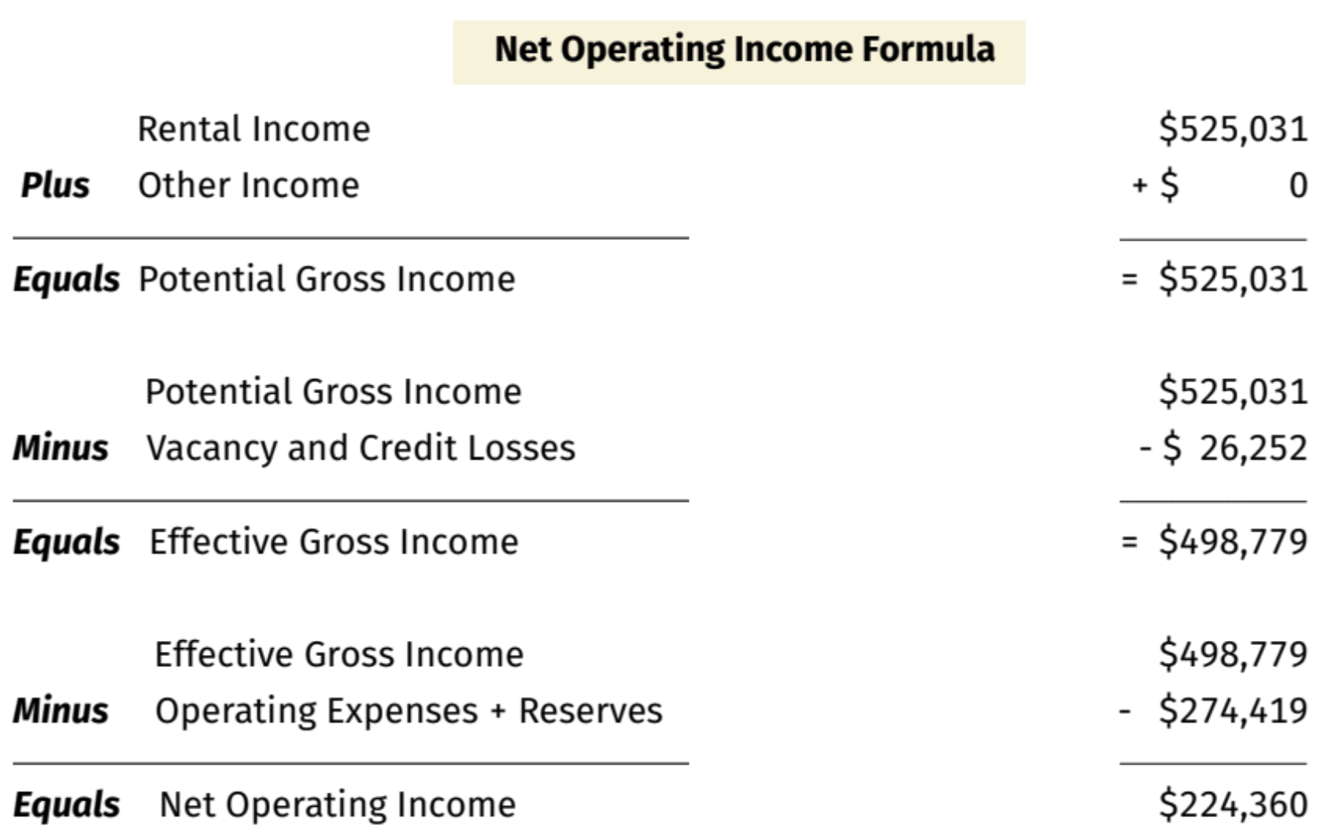

Slide 10
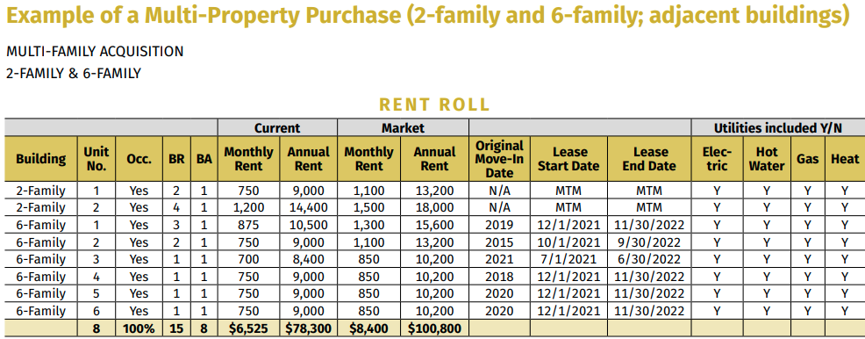

Slide 11
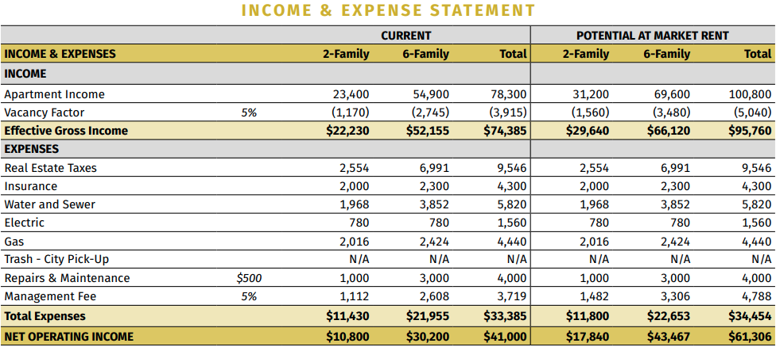

Slide 14
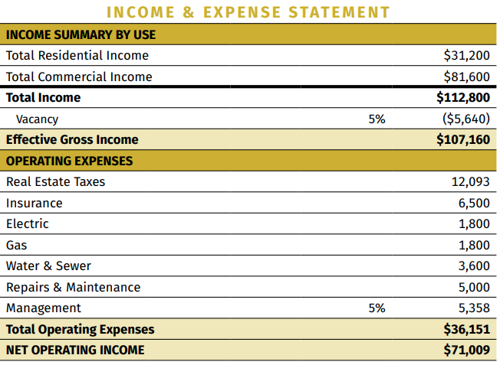

Slide 16
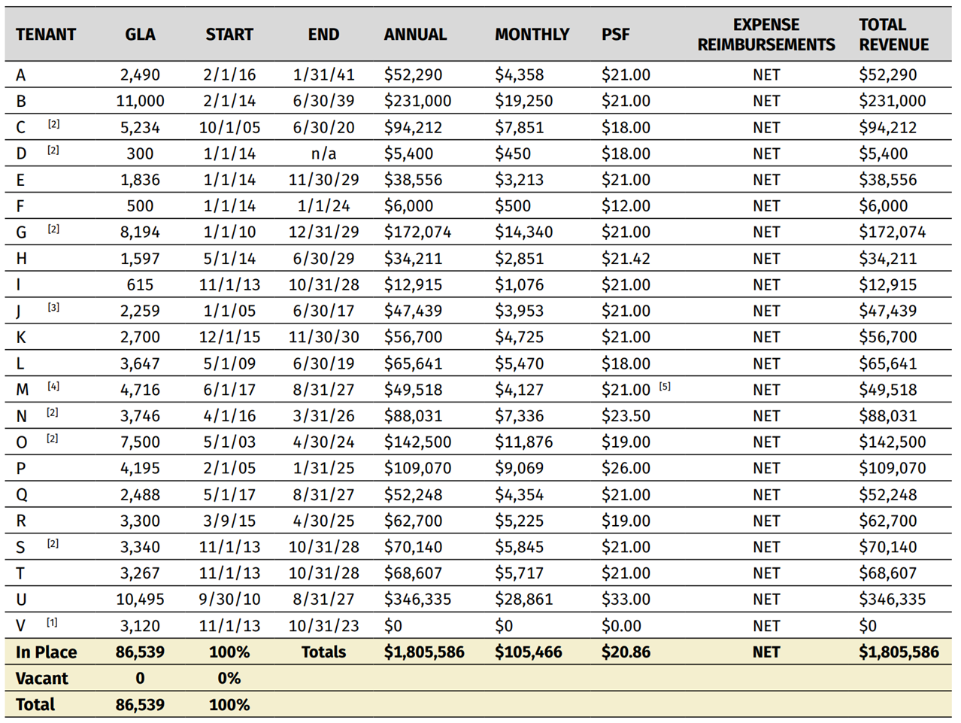

Slide 17
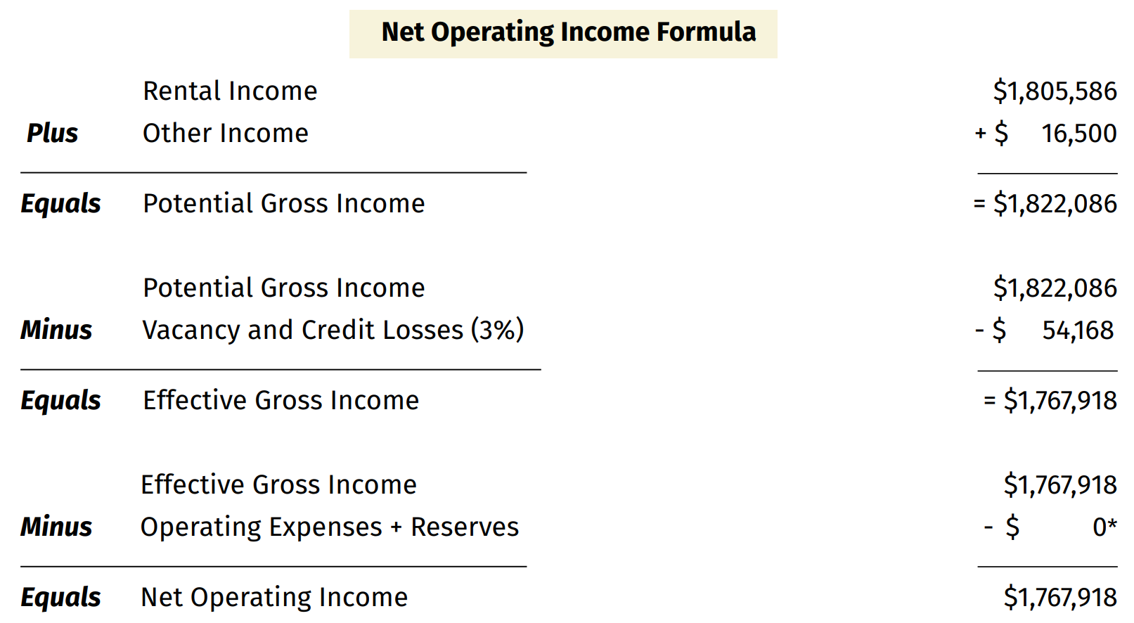

Slide 18
Greatness is Within

