Slide 2
The Math You Need to Know, Simplified

Slide 3
Market Value
This method is based on the IRV formula: converting a one-year stabilized net operating income (NOI) into the market value of the property. If the property is not yet built or fully occupied (has not reached its full potential NOI), the appraiser will put together a value they feel reflects the true marketplace.
Example: Given the follow scenario, what is the market value of the property?
I = One-year stabilized NOI = $54,630
R = Capitalization Rate (Cap Rate) = 12.14%
V= Market value = ?

Slide 4
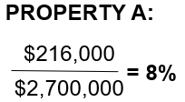
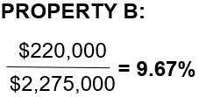
Cap Rate (Capitalization Rate)
The capitalization rate is the rate of return on a real estate investment property based on the income that the property is expected to generate. Cap rate is determined by the following formula:
Example: Property A has a net operating income (NOI) of $216,000 and a sales price of $2,700,000. Property B has an NOI of $220,000 and a sales price of $2,275,000. What are the indicated cap rates and how do they compare?

Slide 5
Net Operating Income (NOI)
NOI is the income available to pay the mortgage (debt service) after all operating expenses have been paid.
Example: If the value of the property is $2,700,000 and the capitalization rate is 8%, then what is the NOI of the property?
$2,700,000 × 0.08= $216,000
$2,275,000

Slide 6
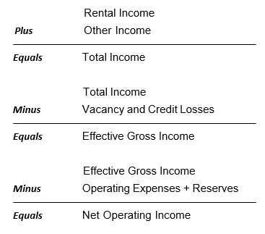
Net Operating Income Formula
$2,275,000

Slide 7
Measuring Investment Value (I ÷ R = V)
Question - What should an investor who is looking for a minimum cap rate of 8% be willing to pay for a building that has an NOI of $228,000?
Answer:
$2,850,000
V = $228,000 ÷ 8%
V = $2,850,000
$2,275,000

Slide 8
Measuring Investment Performance Using Direct Capitalization (I ÷ V = R)
Question – What is the cap rate of a building being offered for sale at $2,850,000 with an NOI of $228,000?
Answer:
8%
R = $228,000 ÷ $2,850,000
R = .08 or 8% cap rate
$2,275,000

Slide 9
Determining Net Operating Income: (R x V = I)
Question – What is the NOI for a building in which the listing notes a price of $2,850,000 and a cap rate of 8%?
Answer:
$228,000
I = 8% x $2,850,000
I = $228,000
$2,275,000

Slide 10
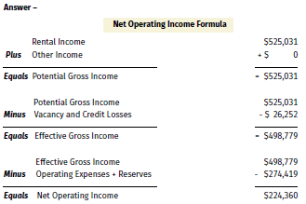
Determining Value Using the Income Capitalization Approach
Question – What is the Net Operating Income of a building with the following data:
What is the market value for this building? Assume a cap rate of 8%.
$224,360 (NOI) ÷ 8% (cap rate) = V
$224,360 ÷ 8% = $2,804,500 Market Value

Slide 11
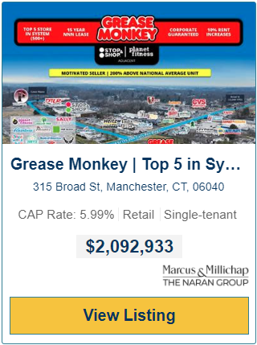
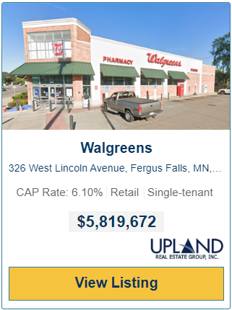
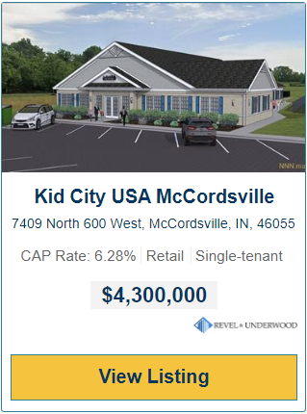
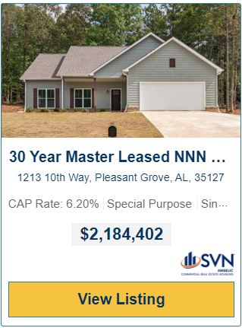
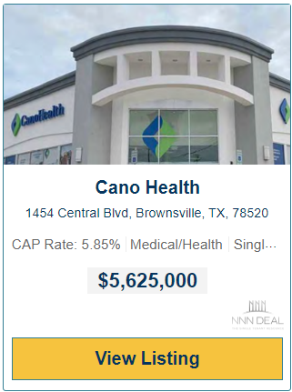
$2,275,000

Slide 12
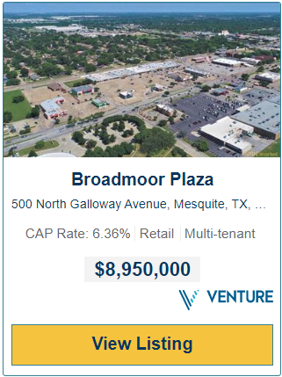
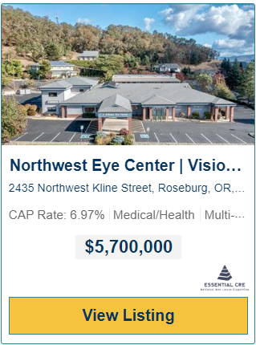
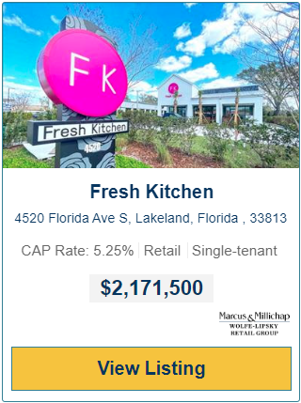
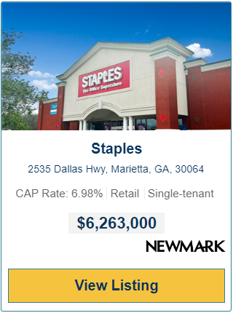
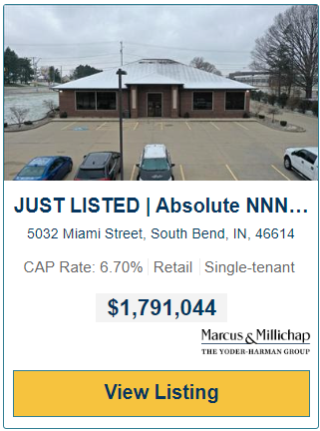
$2,275,000

Slide 13
Loan-to-Value (LTV) Ratio
The loan-to-value (LTV) calculation is used to determine the percentage of the loan borrowed in relation to the purchase price or value of a property. The loan amount is divided by the sale price or appraised value, whichever is less.
Loan Amount
= Loan-to-Value
Sale Price
$2,275,000

Slide 14
Loan-to-Value (LTV) Ratio
The loan-to-value (LTV) calculation is used to determine the percentage of the loan borrowed in relation to the purchase price or value of a property. The loan amount is divided by the sale price or appraised value, whichever is less.
Loan Amount
= Loan-to-Value
Sale Price
$2,275,000

Slide 15
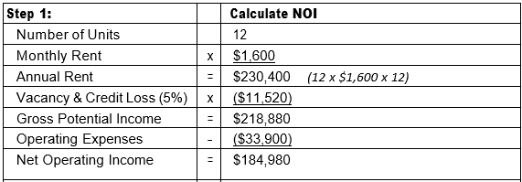
Debt Service Coverage Ratio (DSCR)
DSCR is one of the underwriting standards a commercial lender uses to determine if they will offer a purchaser financing. Different types of real estate have different minimum debt service coverage ratio standards.
Lenders use the DSCR ratio as a metric to determine a borrower’s ability to repay their debt obligation. A DSCR less than 1.0x indicates that the property might experience zero or negative cash flow. Lenders typically use 1.25-1.30x.
$2,275,000

Slide 17
Rentable Square Feet
The amount of square footage on which the tenant pays rent. The rent is based on the usable area plus a portion of the building’s shared space, to include common areas such as lobbies, restrooms and hallways.
Usable Square Footage (USF)
+ Allocated Portion of Common Areas
= Rentable Square Footage
Example: If a property has a usable square footage of 42,000 square feet and has 6,000 square feet of common area. If a tenant occupies 20,000 square feet of the usable square footage, what is the rentable square footage on the property?

Slide 18
Lease Rate per Square Foot
The lease rate per square foot is the cost to occupy a leased space on a per square foot basis. This figure is represented as the dollar amount per square foot per year.
Annual Lease Rent
= Lease Rate per Square Foot
Square Footage

Slide 19
Operating Expenses
Costs the owner pays to operate and maintain a building. These expenses include property taxes, insurance, utilities, maintenance, repairs, management, legal and accounting services. It does not include mortgage payments (debt service), cost recovery or capital expenditures.
Operating expenses recur annually.

Slide 20
Management Fee
Fee paid to a management company to conduct daily oversight of the property and take responsibility for repairs, maintenance, security and upkeep.
The fee is usually 3-5% of the EGI of the property.

Slide 21
Commissions
Square Footage x Base Rent x Number of Years x Commission % = $ Commission Due

Slide 22
Commission rate can be negotiated with the owner, but one popular model is as follows:
When no other agent is involved – “No Co-Broke”
Years 1-5 – 5%
Years 6-10 – 2.5%
Years 11+ – 1.25%
When another agent is involved – “Co-Broke”
Years 1-5 – LA 2.5%, SA 2.5%
Years 6-10 – LA 1.25%, SA 1.25%
Years 11+ – LA 0.625%, SA 0.625%
When another agent is involved – “Override*”
Years 1 – 5 – LA 2.5%, SA 5.0%
Years 6 – 10 – LA 1.25%, SA 2.5%
Years 11+ – LA 0.625%, SA 1.25%

Slide 23
Commission Calculation
Example: 3-year Initial lease term
SF = 2,500 rentable SF
Base Rent = $20 per gross square foot, fixed years 1-3

Slide 24
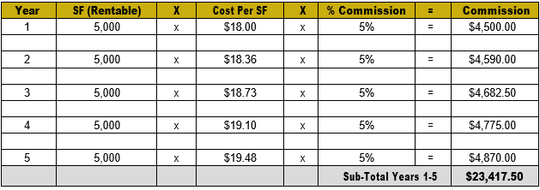
Example: 5-year initial lease term; 5-year renewal option SF = 5,000 rentable SF
Base Rent = $18 NNN for year 1 and 2% increases years 2-5

Slide 25
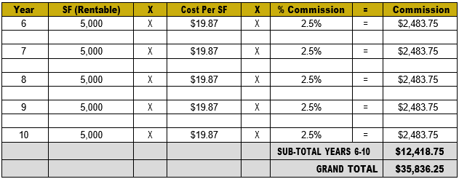
Years 6-10: The base rent increases 2% in year 6 and remains fixed in years 7-10.

Slide 26
Next Session: June 21st 12-1:00 EST
Topic: CRE Transactional Questions: 12-12:15 EST
Mindset Training: 12:15-1:00 EST
Greatness is Within
Peak.Sander.com

