Slide 1
Jeff's Historical Review of The Market and Why He Believes The Market Will Be Strong Once The Pandemic Passes

Slide 2
THURSDAY
9:30 Jeff’s Historical Review of The Market and Why He
Believes The Market Will Be Strong Once The Pandemic
Passes
12:00 Getting the most out of RE/MAX First
2:00 BOOJ Websites (Repeat)
4:30 Virtual Cocktail Party
FRIDAY
9:30 Rockstar interview MJ Agostini
12:00 RE/MAX LLC ... Kerron Stokes Connecting Virtually
2:00 BOOJ CRM (Repeat)

Slide 3
MONDAY
9:30 No Guts, No Gain ..... Ed Schultek/Sandler
12:00
2:00
TUESDAY
9:30 No Guts, No Gain ..... Ed Schultek/Sandler
12:00 RE/MAX Technology Referral Strategy
2:00 Megaphone

Slide 4
WEDNESDAY
9:30 No Guts, No Gain ..... Ed Schultek/Sandler
12:00 Anne Miller, VP REMAX Luxury and Commercial
Doug Winfrey, Sr. Branch Manager, RE/MAX Commercial
2:00
THURSDAY
9:30 Rockstar Interview
12:00 RE/MAX First Best Practices
2:00

Slide 5
FRIDAY
9:30 Rockstar Interview
12:00
2:00 Megaphone

Slide 6
ShowingTime Target Market Analysis Reports

Slide 7
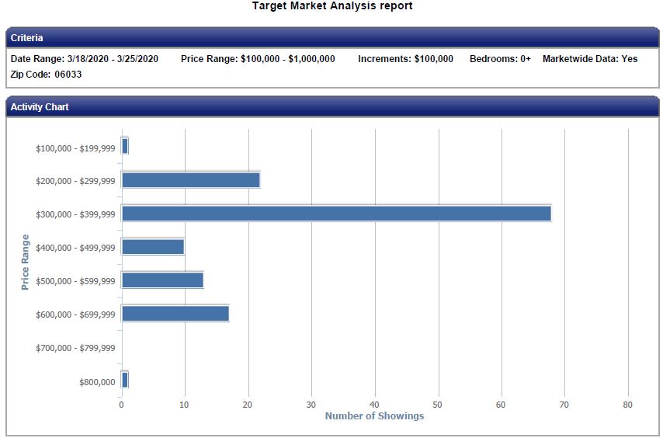
GLASTONBURY

Slide 8
GLASTONBURY

Slide 9
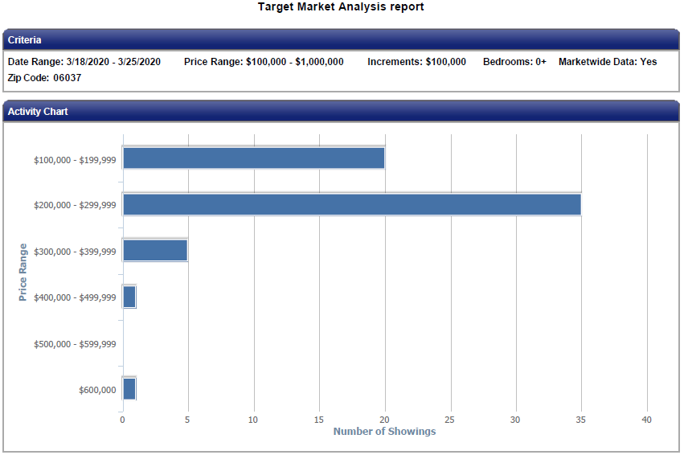
BERLIN

Slide 10
BERLIN

Slide 11
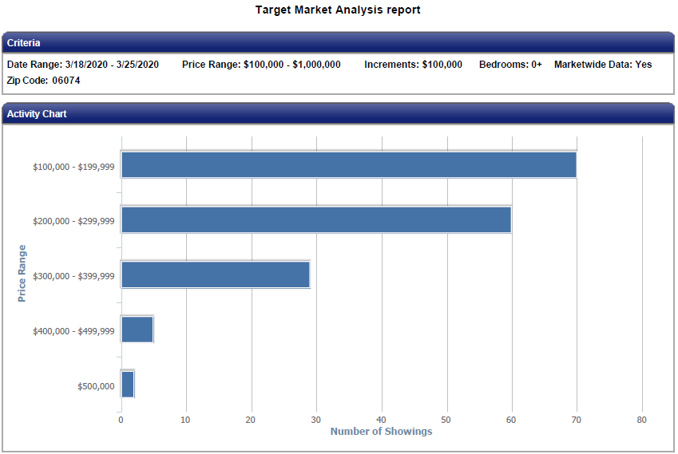
SOUTH WINDSOR

Slide 12
SOUTH WINDSOR

Slide 13
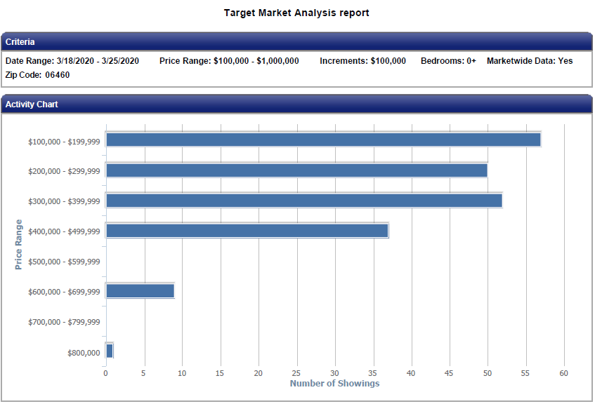
MILFORD

Slide 14
MILFORD

Slide 15
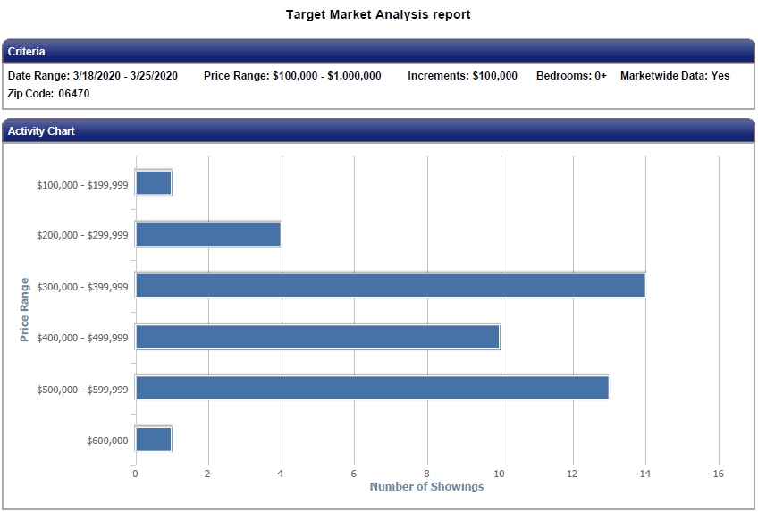
NEWTOWN

Slide 16
NEWTOWN

Slide 17
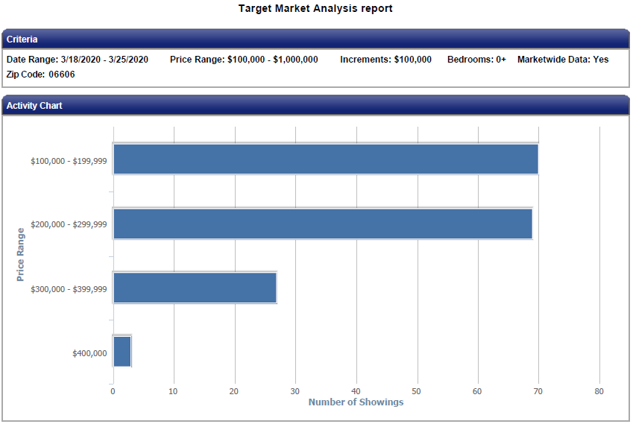
BRIDGEPORT

Slide 18
BRIDGEPORT

Slide 19
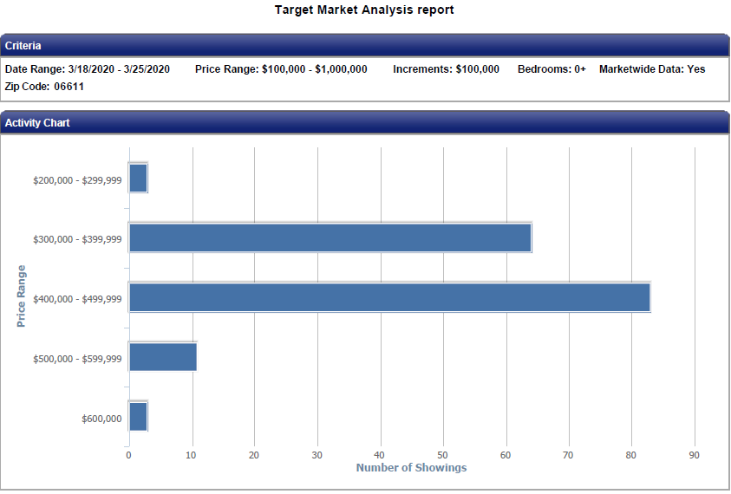
TRUMBULL

Slide 20
TRUMBULL

Slide 21
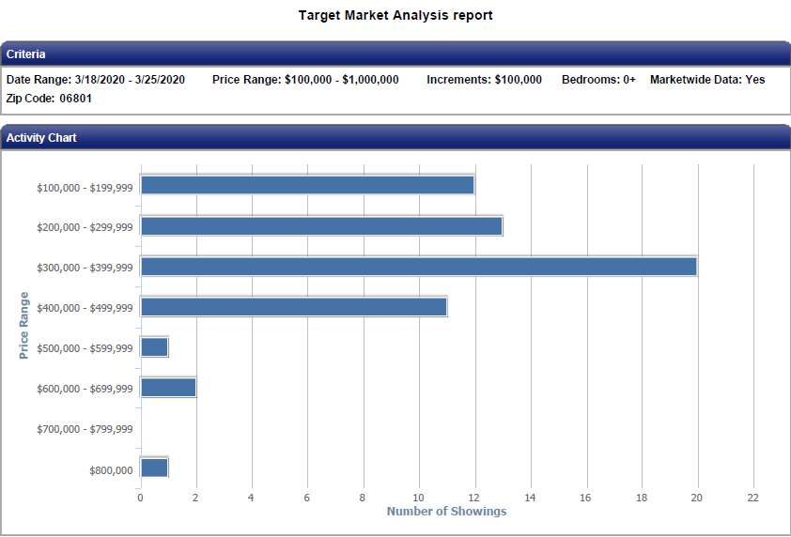
BETHEL

Slide 22
BETHEL

Slide 24
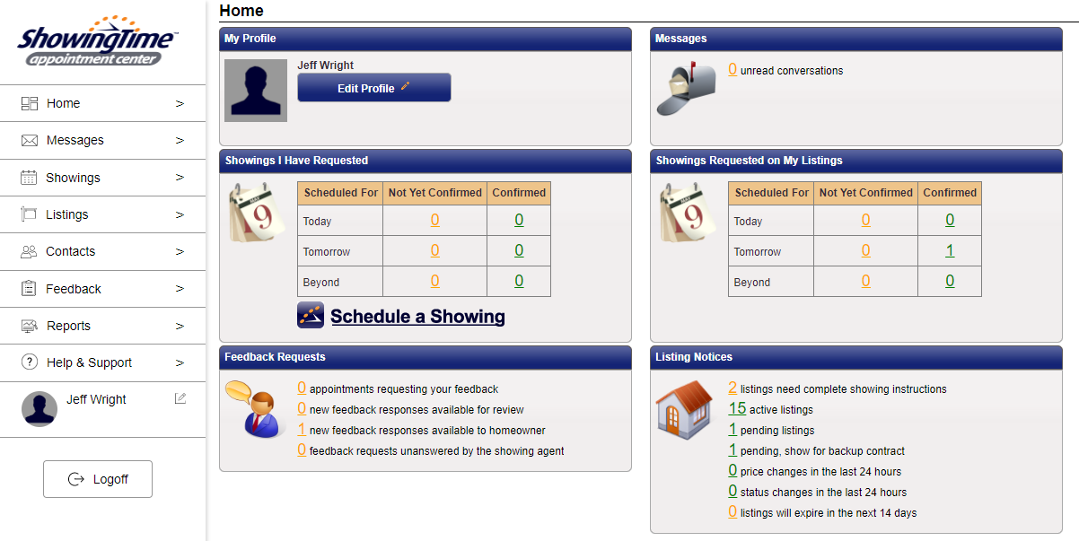

Slide 25
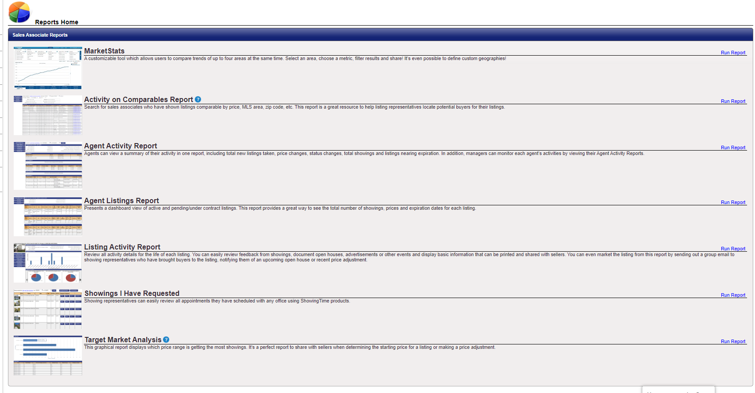

Slide 27
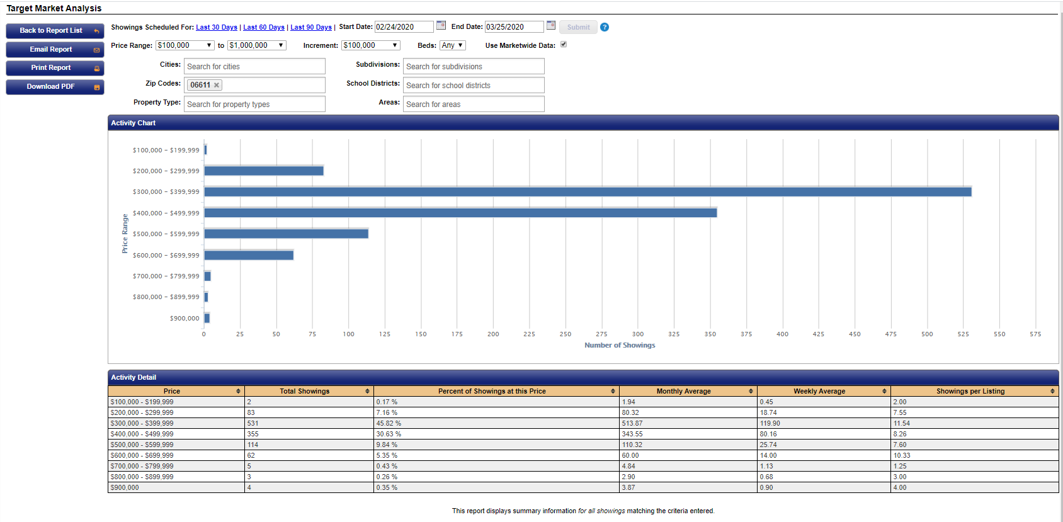

Slide 33
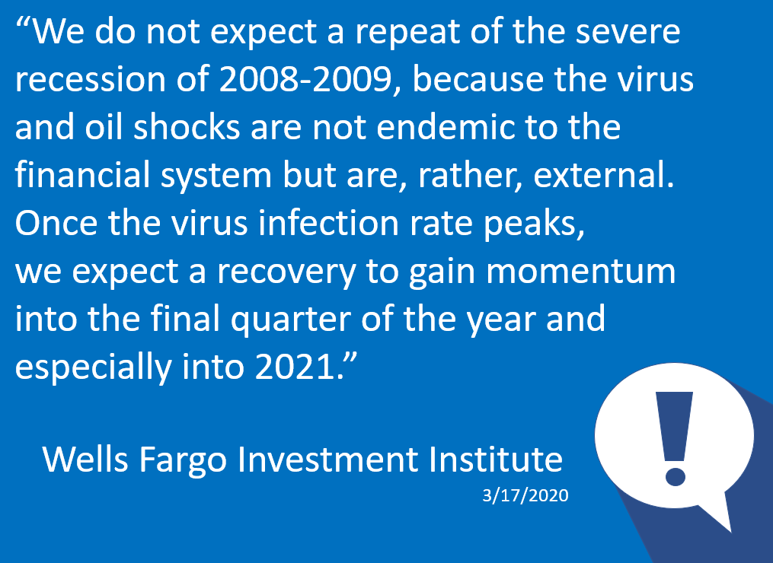

Slide 34
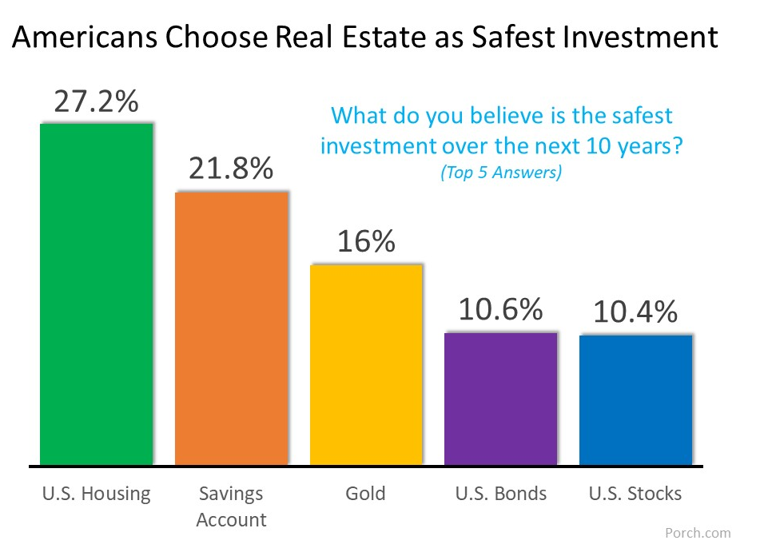

Slide 36
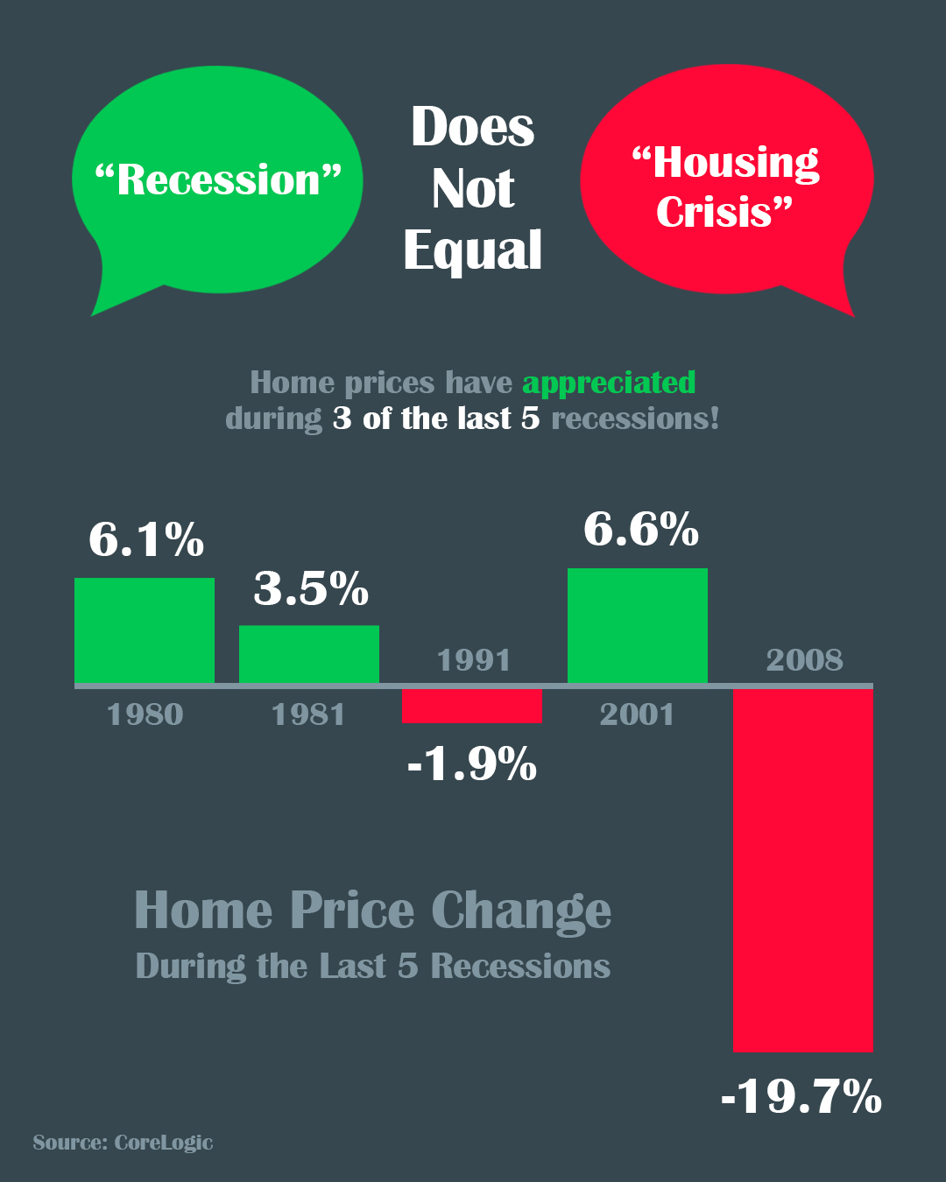

Slide 38
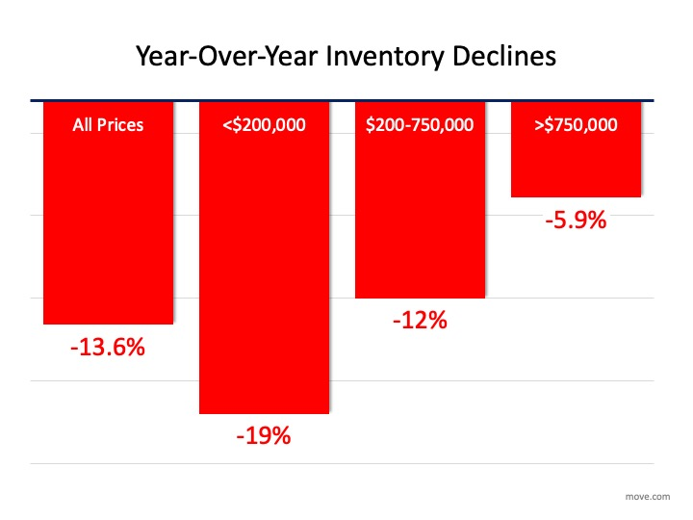

Slide 42
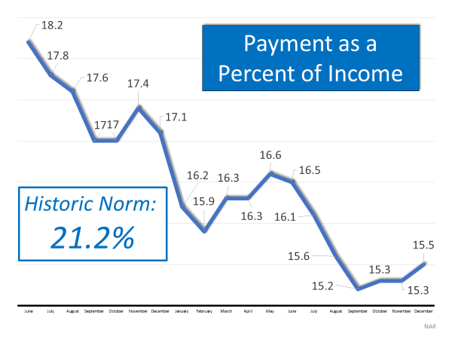

Slide 47
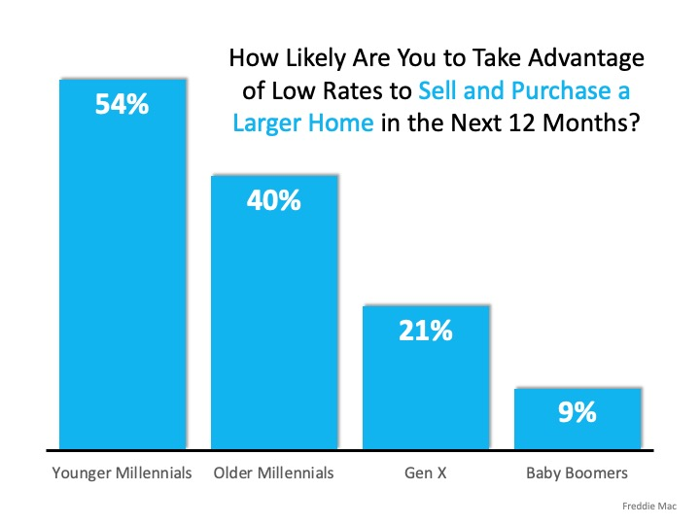

Slide 50
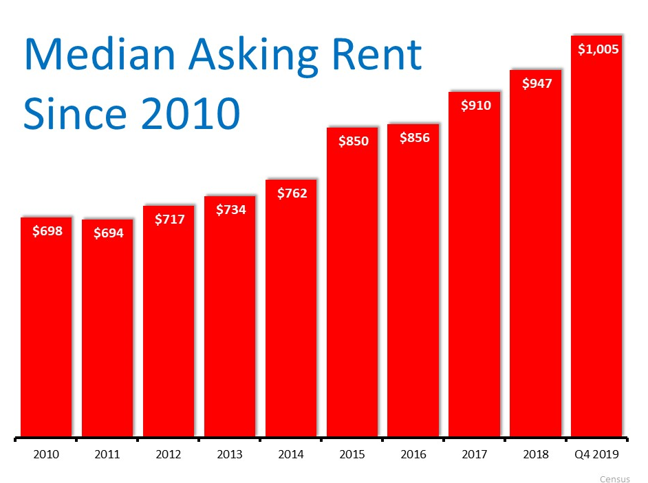

Slide 52
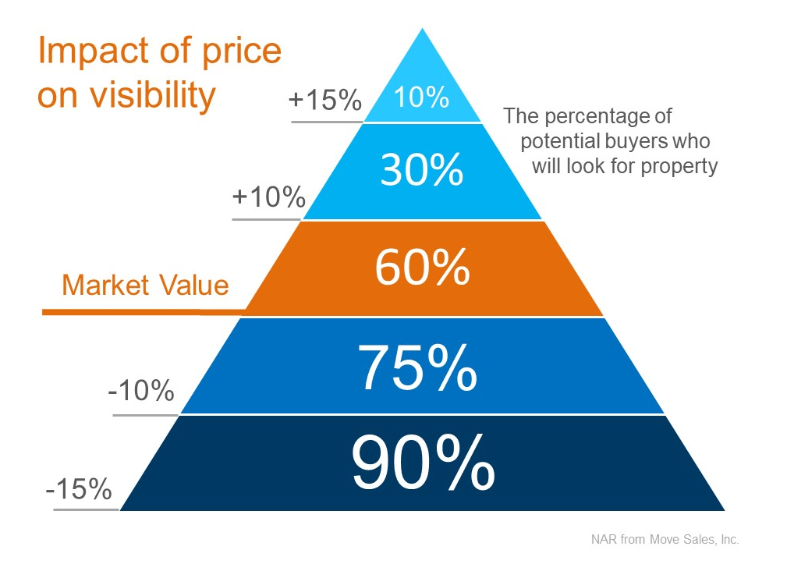

Slide 55
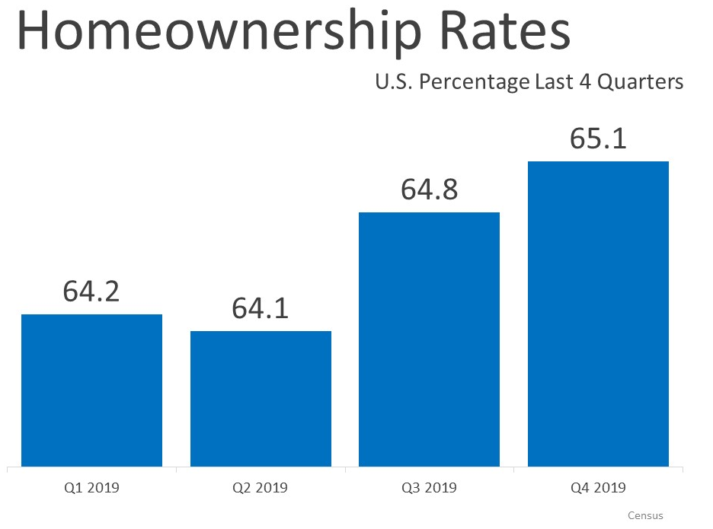

Slide 58
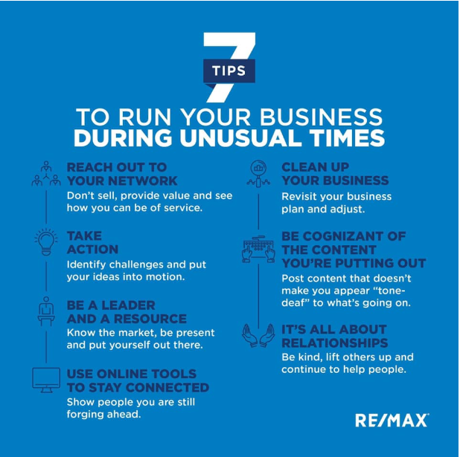

Slide 59
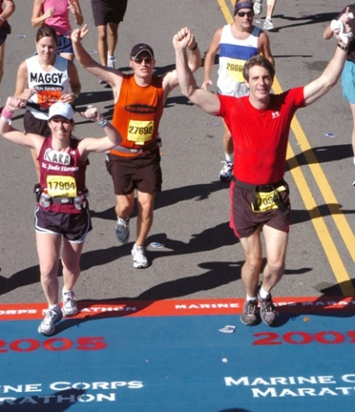
Concluding Thoughts
You don’t have to be great to start,
but you have to start to be great.
Joe Sabah

