Slide 1

Crumbling Foundation:
Types, Causes, & Remediation

Slide 2

Types Of Foundation Cracks
Vertical
Diagonal
Horizontal
Step

Slide 3
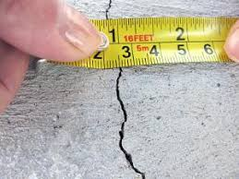
Vertical cracks
Of least concern, very common
Occurs from natural settlement
Can allow for water seepage
May be repaired with urethane
and/or epoxy injection

Slide 4
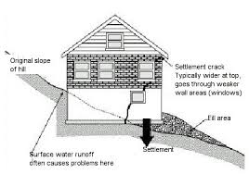
Diagonal cracks
Typically caused by differential settling of foundation from a change in ground or bearing conditions
Can happen when a house is built on a hill or there is a change in soil conditions from excessive rain or drought
Sometimes this is caused by improper drainage
Need to determine the cause and position of settling before repairing *
May be repaired with urethane and epoxy

Slide 5
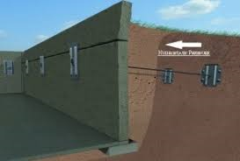
Horizontal Cracks
Commonly in concrete block or brick foundations
Caused by bowing foundation
If the backfill is improper it won’t drain properly and will have excessive pressure against the wall
This is a serious problem that can lead to structural failure
Can install high- strength strapping onto the interior wall to prevent further bowing
Installing reinforcing posts of braces
Anchors buried in the surrounding soil can be used to pull and secure wall
Always consult a structural engineer

Slide 6
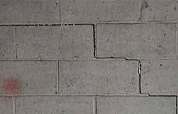
Step cracks
Similar to diagonal cracks and typically caused by differential settling
Usually not serious unless the brick or block is displaced or cracking extends through the blocks
Step cracks should always be evaluated by a structural engineer

Slide 7
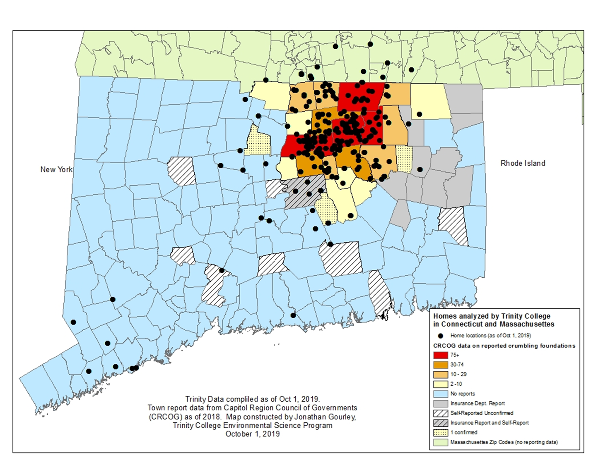
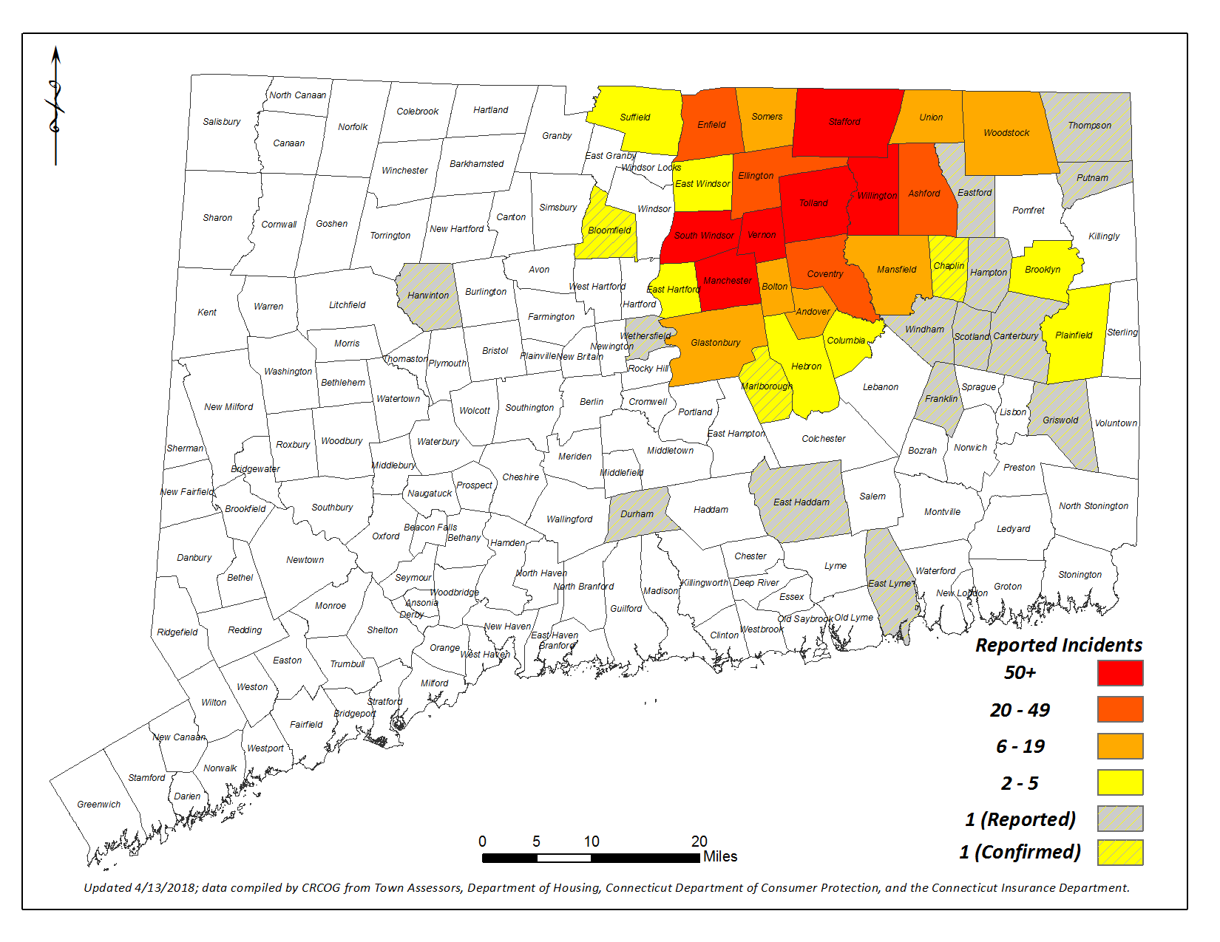
Map of CT Crumbling Foundations

Slide 8
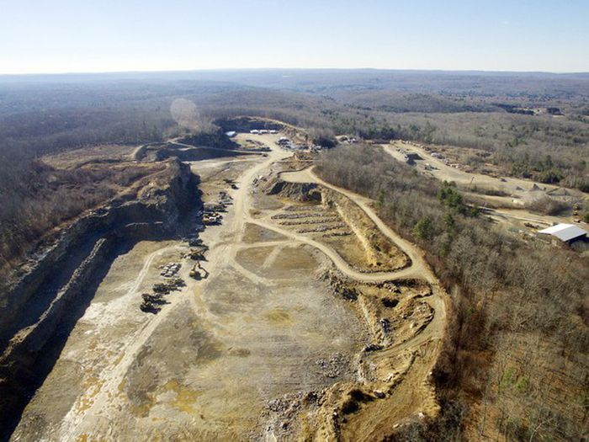
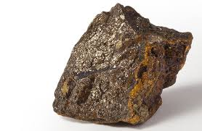
Crumbling Foundation Info
35,000+ homes can potentially be affected in areas of CT
Homes built 1983 – 2015
The home is within 20 miles radius of J.J. Mottes Concrete Company in Stafford Springs. A waiver application for homes outside of the 20 mile radius is available.
Damage is irreversible – most effective repair is to replace the existing foundation
Due to the presence of pyrrhotite, a naturally occurring iron sulfide originating from a quarry (Becker’s) in Willington
Cracking, flaking, bowing and separation of the concrete has appeared in some homes
Web cracking is the most concerning
A rust or white powder may appear
https://portal.ct.gov/DOH/DOH/Programs/Crumbling-Foundations

Slide 9

Reimbursement Program
www.crumblingfoundations.org
CFSIC has been chartered and licensed as a captive insurer to assist the State of Connecticut with the fair and equitable adjustment of homeowner claims resulting from the pyrrhotite-affected home foundations natural disaster.
Contact Crumbling Concrete Foundations Qualified Vendor List (CRCOG) at 860-724-4277 or foundationtesting@crcog.org or visit www.foundationtesting.org
The Capitol Region Council of Governments (CRCOG) is assisting the state with providing testing reimbursements
VISUAL inspection reimbursement is 100% of the cost, up to $400. Costs for testing can range from $400 - $1000, depending on the Engineering firm conducting the test
CORE testing reimbursement for a maximum of 2 samples is 50% of the cost, up to $2000. Costs for testing can range from $1400 - $4000 depending on how many samples are taken and to which lab they are sent

Slide 10
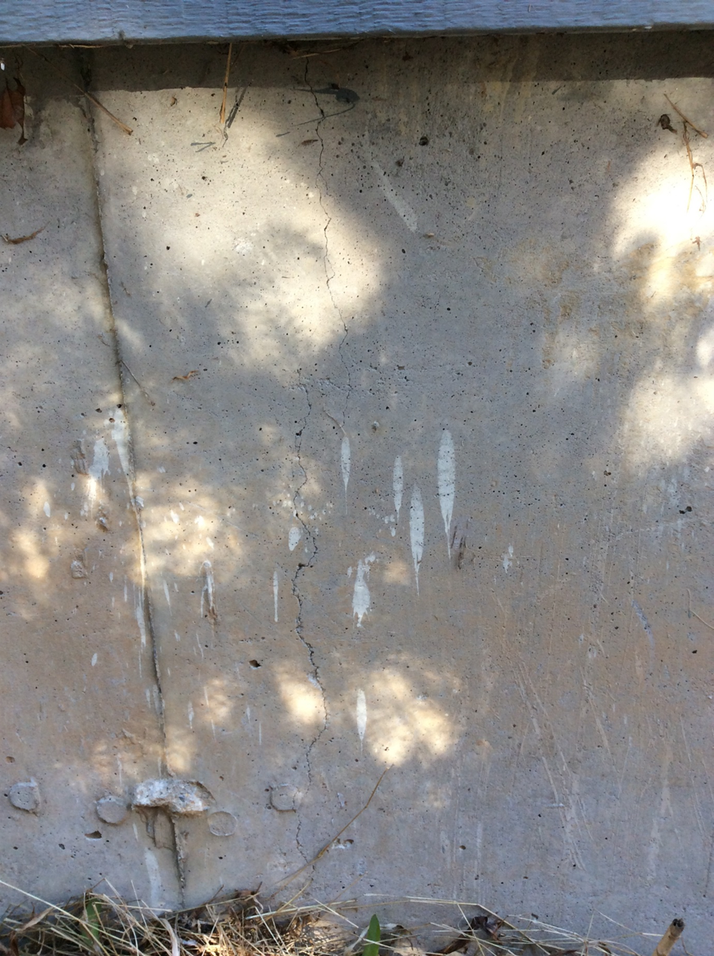
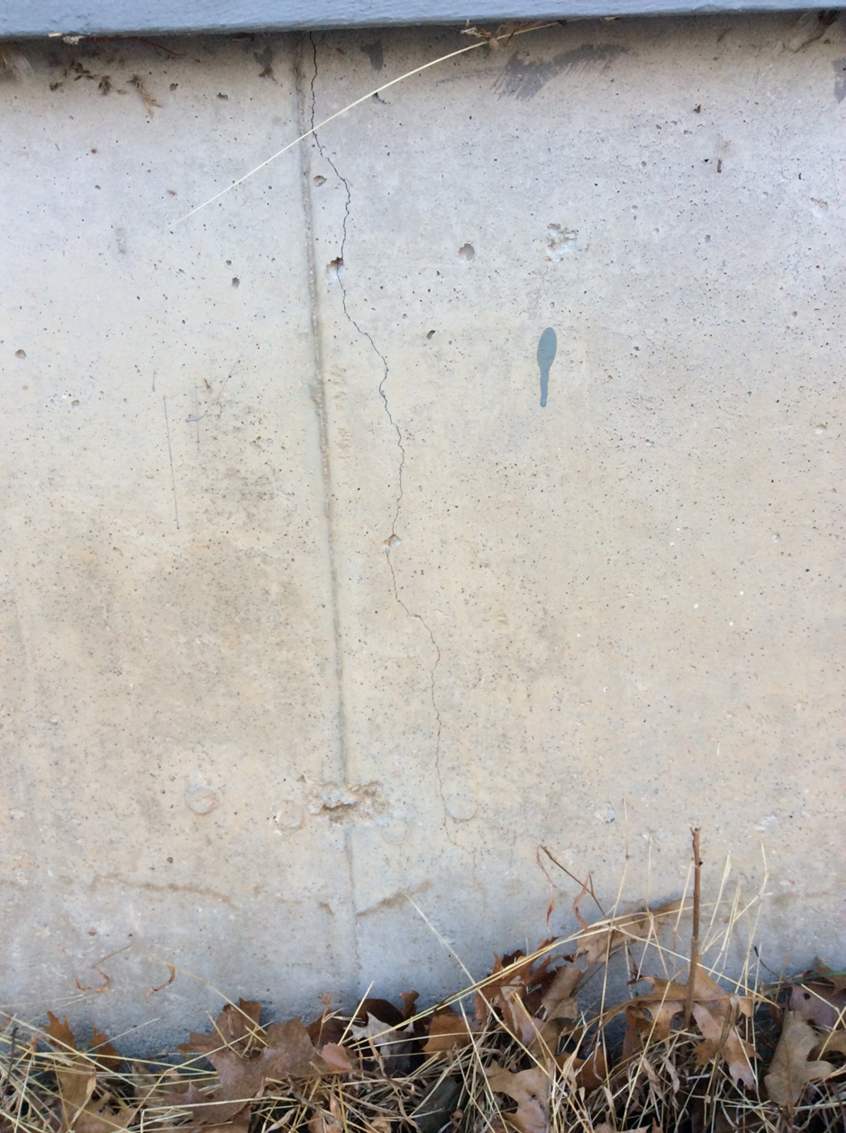
Inspecting & TESTING FOR PYRRHOTITE
Inspecting
  Determine the Severity Class 1, 2 or 3
    Based on the visual examination report, a Connecticut-licensed engineer and describes the current condition of the concrete and cannot predict if un-cracked concrete will deteriorate at a later date.
    Severity Class 1
      Most difficult for determining if pyrrhotite is present
      Normal cracks misdiagnosis or difficult to see
      Unknown source of concrete
      If pyrrhotite is indeed present, it has not started to react
      Inconclusive without coring
      Requires obtaining a core sample of the foundation to be taken, and that laboratory report must conclude that pyrrhotite exists in the sample in order for a claimant to make a claim

Slide 11
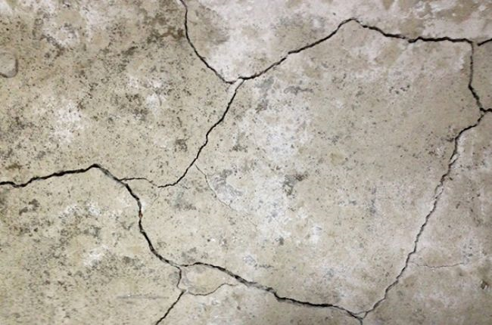
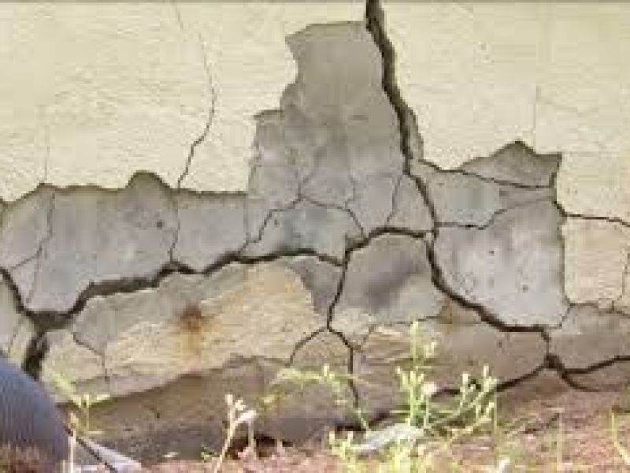
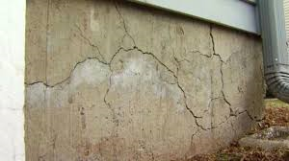
Inspecting & TESTING FOR PYRRHOTITE
    Severity Class 2
      Visible cracking patterns commonly associated with pyrrhotite-bearing aggregate are present, inclusive of typical crack widths of 1.0mm or less, and with the entire crack pattern extending over less than 20% of any contiguous wall plane.
    Severity Class 3
      Visible cracking patterns commonly associated with pyrrhotite-bearing aggregate are present, inclusive of typical crack widths of greater than1.0mm, and with the entire crack pattern extending over more than 20% of any contiguous wall plane.

Slide 12
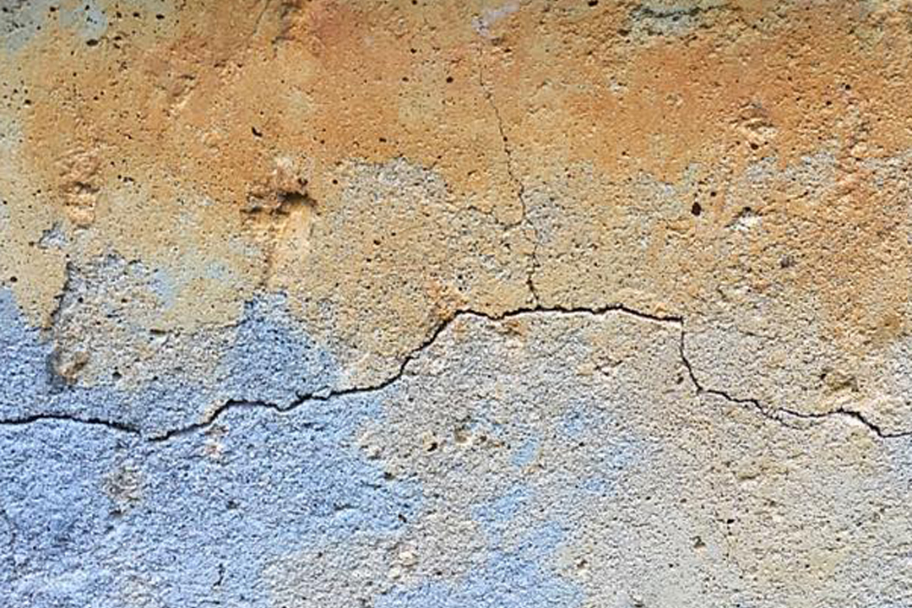
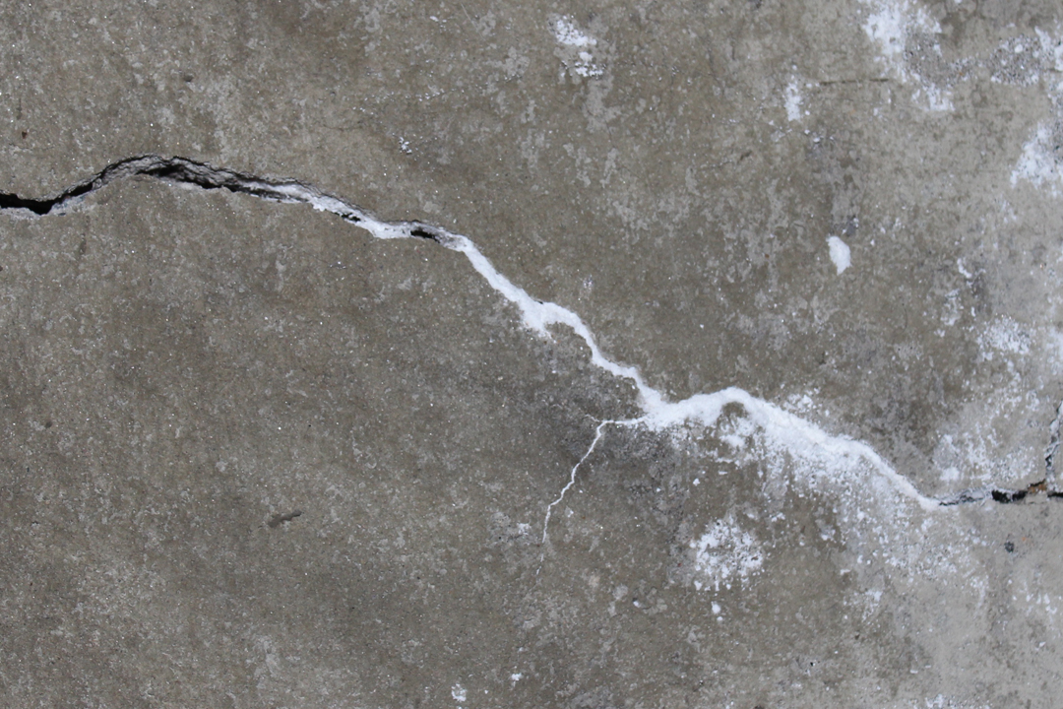
Other visual signs
Brown stains or drips may​appear that resemble rust
White powder ​in and around the cracks

Slide 13
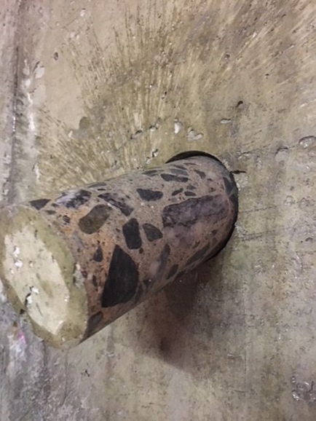
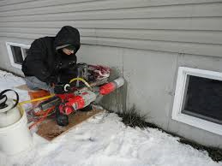
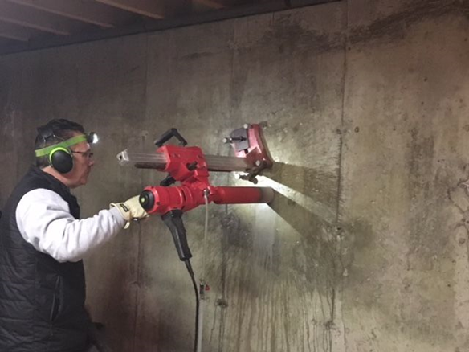
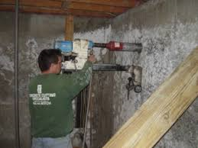
Core drilling and laboratory testing
Core drilling test is usually done in two different walls and determines the presence, or absence, of pyrrhotite and the percent of pyrrhotite that exists in the sample. It requires drilling out a 4 inch diameter cylinder from the concrete which is sent to a lab for analysis. The concrete is plugged after the core sample is removed.

Slide 14
Two types of Claims
Claim Type 1: Type 1 claims will be those claims where the claimant has a compromised foundation according to the standards set forth in these guidelines and who is seeking financial assistance for a foundation replacement.
Claim Type 2: Type 2 claims will be those claims where the claimant has, through his or her own resources, or a combination of those resources and other resources, already replaced an entire foundation, or part of a foundation, where that foundation was compromised according to the standards set forth in these guidelines, and where the claimant is seeking reimbursement for the costs associated with replacement, subject to these guidelines.

Slide 15
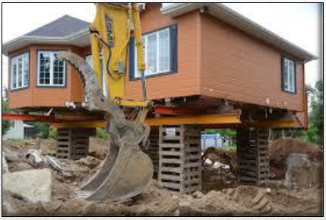
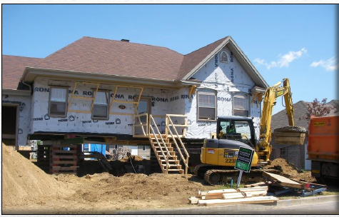
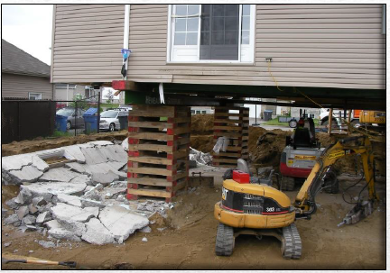
Fixes-Jack and replace

Slide 16
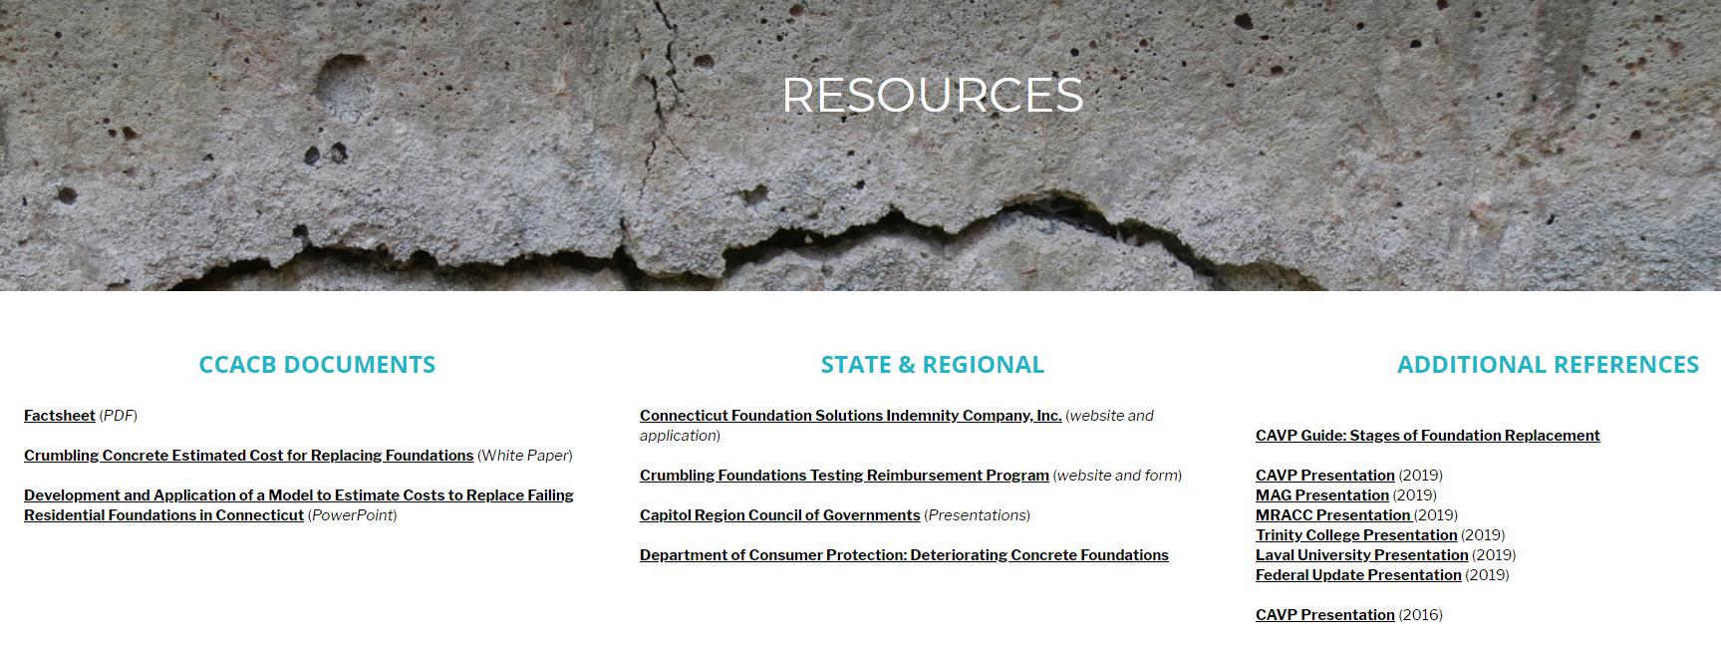
Other Resources
https://www.ccacb.org/ Connecticut Coalition Against Crumbling Foundations

Slide 17
Q&A
Rob Barakat, PE
Liz Cote, Regional Marketing Manager
800-345-27776 | mhschaefer.com

