Slide 1
SELLING RE/MAX
AND
RE/MAX RIGHT CHOICE

Slide 2
RE/MAX Right Choice | RE/MAX LLC | RE/MAX Integra
RE/MAX LLC
RE/MAX INTEGRA
RE/MAX of NEW ENGLAND
RE/MAX RIGHT CHOICE

Slide 3
HISTORY of RE/MAX Right Choice
1987 - The Wright Company, Realtors
1997 - RE/MAX Right Choice
The Wright Company, Realtors
RE/MAX United and RE/MAX Preferred
2004 - RE/MAX Realty Associates of Milford became RE/MAX Right Choice
2012 - Nova Realtors of Bridgeport became RE/MAX Right Choice
2012 - RE/MAX Enterprise of Newtown and Bethel became
RE/MAX Right Choice
2018 - RE/MAX Edge of South Windsor, Glastonbury, and Berlin became RE/MAX Right Choice

Slide 4
The RE/MAX Right
Choice Difference:
Our agents and staff

Slide 5
HOME OF THE TOP PRODUCERS
AND THOSE THAT WANT TO BE

Slide 6
Our Internal Mission Statement
To help agents to reach their full potential so they can live the life they deserve to have where life balance, abundance and greatness is possible.

Slide 7
Why RE/MAX Right Choice
Our agents and staff
When you surround yourself with like-minded professionals, you get better because of them and they get better because of you!
A culture of kindness, integrity, and being your best is very important to us.

Slide 8
Our Belief Systems
A belief that you can be as great as you desire
Greatness is within all of us

Slide 9
Everyone Matters
A philosophy that recognizes the importance
of every team member because collectively a great team working in harmony is always stronger than any great individual.

Slide 10
Our Success Formula
We provide an environment where everyone can succeed at whatever level they desire. Continuous
Transactional and Peak Performance Training, along with, mentoring and coaching on a daily basis enable us to provide an environment where everyone can succeed at the level they desire.

Slide 11
Our Success
We are the largest and most successful RE/MAX company in CT
We are the second largest and one of the most successful RE/MAX companies in New England
We were honored in 2007 by RE/MAX LLC as a RE/MAX Great Office

Slide 12
Our Success
2016 - REAL TRENDS ranked us #9 nationally in
Transactions per agent
2017- We were the #1 real estate company in
Connecticut in transactions per agent for
firms with 30 or more agents
21.5 Sales transactions per agent
29.2 Sales and rental transactions per agent
$6,781,131 per agent in sales volume

Slide 13
Our Success
2017 NEW ENGLAND AWARDS
#1 Individual by Transactions – Angela Morales
#1 Commercial Agent by Commissions – John Labella
#2 Team by Transactions – Stephanie Ellison Team
#2 Office in Per Agent Productivity – Bridgeport Office
Manager of the Year – Sue O’Shea

Slide 14
Our Success
2017 CONNECTICUT AWARDS
Top Individuals by Transaction - #1 Angela Morales
Top Individuals by Gross Commission - #1 Matt Nuzie
Top Teams by Transaction - #1 Stephanie Ellison Team
Top Teams by Gross Commission
#1 Stephanie Ellison Team
#3 Perez and Partners
Top Multi-Office by Transaction – RE/MAX Right Choice
Top Multi-Office by Dollar Volume – RE/MAX Right Choice

Slide 15
Some Things To Know
We have marketed over 100 subdivisions
and thousands and thousands of new homes
Our Commercial Team is consistently in the Top 5 in all of RE/MAX in the United States.

Slide 16
My Belief
You don’t have to be great to start, but you have to start to be great.
~ Joe Sabah

Slide 17
RE/MAX LLC

Slide 18
RE/MAX CHANGES THE REAL ESTATE INDUSTRY – JANUARY OF 1973
It all began as a dream and a plan on a pad of paper.
Dave Liniger had a controversial idea to build a real estate powerhouse where experienced, productive agents would keep more of their commissions and enjoy the freedom to run their business as they saw fit.
Liniger had experienced the maximum-commission model and realized it would appeal full-time, serious professionals who would rather contribute collectively to office expenses than settle for a traditional commission split.
Combining the model with robust marketing and other agent services for the first time was revolutionary genius, and it absolutely changed the real estate landscape forever.

Slide 19
RE/MAX Growth
1973 – The beginning
1984 – 5,000 Agents
1986 – 10,000 Agents
1989 – 25,000 Agents
1998 – 50,000 Agents
2018 – 120,000 Agents

Slide 20
RE/MAX By The Numbers (2017)
#1 in Transactions per agent - 17
#1 in Global Home Sales
#1 in Brand Name Awareness

Slide 21
RE/MAX By The Numbers (2017)
120,821 Agents as of 3/31/18
7,930 Offices
100 Countries and Territories
15.1 Average Years in Real Estate
$122,953 Average Commission

Slide 22
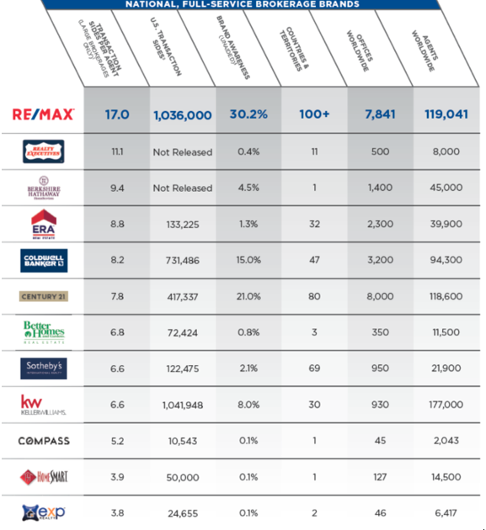
2017 RE/MAX vs. The Industry

Slide 23
Net Promoter Score

Slide 24
Brand Power
BUYERS AND SELLERS KNOW YOU BEFORE THEY’VE MET YOU
From TV to sports arenas, radio, digital and more, the RE/MAX name is out there working – for you. Top brand awareness has you top of consumers’ minds. That means an immediate recognition for your business, and the potential for consistent referrals. This balloon has clout.

Slide 25
Buzzfeed.com/REMAX
The immersive brand page engages and delivers values to millennials, the largest group of homebuyers and sellers since the Baby Boomers.

Slide 26
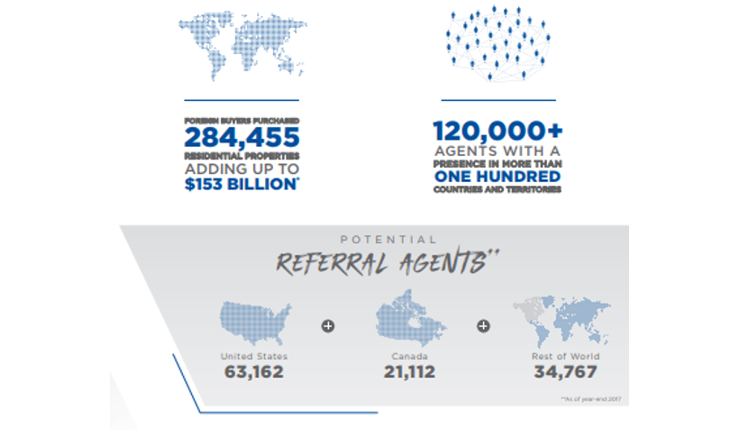
Worldwide Network

Slide 27
GLOBAL.REMAX.COM
Globalremax.com averages over 900,000+ RE/MAX listings from 100+ countries and territories, making it one of the largest global listing inventories of any real estate brand. Plus, listings are viewable in more than 40 languages and over 60 currencies.

Slide 28
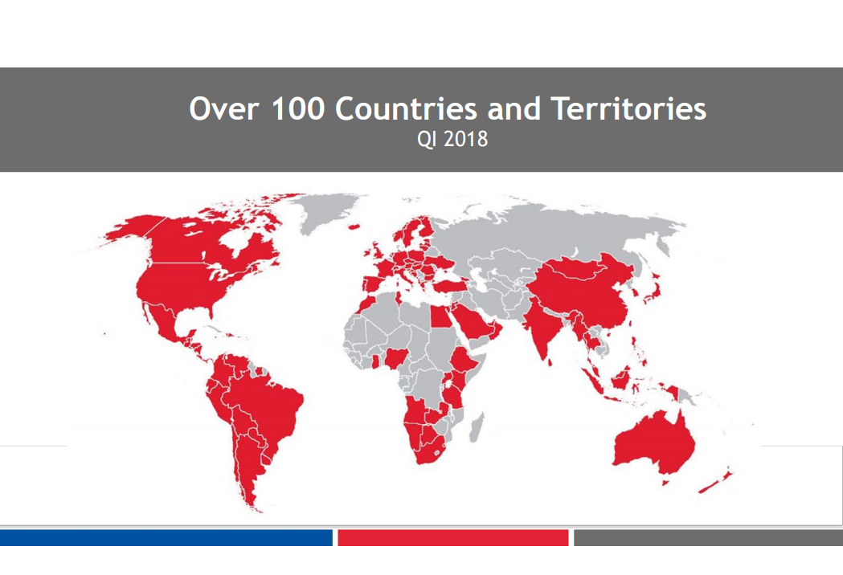
RE/MAX Tools
GLOBAL.REMAX.COM

Slide 29
RE/MAX Tools
DESIGN CENTER
With thousands of free, customizable templates for flyers, postcards, virtual tours, websites, and presentations, the RE/MAX Design Center helps you make the best first impression with potential buyers and sellers. It allows you to be creative and is simple to use, as it automatically pulls property details from the MLS to populate the designs you choose. Plus, projects are instantly branded with your photo and contact info.
DESIGN CENTER AUTOMATION
Want to save even more time? With Design Center Automation, a no-cost extension of the service, you automatically receive an email containing a complete marketing package for each of you listings in the MLS.

Slide 30
Design Center Automation (cont.)
From: Design Center Listing Automation
<support@remaxintegra.com> To:
Sent: Subject: Congrats on Your New Listing at 123 Main Street!

Slide 31
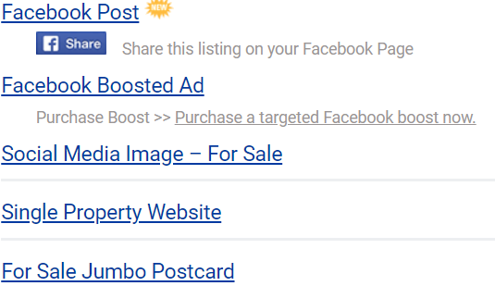
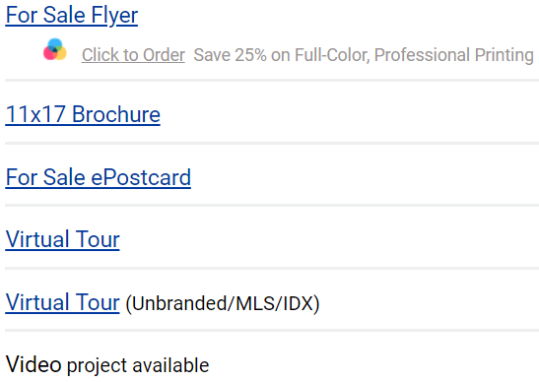
Design Center Automation (cont.)
It's easy to impress your seller and take the first step in marketing your new listing! Use the links below to preview your "For Sale" Marketing materials. You can send the print pieces directly to your preferred printer, share the listing on social media, or start distributing the hosted digital content. Sign in to your Design Center account to make edits or to email your database. (Courtesy of RE/MAX Right Choice Real Estate)
Update or create materials: Log in to Access Design Center via MAX/Center

Slide 32
RE/MAX Tools (cont.)
LAUNCHPAD
RE/MAX Launchpad is a fully comprehensive technology solution that will quickly become your most utilized resource. This mobile responsive platform allows you to set and track yearly production goals and access a robust fully-searchable library for marketing resources and industry tools – with greater business intelligence and app customization than ever before. It also features with top real estate partners and connects MAX/Center making it easier for your business to drive results.
MAX/CENTER
Your central access to the entire universe of RE/MAX resources. MAX/Center features a clean layout with apps that correspond to various internal and external sites. You can easily find what you’re looking for, save your favorite items, and discover what’s new – all in one place.
RE/MAX MOBILE APP
With real-time listing updates and one-click sharing, the RE/MAX Mobile App is a modern property search tool for clients and a vital lead generation tool for you. It can be quickly branded with your photo, name, and contact info, so it’s ready to share with prospects.

Slide 33
Education
The more you learn, the more you earn
RE/MAX University allows you to easily stream over 1,000 training videos and 70+ designations and certification courses at the click of a button.

Slide 34
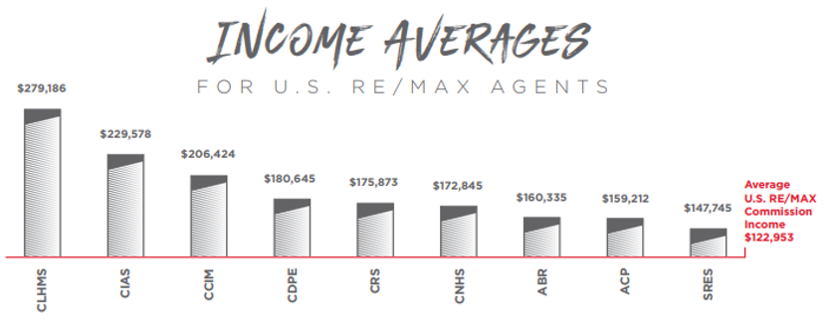
Education

Slide 35
RE/MAX Luxury Collection

Slide 36
THEREMAXCOLLECTION.COM
If your listing is twice the average sales price in a zip code, it will automatically be included on the site. The highly coveted leads generated here are distributed to RE/MAX luxury agents who hold the CLHMS designation or have an active luxury listing.

Slide 37
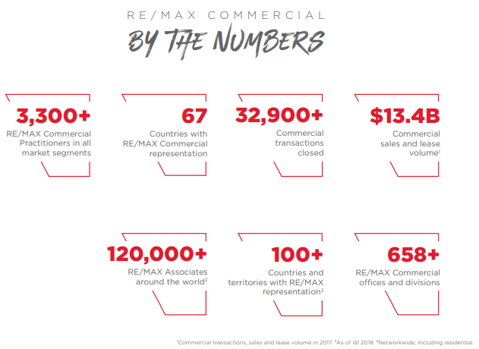
RE/MAX Commercial

Slide 38
RE/MAX Commercial
Redesigned in 2017 with over 250,000 listings, remaxcommercial.com boasts an intuitive interface that prominently features commercial listings from around the world.
All product types are represented, and visitors receive additional value through exclusive updates and access to industry reports. It’s built to help clients find the information they’re looking for faster (and get them connected with Practitioners sooner).

Slide 39
Networking Events

Slide 40
Networking Events (cont.)
R4 Convention
February 25 - 28th
MGM Grand, Las Vegas

Slide 41
Networking Events

Slide 42
Children’s Miracle Network Hospitals
IF YOU HAVE A BIG HEART, YOU’VE FOUND THE RIGHT PLACE
Through a RE/MAX partnership with Children’s Miracle Network Hospitals ®, you can support kids and their families right in your community. The best part – 100% of donations stay local.

Slide 43
Children’s Miracle Network Hospitals

Slide 44
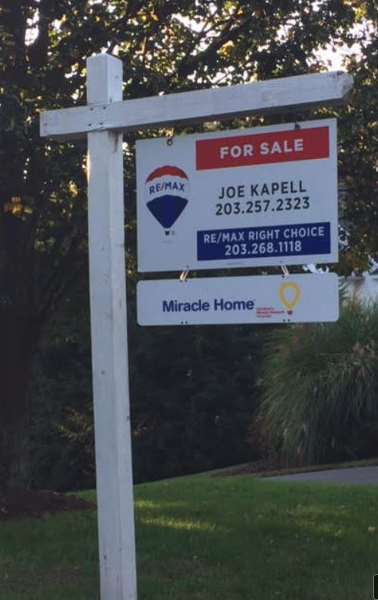
Children’s Miracle Network Hospitals

Slide 45
Adam Contos, CEO

Slide 46
Adam Contos, CEO
Vision for Today, Tomorrow, and Far Into the Future
RE/MAX is built on a culture of productivity, service, and quality. CEO Adam Contos, who took the reins in early 2018, has a progressive approach that merges the best of the past with the promise of the future. He’s supported by a talented group of senior leaders, all of them focused on servicing an incredible global network of real estate professionals.

Slide 47
Adam Contos, CEO – Dave Liniger (Founder)

Slide 48
RE/MAX Integra
40,000 Plus Agents
2,900 Plus Offices
36 Countries to include Ontario and Atlantic Canada, Europe and the Middle East
RE/MAX of New England, Indiana, Minnesota, and Wisconsin
Debt Free

Slide 49
RE/MAX Integra

Slide 50
RE/MAX Integra
Fiona Petrie Dan Breault E.V.P E.V.P. Managing Director USA Franchise Sales & Strategic Growth
Bob Leighton
Executive Director Franchise Growth

Slide 51
RE/MAX Value Proposition Scripts

Slide 52
Sign and Advertising Calls
“Mr. & Mrs. Seller as you may or may not be aware, RE/MAX works very differently than most real estate firms in that once I list your property, all of the sign and advertising calls go only to me. The RE/MAX philosophy which is different than most firms in that we want your inquiries to be handled by the person that knows the most about your property and that would be me.

Slide 53
Caliber of Agents At RE/MAX
“Mr. and Mrs. Seller, take a look at this chart and tell me what it means to you.”
“Well, first what it shows you is that RE/MAX is doing a lot more business than any other real estate firm. Over 1,036,000 closings in 2017. Believe me, it’s a number I’m proud of. However, more importantly is the second number reported...that 17 transactions per agent. That is what really makes me proud to be at RE/MAX.”
“You see, Mr. and Mrs. Seller, as soon as you sign the listing agreement I’m going to set out to get this home sold. The first people I’m going to tell about this listing is my team at RE/MAX. Almost everyone at my firm is a full-time career agent. This is what we do for a living. That is why we outsell the competition.

Slide 54
My Design Team
I have a Design Team - the RE/MAX Design Center, gives me hundreds of marketing materials to choose from...over 1900 materials at my disposal to get your home marketed. We aren’t on our own when it comes to RE/MAX. Some of the materials my team can offer are:
• Property flyers
• Web commercials
• Property tours
• Marketing brochures
• Postcards

Slide 55
Charitable Initiatives
“So, Mr. and Mrs. Seller, I’ve done a lot of presentations for sellers. I constantly refine my talk because I want to make sure to cover all the important items that make me different than other real estate agents. There are lots of us to choose from. One day it occurred to me that the reasons for which a seller would want to work with me are the same reasons as I chose to affiliate with RE/MAX. You see....at one time I too had to choose RE/MAX over all of the other firms out there, just like you’re doing now. Well, one of the big reasons I chose RE/MAX was that that their mission is more than just helping buyers and sellers...they are also about helping communities.”

Slide 56
Charitable Initiatives
"A portion of each closing I get goes to Children’s Miracle Network. The money I raise goes to our local Children’s Hospital.”
“RE/MAX has been working with Children’s Miracle Network Hospitals since 1992 has raised over $150 million dollars which is second only to Walmart.”
“RE/MAX is the only one that did so with donations from the workers, from agents, not from the consumer. I believe it’s important to work with companies that give back. That’s a big reason why I chose RE/MAX.”

Slide 57
Charitable Initiatives
“In addition to the Children’s Miracle Network, RE/MAX is a big supporter of the military and many local charities.”
(According to the Cone Cause Evolution Study, 85 percent of consumers say that they have a more positive image of a product or company when it supports a cause they care about. And nearly 80 percent would switch to a brand that supports a charity).
Whether you support a cause that RE/MAX has adopted network-wide or one that's closer to your heart, you can expand your success by reaching out.

Slide 58
RE/MAX University On Demand
“RE/MAX University is a 24 hour a day 7 day per week training center for RE/MAX agents. There are over 1000 classes on negotiating, short sales, marketing, business planning, and more.
Everything I could possibly want to know about the art of running a real estate sales and marketing business may be found on RE/MAX University.“
i I spend that time educating myself to further my ability to be the best possible representative for my clients.”

Slide 59
RE/MAX on the Web
“Mr. and Mrs. Seller "The National Association of Realtors tell us that 95% of buyers are shopping online for their homes. That means that the internet becomes a vital key in matching a buyer up with your home. When buyers think of buying a home, they think RE/MAX and your home will have maximum online exposure on REMAX.com”.
“Mr. and Mrs. Seller, when you have a moment please go to this site: http://workingforyou.remax.com
It shows you in real time the power of remax.com”.

Slide 60
Control of The Listing
“Mr. and Mrs. Seller, I know you told me you are interviewing other agents and you should as it is a very important decision and all realtors are not the same.
“At RE/MAX each agent runs his or her business as if they are president of their own Company. We prepare business plans, we study marketing strategies, and we control every listing we bring in, from contract to close. I work with my seller closely and when I commit to something, I always come through. I can do that because I run my real estate business”.

Slide 61
National Brand Exposure
“Everything we talked about today comes down to one thing...BRAND. When people think real estate they think RE/MAX. The RE/MAX balloon represents the amazing lift our organization has had over the last 45 years. It was built by a great executive team and we continue to remain on the forefront of every consumers mind when people think about buying or selling a home.”

Slide 62
National Brand Exposure
“We continue to remain out in front of the real estate world because RE/MAX remains committed to online web exposure, educating agents, and the best technology available. While other firms have cut back or even eliminated national advertising budgets we continue to realize that to remain dominant and do give our sellers the best budgets we continue to realize that to remain dominant and do give our sellers the best exposure possible a national advertising and brand campaign is not optional. And some of my competitors will tell you that national brand recognition does not matter. They tell you that because they don’t have it. You know who realizes that brand is important?
Nike....McDonalds...RE/MAX....and now YOU

Slide 63
Concluding Thoughts
You don’t have to be great to start, but you have to start to be great.
~ Joe Sabah

