Slide 1
25-Step Win The Year Success Formula

Slide 2
Goal: Win the Day
Personally and professionally
Keep the most important things the most important
Unless you try do something beyond what you have already mastered, you will never grow

Slide 3
Goal: Win the Day
Success is a journey – NOT a destination
The infamous January 1st – you can start today
Nothing like starting on the path of success right now

Slide 4
1. Win the Year Plan
Must be in writing
Do you know where you want to go? Start there and strategize backwards.
What you desire, precise date, willing to give in return
Feed your goals with emotion
Read them everyday
Make them visible: bathroom mirror, nightstand, car, phone
Create a Screensaver: $100k, $250k, $500k, $750k or $1M
Out of sight, out of mind. In sight, in focus.

Slide 5
2. Find Time For Daily Focus
Sit in a quiet place and outline a success plan for the day
1st thing: gratitude, work out, beliefs
The focus should be on the activities that are the most important to your business and you personally

Slide 6
2. Find Time For Daily Focus
Time Block: What daily routines can you follow to achieve your A priorities
Personally
Diet: Our intake affects our output
Exercise: The result is greater mental and emotional clarity
Mental Health: Recognize what you need to do for yourself, we are all different
Professionally
Prioritize, Closings, Contracts, Listing Presentations, Buyer showings for buyers ready to purchase, Creating business, etc.

Slide 7
3. Visualize Your Success Daily
Dream big – If you believe you can, you CAN!
Mental vision board: 12, 24, 36 months
The Roger Bannister story

Slide 8
3. Visualize Your Success Daily
Chose not to believe others, but to believe in himself
Physical and mental shape
Visualized breaking the 4-minute mile

Slide 9
The Power of Belief
The teacher experiment
Belief was the only difference!

Slide 10
4. Prospect Daily
We are in the sales business – we have to sell
If you want to increase your business, you need to increase your opportunities. This means you need to create opportunities

Slide 11
4. Prospect Daily
Geo-farming/targeting
Circle prospect your listed, under deposit, sold properties and open houses
Top people prospect continuously
Never end a prospecting call without adding more value than you have received
USE A CRM .... IT’S A DIFFERENCE MAKER

Slide 12
5. Communication Strategy
Video
Social Media; Facebook, Instagram, LinkedIn, YouTube
Text
Constant Contact
Cellphone
In person

Slide 13
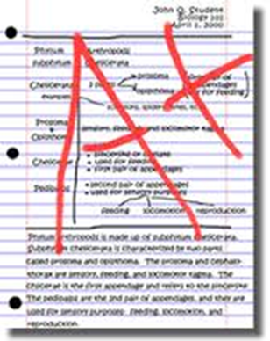
6. Professional Growth.. Increase Education/Knowledge
Be an A+ student, this is YOUR career
The most successful people in life have been blessed with great confidence
Designation statistics
Learn RE/MAX TOOLS
Adopt a Mastery Philosophy

Slide 14
6. Professional Growth.. Increase Education/Knowledge
Mirror what successful agents are doing
They have industry knowledge
They have market knowledge
They are hungry for success
They have business and usually want more

Slide 15
6. Professional Growth.. Increase Education/Knowledge
They market their success in social media, and/or they use social media to create their brand presence
They want to be coached and/or learn more ways to be successful
They respond immediately when an opportunity presents itself
They use their success to their advantage at the listing table
Look in the mirror. Are you doing what you need to do to become more successful

Slide 16
Life is not about waiting for the storms to pass…it’s about learning how to dance in the rain.
~ Anonymous

Slide 17
7. Learn to Uncover Pain, Needs and Wants
Master this skill
How can I help? Why am I here?
Pain is determining needs
Pain is 4x the motivator in making a decision
People buy emotionally and justify decisions intellectually
You cannot create solutions until you know the full scope of the problem… what is most important to you?
What will make this a great sale or purchase for you?
When uncovering needs, you must know when to ask for further definition and /or clarification.

Slide 18
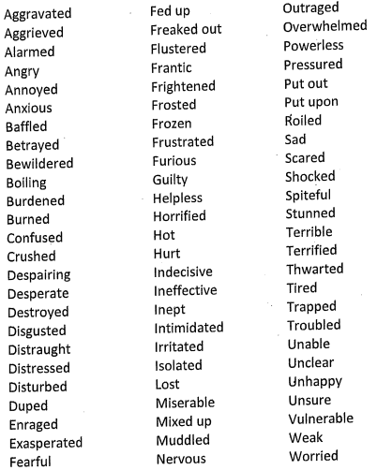
7. Learn to Uncover Pain, Needs and Wants
Words to use when talking to a prospect to uncover their emotional pain.

Slide 19
8. Earning Trust.. Bonding and Rapport
We need to understand how our customer/client interprets the world
We need to be flexible and change the way we communicate with them as they are not going to change how they see the world
Clients decide in the first 5 to 7 minutes whether they can trust us or not
Our body language comprises 55% of our communication, our tone of voice is 38%, and words are only 7%

Slide 20
8. Earning Trust.. Bonding and Rapport
Some things I always try to say:
My goal is to make this a great transaction for you and your family
For me it is win-win relationship, or it does not work
I want you to feel comfortable each step of the way. Please feel free to ask questions at any time
I will never do anything that is not in your best interest. I will always let you know if I think you are making a mistake, or if you're better off responding in a certain way. From there the decision is yours
My goal is to earn your trust now and forever
I always want to know the things that are most important to you in the context of the transaction. This information will help me to make this a great transaction for you

Slide 21
9. Be the Expert
In a given market
Property type
Expired's, FSBO’s
Become the "referred agent"
Be more like a doctor

Slide 22
9. Be the Expert
Market knowledge is attainable by all
Drive by properties, preview them, visit Broker or public open houses
Learn property values by doing CMAs of sold properties
Market knowledge gives you confidence and allows your customers and clients to trust you sooner in the process

Slide 23
10. Master Your Pre-listing Phone Conversation
1) ANOT
A - First of all, I appreciate you thinking of my firm to help you find / sell your home
N - Naturally, you’re going to have some questions for me, so let’s get those answered
O - Obviously, I’ll have a few myself...I hope you don’t mind if I ask you a few questions
T - Typically, you’ll know at the end if this seems like a fit...if it is, we’ll figure out what the next step is...if it isn’t, then
let’s not push it – we don’t fit everybody...is that fair?
2) So you mentioned you’re moving ( )...I never asked why...I’m sure there’s an exciting reason! (HUG)
3) How soon do you have to be there? (HUG)

Slide 24
10. Master Your Pre-listing Phone Conversation
4) As you can imagine I study real estate all day long ☺... I’m sure you have a range in mind of what you think your home would sell for. Let’s talk through that bracket and when I see you I’ll share what other homes, like yours, have sold for in the past few months. How quickly do you have to move? (listen for PAIN)
Sandler Pain Funnel:
...Tell me more about that...
...Have you been thinking of selling for a long time?
...What did you try to DO about it?
...Did that work?
...What do you think that cost you?
...How do you feel about that?
...Finally ready to do something about it?

Slide 25
10. Master Your Pre-listing Phone Conversation
5) What happens if it takes longer to sell your property than you were anticipating? And then what would happen (refer back to Pain Funnel questions)?
6) You must be very proud of your home. Is there anything left to pay on your property? (HUG)
7) When you or your family have made a decision like this in the past, how have you gone about it? Is there anyone else in your family who will be impacted by selling your home?
8) If there were one or two things you could do to improve the value of your home and the probability of selling it, what would those be? Would you be willing to do those if need be?

Slide 26
10. Master Your Pre-listing Phone Conversation
9) I’ll be sending some information to you to read prior to my arrival which should help our conversation. Do you think you can read it before I arrive?
10) I’m sure there are some things you’d like to ask before I get there. What would you like to ask me so you can be as comfortable as possible during our discussion?

Slide 27
11. Master Your Listing Presentation
a. You need to be able to deliver on demand.

Slide 28
11. Master Your Listing Presentation
You need to know -
b. What a seller can control?
- Price
- Condition
- Commission being offered
- Who markets their property

Slide 29
11. Master Your Listing Presentation
c. What a seller can not control?
- Economy
- Real estate market
- Other properties prices
- Location

Slide 30
12. Determine Your Points of Difference
a. What is your unfair advantage?
b. Why should someone list with you?

Slide 31
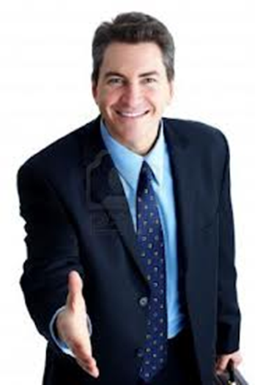
12. Determine Your Points of Difference
What is your unfair advantage?
Expertise
List to sale/price ratio
Transaction count compared to an average agent

Slide 32
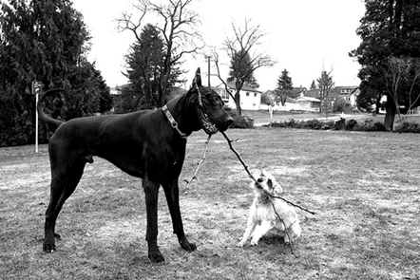
12. Determine Your Points of Difference
Market share
Specific type of property market share
Enthusiasm
Internet marketing expertise
If you are new you can pull into the accomplishments of your brokerage

Slide 33
12. Determine Your Points of Difference
In 60 seconds or less you should be able to highlight…
1. The great majority of the time when the seller took my advice, I was able to sell their property
2. Comprehensive marketing plan
3. Market expertise
4. Market leaders
5. Negotiating skills
6. Strong desire to represent you

Slide 34
13. Improve Negotiating/Closing Skills
Anticipate objections, rehearse, learn scripts, close, close, close
Earning potential is directly related to your closing ability
Some were born to negotiate, others learn how

Slide 35
13. Improve Negotiating/Closing Skills
• Firmness, with passion and most of all with confidence
• Read the seller, especially their nonverbal signs
• You have to be able to listen and hear their reaction
• Always, always, always, acknowledge what their
objections are

Slide 36
13. Improve Negotiating/Closing Skills
• “I can appreciate that…I agree…I understand…That’s a valid concern.”
• Caution about using the word “but.”
• Once you have said “I agree” or “I understand,” you can use the word ‘and’ as a segues.
• If you can, have them to tell you specifically what causes them to feel that way, what causes them to believe that.

Slide 37
13. Improve Negotiating/Closing Skills
You must learn the power of reversing
a) Good question. Why did you bring that up just now?
b) That’s an interesting question, and the reason you asked is?
c) That makes sense. Why is that important?
d) A lot of people ask that. Can you tell me why you asked that just now?
e) I am glad you asked. What if I said I can deliver what you asked?
f) I understand, if you were me, what would you do?
g) That sounds important to you, if we could provide that, what would be the next step?
h) That’s an excellent question. I really want to make sure that I understand what’s important to you. Please give me a specific example of what that looks like.

Slide 38
13. Improve Negotiating/Closing Skills
Prospect: I believe that there’s a good chance that we will list our house with you.
Salesperson: I appreciate you telling me that. I’m curious, however. When you say, “good chance,” what does that mean?
Prospect: We’re inclined to list our house this spring.
Salesperson: That’s great. Let me ask you something. When you say “inclined,” what does that mean?
Prospect: We’ll be making our decision very soon.
Salesperson: I appreciate you sharing that information with me. When you say, “very soon,” what exactly does that mean?

Slide 39
14. Develop Your Elevator Speech
The best elevator speeches are specific: Who do you help? How? What results do you provide?
Most people hire me for one of three reasons:
One, they are concerned about getting full market value for their home
Two, they have a fear their house may not sell in the time frame they would like, and
Three, they were upset that the last realtor they hired did not make them feel like a priority

Slide 40
14. Develop Your Elevator Speech
Clients come to us for a variety of reasons, but most often they come because:
They are frustrated by the challenging real estate market
They are concerned they may leave hard earned dollars on the table
They are overwhelmed by the entire real estate sales process
They are upset that their previous Realtor did not make them a priority
They are afraid / terrified they will make a big mistake
They are worried that not all Realtors understand how to sell a high-end home or a vintage home
They are concerned about not maximizing the money they receive in a very challenging market
They are pressured to sell quickly, and they want someone who understands what needs to be done so they do not get trapped
First- time home buyers come to us because they are overwhelmed by the entire home buying process
They doubt they will find someone they can trust

Slide 41
15. How Do You Want to Be Known?
What is your professional equity?
Your reputation: honesty, integrity
Your expertise
Your education
Your care and compassion
Kindness

Slide 42
15. How Do You Want to Be Known?
People like to do business with people they like and trust
Always remember making a difference is more important
than making a dollar
If you focus on your client’s needs, and not yours, you will
build a lasting solid relationship

Slide 43
15. How Do You Want to Be Known?
Befriend every agent in a negotiation – thank them for their effort showing your property and making an offer
It is important that every professional you work with in the process respects you
They are all great referral sources

Slide 44
The Dash
Man speaks at the funeral of a friend. He refers to the dates on her tomb stone from the beginning to the end.
He said what mattered most of all was the dash between those years. For that dash represents all the time that she spent alive on earth and now only those who loved her know what that little line is worth.
For it matters not, how much we own, the cars, the house, the cash, what matters is how we live and love and how we spend our dash.
1963- ?

Slide 45
The Dash
You never know how much time is left.
Slow down and always try to understand the way other people feel.
Be less quick to anger and show appreciation more and love the people in our lives like we’ve never loved before.
When your eulogy is being read with your life’s actions would you be proud of the things they say about how spent your dash?

Slide 46
16. Manage Professional Stress
Understand how to mange the real estate listing and selling process
Understand how to manage the agent you are co-brokering with- we are all different
Self evaluate what creates the stress- lack of knowledge, self confidence, ok ness, communication, organizational skills

Slide 47
17. Get Out of Judgment and into Curiosity
If some thing does not seem right, or if someone seems unnecessarily or uncharacteristically short or rude do not punch back - ask questions
Kindness is magical, free and powerful
No one has a perfect life
No real estate company is perfect
No human is perfect
Do not let gossip, pettiness and “it’s all about you”, distract you from being uber productive and focused

Slide 48
18. Do Not Make Anyone in Life Feel Not Ok
People learn by the time they were five years old (and they hope you never learn) that they are not OK. They have spent 75% of their life covering that up
Everyone is fighting for Ok-ness
Help people feel OK. A seller or buyer is not going to work with you if you make them feel more not OK

Slide 49
19. Implement and/or Work Your Client For Life Program
NAR stats: By year 4 did not know Realtor’s name
Move on average 7 years
Existing business is more valuable and less stressful
than new business
“View all customers as beautiful gardens that must
be cultivated and watered frequently”
Focus on being a referred agent.

Slide 50
20. Show Appreciation and Gratitude
How do we feel when someone thanks or appreciates us?
A handwritten note, a phone call, a text or an email daily is a difference maker.
One of our top agents sends (4) handwritten notes a day! 48 weeks x 5 days x 4 notes a day = 960 signs of appreciation and lots of repeat and referral business.

Slide 51
20. Show Appreciation and Gratitude
The more you appreciate – the more you give – the more you get
Being more grateful more often makes us happier and more optimistic
Gratitude also adds to the bottom line - it requires little time and no money
Gratitude attracts what we want, improves relationships, reduces negativity, improves problem solving skills, and helps us learn

Slide 52
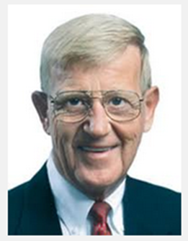
No matter how bad someone has it, there are others who have it worse. Remembering that makes life a lot easier and allows you to take pleasure in the blessings you have been given.
Lou Holtz

Slide 53
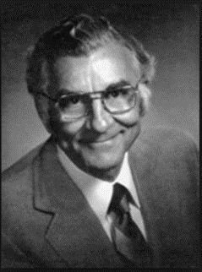
If you don’t think every day is a good day, just try missing one.
Cavett Robert

Slide 54
21. Laugh a Lot. Have Fun Daily. Be Positive.
We function best when we laugh a lot and are happy
Laugh for seven seconds upon awakening
When I choose to smile, I become the master of my emotions
Remember: Positive energy attracts other positive energy. Run from negative people. Be positive.

Slide 55
22. Create Raving Fans
Out of your: family, friends, clients and colleagues
When you have a happy home you can focus and concentrate at another level
You have to be able to keep time and activities with children, spouses, significant others in balance with your work

Slide 56
22. Create Raving Fans
Clients:
Greatest referral source
Creating trust is critical
Colleagues:
The more you give, the more you will receive

Slide 57
23. Extra Degree of Effort
At 212 degrees water boils and then turns to steam and steam powers a locomotive.
The results of one degree more of effort over a year or a career can lead to extraordinary results.

Slide 58
24. Let Your Confidence Be Your Difference Maker
Those that are more confident in their abilities have a greater chance of success
We are the gifted kids – the best of the best
None of us can change yesterday but we can make the most of today and the future
We have to constantly unlock our potential because the potential for much greater things is inside all of us
Go around, go over, never give up!

Slide 59
When you believe and think “I can,” you activate your motivation, commitment, confidence, concentration and excitement – all of which relate directly to achievement.
Dr. Jerry Lynch

Slide 60
25. Determine Your Actions/Next Steps Based On WIN
What one single change in your career, business, lifestyle would boost you to the next level?
Visualize how your life would change as a result of accomplishing this goal. What would you be doing, seeing and feeling?
Focus on always taking your next action based on what is important now and you will have a great chance of winning the majority of the days, weeks and months so you end up with a great next 12 months.

Slide 61
Procrastination is opportunity’s
natural assassin.
Victor Kiam

Slide 62
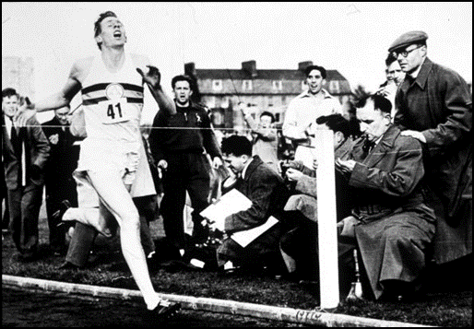
Adversity causes some people to break; others to break records.
William A. Ward

Slide 63
You can have total success when you balance your physical, mental and spiritual, as well as your personal, family and business life.
Zig Ziglar

Slide 64
Perseverance
Go over,
Go under,
Go around,
Or go through,
But never give up.

Slide 65
Excellence
Excellence is not an act. It’s a habit.
Aristotle

Slide 66
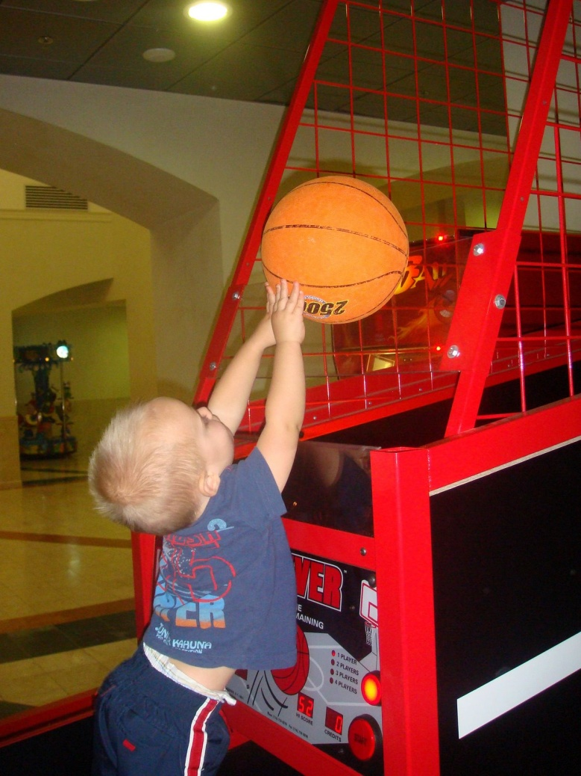
Take a Shot
You’ll always miss
100% of the shots
You don’t take.

Slide 67
Take Action
You cannot discover
new oceans unless you
have the courage to
lose sight of the shore.

Slide 68
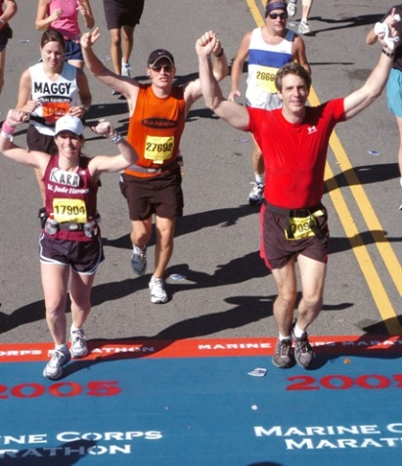
Concluding Thoughts
You don’t have to be great to start,
but you have to start to be great.
Joe Sabah

