Slide 1
Win The Listing Scripts For Success: Luck Favors The Prepared!

Slide 2
Some Overall Comments
Most objections will repeat themselves over
and over during your career
b) In order to Win Listings you need to be able to
master objection handling with knowledge
and confidence
c) You have to tune in to non-verbal signs

Slide 3
Some Overall Comments (Contd.)
d) You have to learn to be a great listener –
There is a reason God gave us two (2) ears
and one (1) mouth
e) They must feel that you are focused on
what’s most important to them - you have to
build their trust
f) You have to learn to mirror their personality profiles

Slide 4
Some Overall Comments (Contd.)
g) Always, always, always acknowledge their
objections -
I can appreciate that, I agree, I understand, That’s a valid concern
I caution you against using the word “but “ when you are acknowledging their concerns as it may appear like you are challenging them

Slide 5
Some Overall Comments (Contd.)
After you have said I agree, or I understand you can use the word “and” as a segue into your comment
That way you will be able to smoothly transition into your objection handling
You may also consider asking them to be specific about how they feel or what is making them feel that way…reversing

Slide 6
Some Overall Comments (Contd.)
You also may ask a question along the lines of feel, felt, found - Has there ever been a time you felt like this?
We need to do whatever we can to connect with them - to gain their trust and confidence to Win the Listing

Slide 7
Some Overall Comments (Contd.)
Not all of our responses to objections will be handled the same way because we have to read the individuals we are dealing with and what the overall situation may be
What should be consistent is our professionalism, our demeanor and our confidence!

Slide 8
The Listing Conversation
Not all realtors are the same
We must find and agree on the most appropriate price entry point
We each have rules with specific expectations
Telling sellers you are different and can add more value isn’t enough…You must allow them to self- discover what a working relationship with you will be like…It’s the way we handle ourselves, how we speak, how we make them feel

Slide 9
Set The Tone
Confidentiality
Great. I want you to rest assured that anything said here tonight will remain totally confidential. So, please feel free to be as open and as honest with me as you feel you can be! Is that fair?

Slide 10
Transition to CMA
Pricing Dialogue
You see MR./Mrs. Seller, there are three basic sheets in real estate: the sold sheet, the dream sheet and the expired sheet.
The sold sheet represents what we can expect to get in this area at this time! 100% of the people on this sheet have already achieved what you are trying to achieve – they’ve sold their home!
The dream sheet is our competition and tells us what people are hoping to get in this area at this time. What most people do not realize is that only about 70% of the dreamers actually make it to the SOLD sheet the first time around.

Slide 11
Introduce CMA Summary Pages
The other 30% go to the dreaded expired sheet. This is the sheet of rejected properties and tells us what people are not willing to pay in this market.
Do we want to position ourselves in a way where we are expecting to sell the home or hoping to sell the home?
“Expecting of course!”
Then based on the needs we covered tonight, we should primarily focus on the sold sheet to determine our price.

Slide 12
Agree on the Marketing Plan
It’s important to gain agreement each step of the way!
After reviewing my marketing plan, do you feel your home will be well exposed and promoted?
Is there anything in this plan that concerns you or that you would like to change?
Once you have gained agreement on your role as consultant, change the focus to their role as a cooperating seller.

Slide 13
Common Objections

Slide 14
1. Price Is Not High Enough
Can you please tell me what you mean by the price is not high enough?
I totally understand how you feel
Almost every seller I’ve represented felt the same way
We all found it was not up to us – the market dictated
Buyers are experts on market value in your price range

Slide 15
Strong Market Knowledge
MLS DATA
Absorption stats
Average time on market
NAR stats 10-15 showings
Sell the house 4 times

Slide 16
2.Never Talk Commission Rates Over The Phone!
“What Do You Charge”
I will absolutely cover that with you in person once I understand your needs, what’s most important to you and I have seen your home.
Does that sound fair?

Slide 17
3. Want To Pay Less Commission

Slide 18
One of the four important items you control
Relocation companies, banks
Office policy – my policy

Slide 19
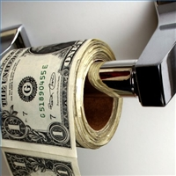
Why most sellers never question my fee
If an agent will reduce their professional service fee for you, what will they do for you when they negotiate?

Slide 20
“Will You Work For Less?”
I guess I could, but if I gave up my money that easily you wouldn’t respect me
as a businessman or trusted advisor.
And if you don’t respect me as a businessman (woman) or your trusted advisor, you sure don’t want me handling a large financial transaction like this for you.
After our conversation tonight, do you feel I have the knowledge, skills and expertise to sell your home?
Do you see more value in my approach?
Great, then shouldn’t we move ahead with this?

Slide 21
4. I Only Want A 60-90 Day Listing

Slide 22
Why and be quiet listening for the answer
You are in control of: price, condition, commission
The average market time is 90 days + 60-90 days from the time you get an offer and we are required by law to have the property in listing contract until the time of closing
The minimum listing period our office / I take is 180 days…

Slide 23
“We Want To Sign A Three-Month Listing Agreement”
I would like to list the home for six months and give you an easy-exit clause!
What that means is that in the special provisions of the contract, we’ll state that if at any time you become dissatisfied with my service or with me as a professional, you would notify me and if I can not rectify the issue you can terminate the agreement with 48 hours written notice.
Does that sound fair?
Only agree to this when it’s the difference between taking the listing and not.
And also add
If a seller or broker becomes dissatisfied with the other party’s services or promises to perform, they must notify the other party and if they cannot rectify the issue, they can terminate the agreement with 48 hours written notice.
© David Scott 2012-2015 All Rights Reserved

Slide 24
5. Have A Friend/Relative In The Business

Slide 25
If Objection Comes During The Conversation
1. Why exactly am I here?
2. Can I ask you a few questions?
3. How good are you at separating business and friendship?
4. How good is your friend at separating business and friendship?
5. Did your friend sit down with you and uncover your needs?
6. Did your friend show you the plans and strategies needed to sell your home?
7. Did your friend thoroughly discuss the expectations for each of your roles in a
business relationship?
8. Do you see value in these things?
9. In the event your friend doesn’t meet your expectations, will you be able or
willing to fire him/her?
If “No.”
“How can you hold him/her accountable?
© David Scott 2012-2015 All Rights Reserved

Slide 26
6. I Want To Fix It Up Before We List

Slide 27
Let’s do the paperwork now and we will submit to MLS when you are ready
Your buyer may be in town this weekend while you are cleaning the yard
Let me get the word out to my office and my buyer network and sphere of influence so we do not miss out on what may be your perfect buyer

Slide 28
7. I Want To Build In Negotiating Room

Slide 29
First two weeks are critical
Market dictates value
Fishing frenzy

Slide 30
8. I Can Always Come Down In Price

Slide 31
Everyone can but I do not think it will be in your best interest
A reduction might go unnoticed
Chasing the market

Slide 32
9. We’re Not Giving It Away

Slide 33
I totally agree you should not
Do we agree the market changes
If you bought stock at $100 and today it is selling at $80…

Slide 34
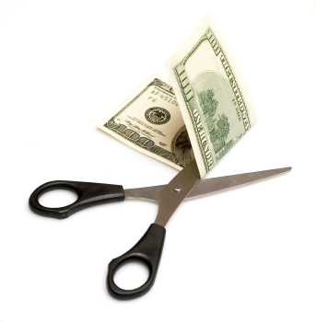
10. If I Sell With You And Buy From You
Will You Lower Your Commission?

Slide 35
NO…Do you think I should? Can I ask why?
Two transactions: two knees, two hips, two cavities
Two separate goals:
Selling – highest value
Buying – lowest value

Slide 36
11. You Do Not Handle Homes In My Price Range

Slide 37
Tricky if you do not handle higher priced properties
Demonstrate your knowledge by learning the market
Most important they trust you and your knowledge

Slide 38
12. I Want To Know Where I’m Going Before I Sell
That would be ideal
2 houses very risky for most
Sale is subject to finding satisfactory housing
Price properly and we will learn the market simultaneously

Slide 39
13. We Promised Two Other Agents We Would Interview Them Before We Make A Decision
Can I ask you a few questions?
If you had not promised two other agents would we be filling out the paperwork right now?
If yes, there is a reason for that - comfort, trust and having an expert is critical today

Slide 40
If no – what did I say that was not acceptable (isolate the objection)
Let me explain why
I will cancel the other appointments

Slide 41
14. Why Should I List With You If You Never Showed The Property When It Was On the Market Before

Slide 42
My job is to execute a marketing plan for my seller clients
I will most likely not be the agent that sells the property, but I will be the reason it sells from the exposure I create
I know that is what you care most about – getting your house sold and I believe I can do that

Slide 43
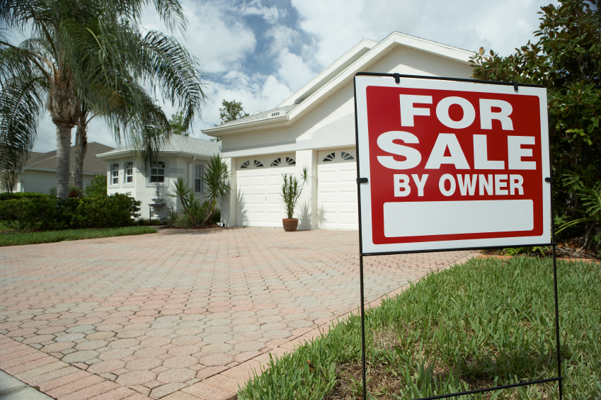
15. We Want To Try To Sell It On Our Own
Why would you want to do that?
Three important things to realize
How marketing and creating massive exposure has changed
Liability exposure
Most buyers want to save the same commission your want to save – who wins

Slide 44
NAR stats
FSBO success rate is declining rapidly
Most FSBO list…

Slide 45
16. Your Office Is Not In Our Town
That used to be a concern
The internet has changed all that
Bricks and mortar offices are shrinking

Slide 46
We all have access to important community and school data at our fingertips
I know how to price and sell real estate
Is that not what is most important?

Slide 47
17. We Want To Think About It
Can you please elaborate
Is there anything I can further explain
What would keep you from getting started right now

Slide 48
Momentum Close
Let’s at least do this. Since we’re here together, let’s complete the listing agreement, and I’ll leave it with you. If you decide you’re ready to put the home on the market when you wake up tomorrow, call me and I will pick it up immediately. This way we don’t waste any more time than is necessary in getting your home exposed! How does that sound?

Slide 49
18. We Cannot Lower Our Price Anymore
I understand
I wish you and I could control what is happening in the economy and specifically in our real estate market

Slide 50
Let’s explore your options
Stay put and wait for the market to come
back
Lower the price – hopefully it works and minimize the damage
My job is to tell you the truth

Slide 51
19. We Will Wait For A Better Offer

Slide 52
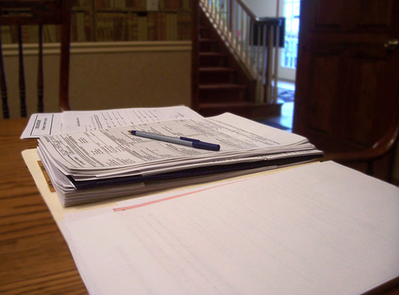
My experience is the great majority of the time the first offer is the best
The Smiths, the Jones, the Dearborns wished they had not waited!
If it’s a unique property you may only get one offer

Slide 53
20. Seller Wants to List Above Competition
We can list high; however that will put us at the high end of the competition.
At the high end of the price range, you can expect to be on the market for longer than I thought you wanted to.
Or at the high end of the market you can expect to be on the market for longer than the average market time and there is always a possibility the market could even move further away from us.
Per your timing need, this option should be unacceptable. Wouldn’t you agree?

Slide 54
Seller:
“We want to list at $275,000 for a few weeks and then come down to $250,000.”
You:
I appreciate that. However, the first few weeks your home is on the market are the most crucial. You see, it’s been my experience if we start the home at $275,000 here’s what is likely to happen.
In the first few weeks we will generate a lot of showing. However, the buyers who will be viewing the home will be buyers who are ready, willing and able to pay $275,000 for a home. They will also be comparing the home to those that are justifiably priced at $275,000. During that process, they will discover they can get more “bang for the buck,” and as a result, buy the larger home.
During these same crucial weeks, there will be buyers who are ready, willing and able to buy your home but will probably never see your home because most agents are not going to show homes that are $25,000 over a buyer’s price ceiling. We will also lose these buyers because they will either buy another home or wait to hear from their agents who many times only search new listings and not price updates.
Doesn’t it make more sense to select a price we can justify so the people who are ready, willing and able to buy will see it?
We really cannot afford to miss a majority of the qualified buyers for your home when their interest is at a peak level.

Slide 55
“We Still Think Our Home Is Better And Have An Unexplained Need To Price It $25,000 Over Market Value!”
Well we could list the home $25,000 over the market value, but in doing so, let me tell you who would become our new target market:
Cash buyers
2. Someone who is willing to pay $25,000 over
market value
How many of these buyers do you think exist?

Slide 56
“Joe Said He Would List My Home Above The Market!”
Let me ask you a few questions:
How did Joe justify his price?
Did he share his numbers with you? Do you have a copy?
Do you think what buyers have done in past buying situations is important?
Do you think Joe was only telling you what he thought you wanted to hear?
Please understand I’m okay with listing the home at $275,000 if we can justify $275,000. Otherwise, I would feel like I was not giving you the best chance of success selling your home
It’s my opinion that Joe has agreed to take your listing at such a high price because he wants to use your home as leverage!

Slide 57
Joe will advertise your home, which will generate buyer leads. However, when potential buyers discover your home is overpriced, they will look to Joe to sell them another home!
Win for Joe because he made money! Lose for you because none of your needs are being satisfied!

Slide 58
You must know your walkout price!
“Joe Said He Would List My Home Above The Market!”
Are you saying that you will not list the home with me unless I list it at a price above the market?
“Yes!”
Then here’s my suggestion. I want you to sign a three-month listing agreement with Joe and hold him accountable to HIS PRICE.
WHEN the home doesn't sell, give me a call and I will be glad to come back out!
Would that be fair? (Start packing your materials.)
I mean I would love to take the listing. However, I refuse to do it at a price that I do not believe I can achieve for you.
Before I leave, let me ask you one more question. Do you really have three months to wait?...What’s your plan B?

Slide 59
21. Never say no until you know what
you are saying no to!
Any objection, question or concern that happens during the solicitation can be overcome with the following dialogue:
Let’s have a conversation. If at the end of our conversation you still (see dialogue below), I won’t list the home. However, by meeting with me you may find you can get all you want and more! We won’t know, though, until we’ve had a conversation.
If at the end of our conversation you still feel like it’s not a good time to sell…
If at the end of our conversation you still feel like I’m not worth what I charge…
If at the end of our conversation you still feel like my office is too far away…

Slide 60
If at the end of our conversation you still want to list with your friend…..
If at the end of our conversation you still feel a need to go FSBO…..
If at the end of our conversation you still see no difference between the others and me…..
If at the end of our conversation you still feel I’m too inexperienced…..
If at the end of our conversation you still feel like I can’t handle the job…..
Etc.

Slide 61
When you prepare well
Your luck increases,
Your confidence increases,
And your success increases.
Prepare well.
Jeff Wright

Slide 62
Concluding Thoughts
You don’t have to be great to start, but you have to start to be great.
~ Joe Sabah

