Slide 1
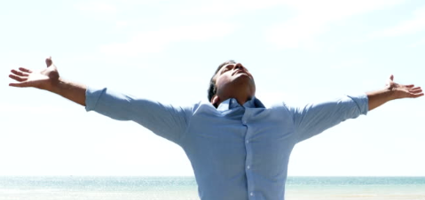
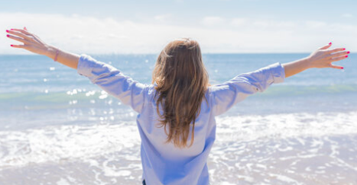
11G

Slide 2
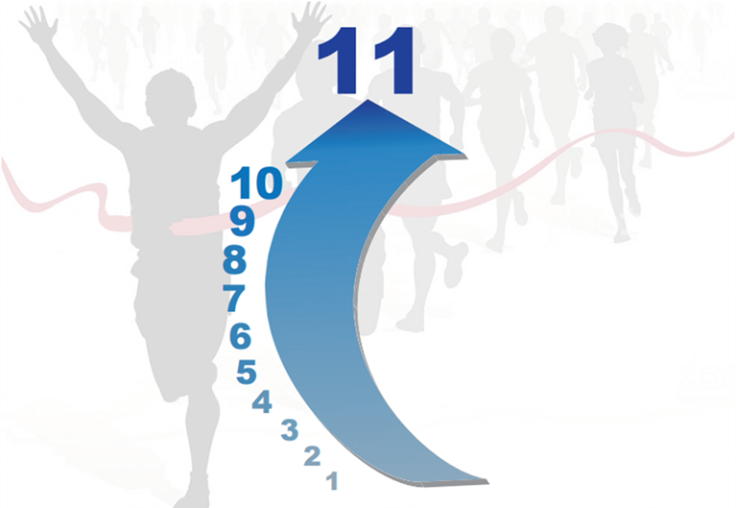
11 Another Level Within Us of G - Greatness

Slide 3
G is My Favorite Letter
G
God, Great, Gratitude, Grow, Give……….

Slide 4
Why?
Help Others
Family Member, Friend, Colleague, Trusted Advisor
Greatness is within all of us

Slide 5
Two Things to Know
My internal mission statement
My belief system

Slide 6
Curriculum Design
Knowledge
Inspiration
Motivation
Mindset
Improved Health
Weekly Video
Monthly Program
Guests

Slide 7
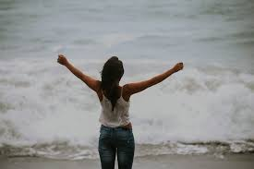
Greatness is Different for Everyone
Your own greatness DNA
Different callings in life
Beauty is inside of everyone

Slide 8
Be Yourself
You can not be something you are not
Who are you growing into
Human gifts are different, even invisible

Slide 9
What We Will Explore
Power of You Connection
G Words
Perspective
Jeff’s Guideposts
Life Lessons
Opposites
What If
Barriers
Stories

Slide 10
Power of You: Open Your Mind
You can be great

Slide 11
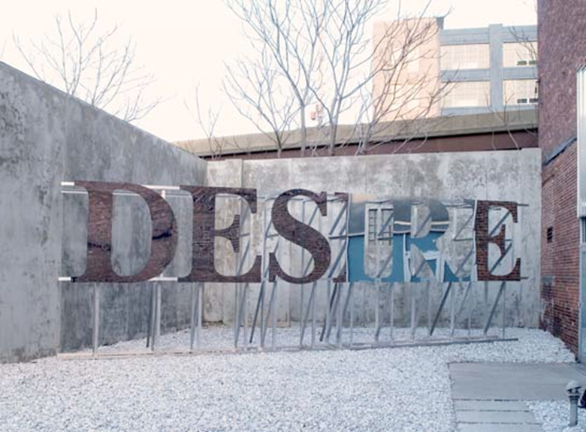
Power of You: Desire
Intense burning desire
What are your goals?

Slide 12
Power of You: Belief
Absolute faith and total expectation
All you control are your thoughts
Believe you can

Slide 13
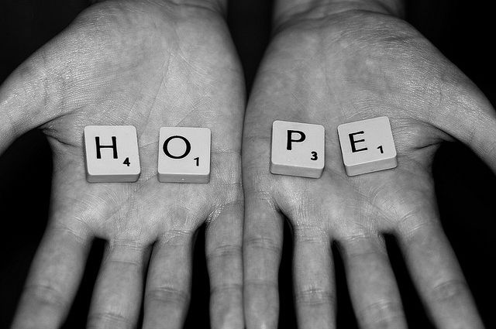
Power of You: Hope
Hope is vital

Slide 14
Power of You: Change
Change is constant
There is no growth without change

Slide 15
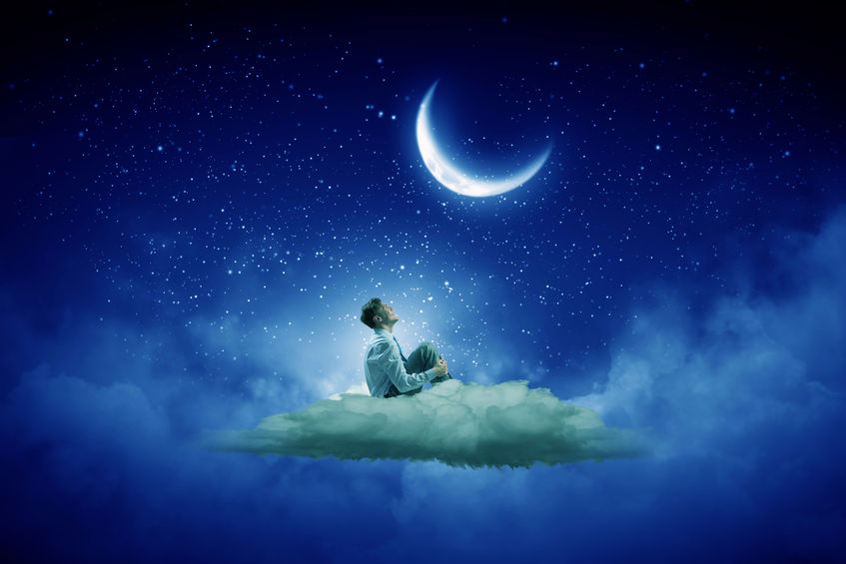
Power of You: Dream
Do not be afraid to dream like a child

Slide 16
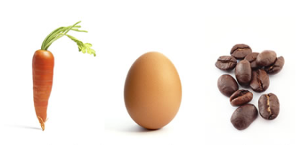
An 11G - Type Story

Slide 17
G Words

Slide 18
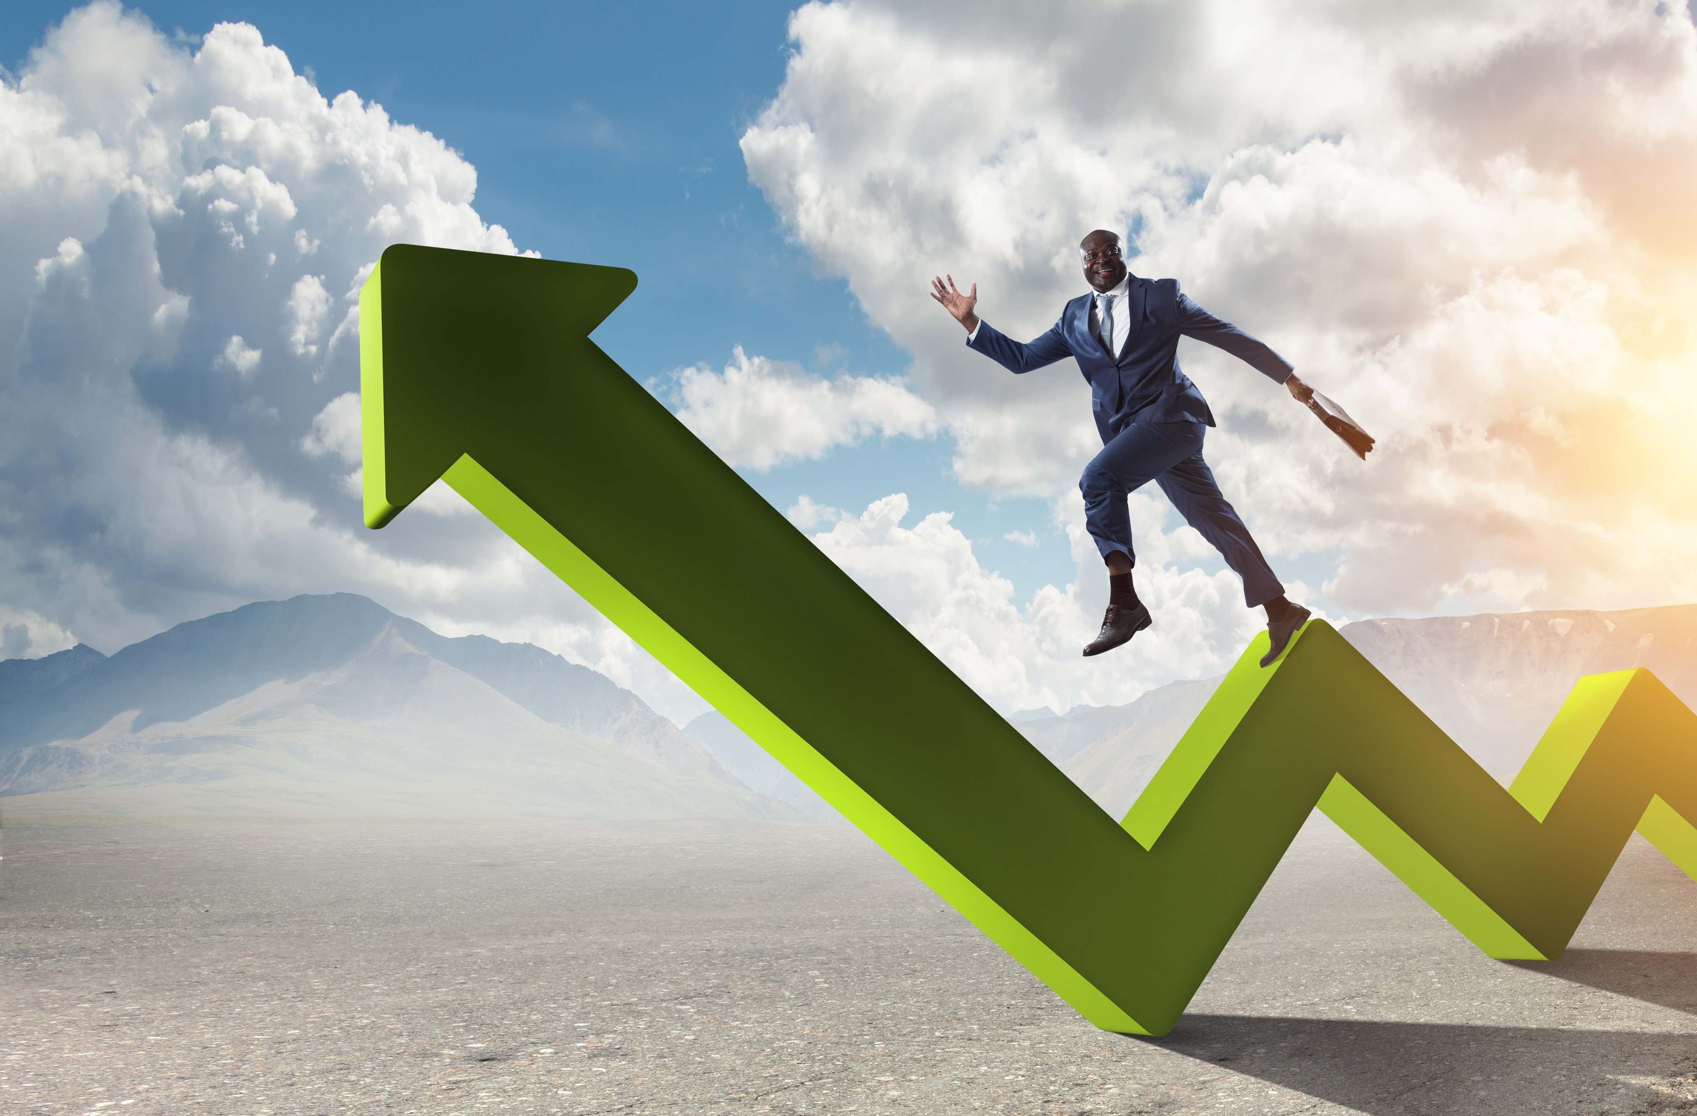
Greatness: Progress > Perfection
Perfection does not exist
Everyone fails
Everyone has challenges
99.99% of us are capable of more

Slide 19
What Can You Control?
Effort
Mindset
Preparation
You have the key

Slide 20
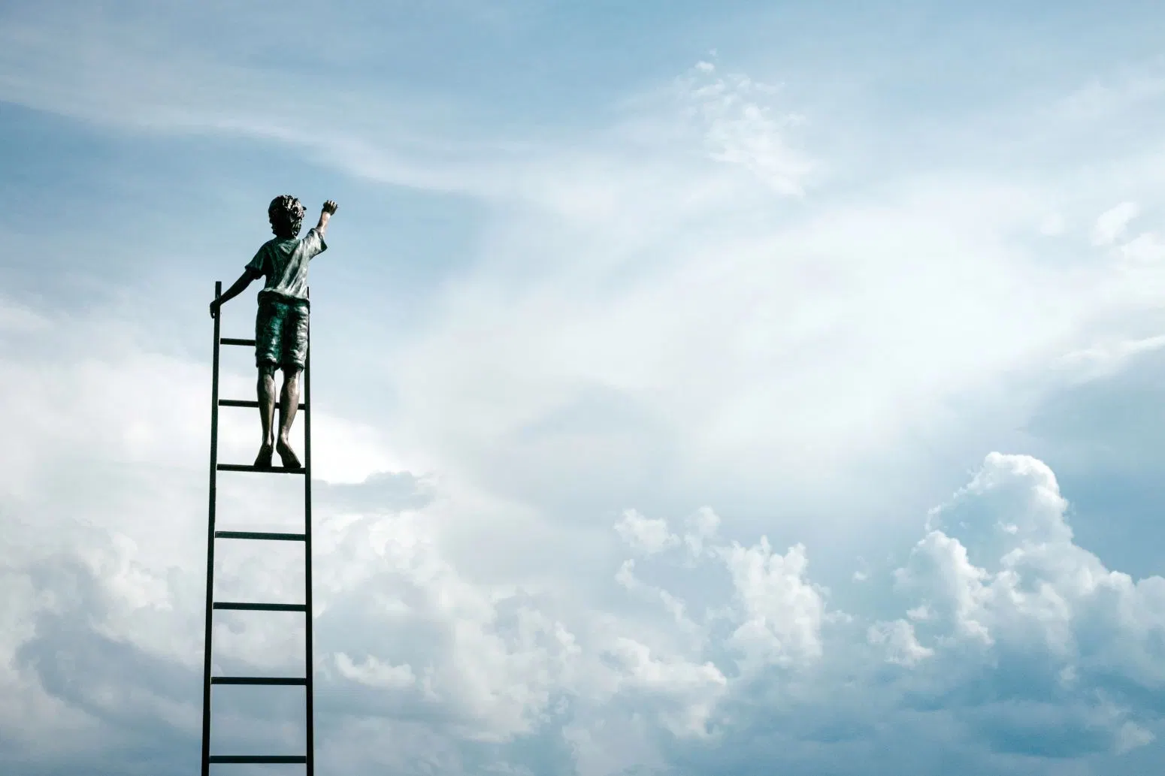
What Do You Really Want?
Higher star
Clear eyes
Power of suffering

Slide 21
Change, Expand, Grow
Be thankful
Retool
Opportunity knocks

Slide 22
Everyday Contributions
Small acts of kindness

Slide 23
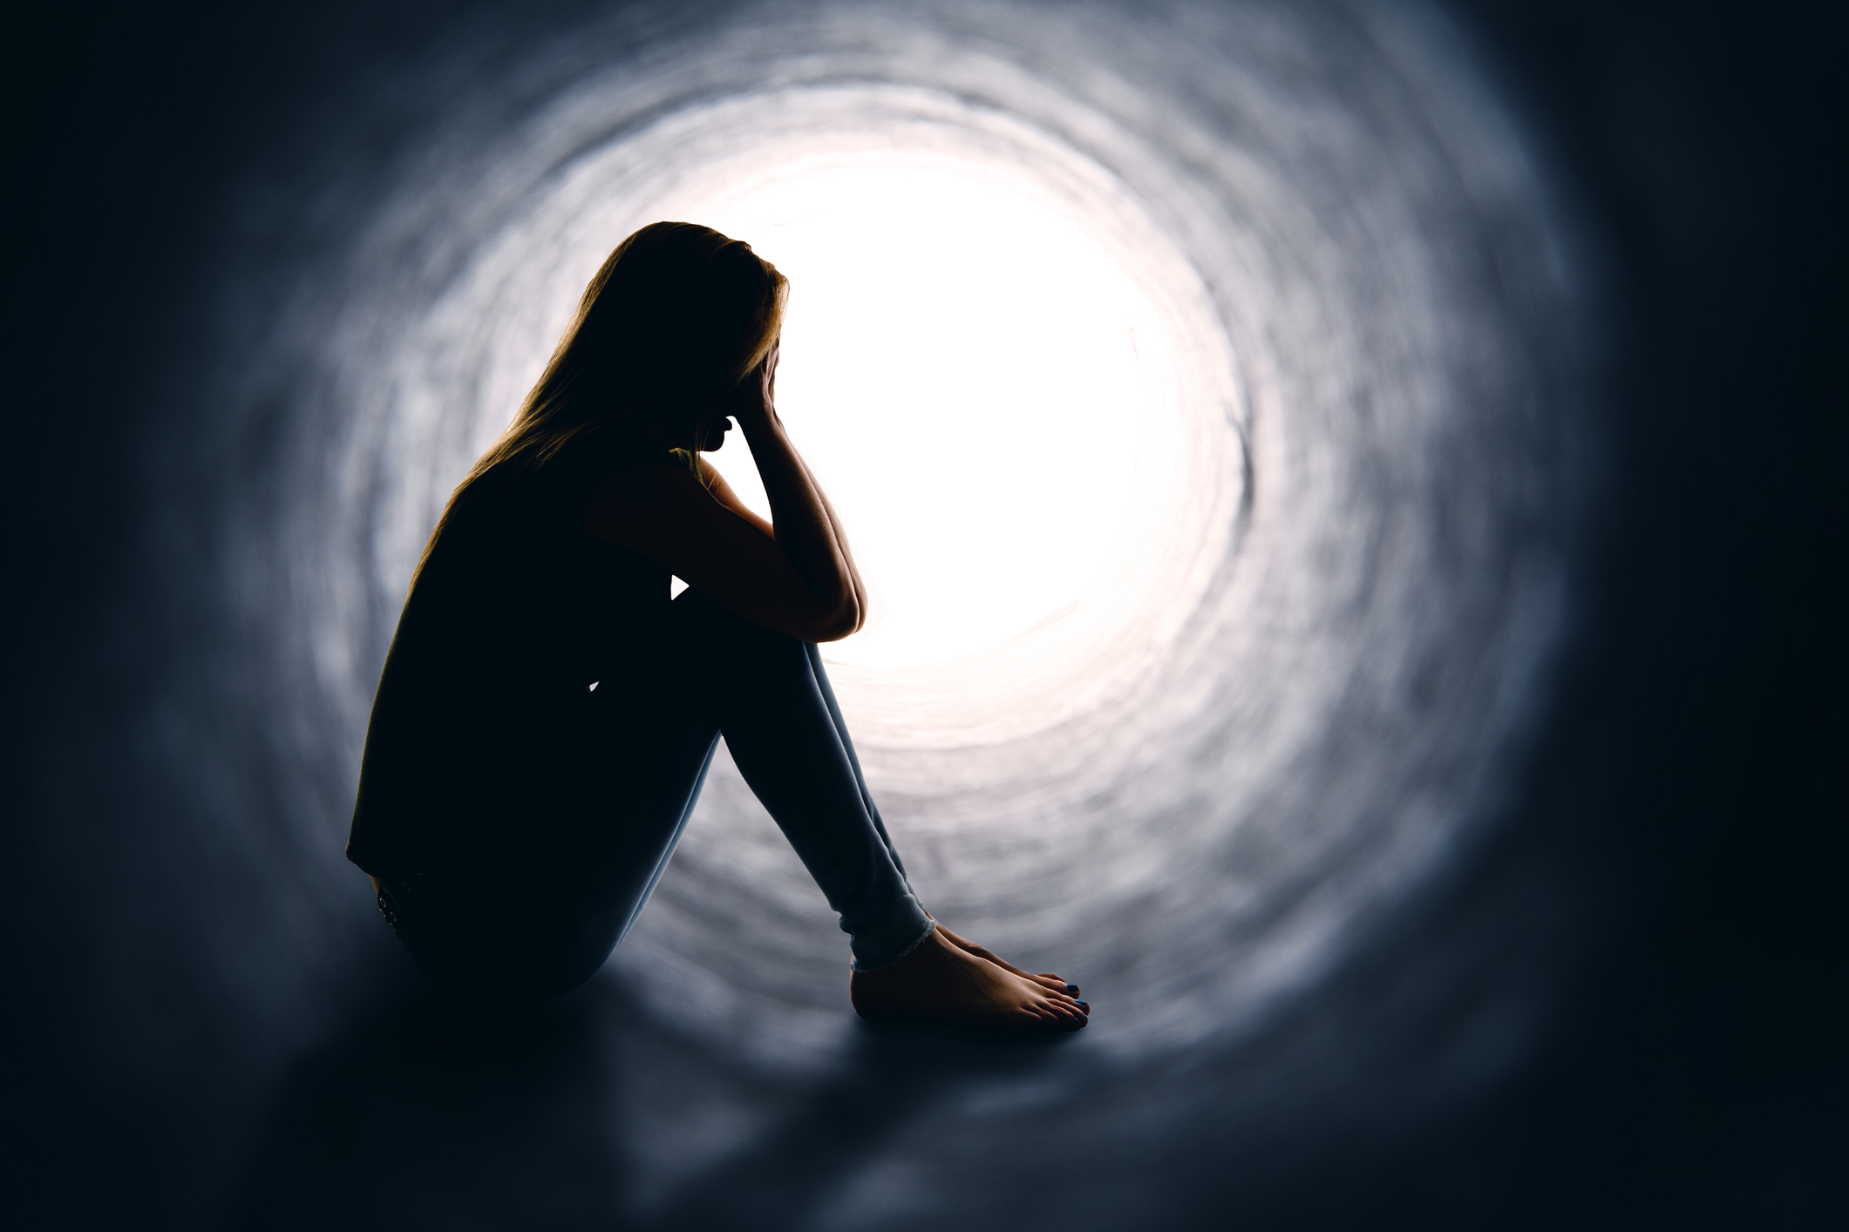
Regret
Regrets stink
They can be with us a lifetime
Be the best you can be
I am glad I did

Slide 24
“I Found a Different Route.”
Do you need to change your course?
Who is learning from us?

Slide 25
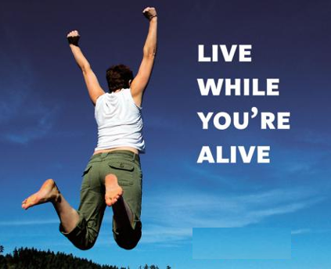
Jeff’s Guideposts: Live While You Are Alive
Everyone dies, but not everyone lives
In a voice recording, do you recognize who you hear

Slide 26
The Speed of Life
It’s Gone in a blink
I failed over and over in life
Impossible is what someone cannot do until someone has done it

Slide 27
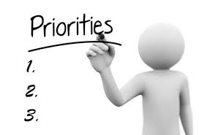
What is Most Important?
Keep the most important things the most important
No one can tell you that you can only be so Great

Slide 28
Where Are You Focused?
Your Gifts
Good is the enemy of Great

Slide 29
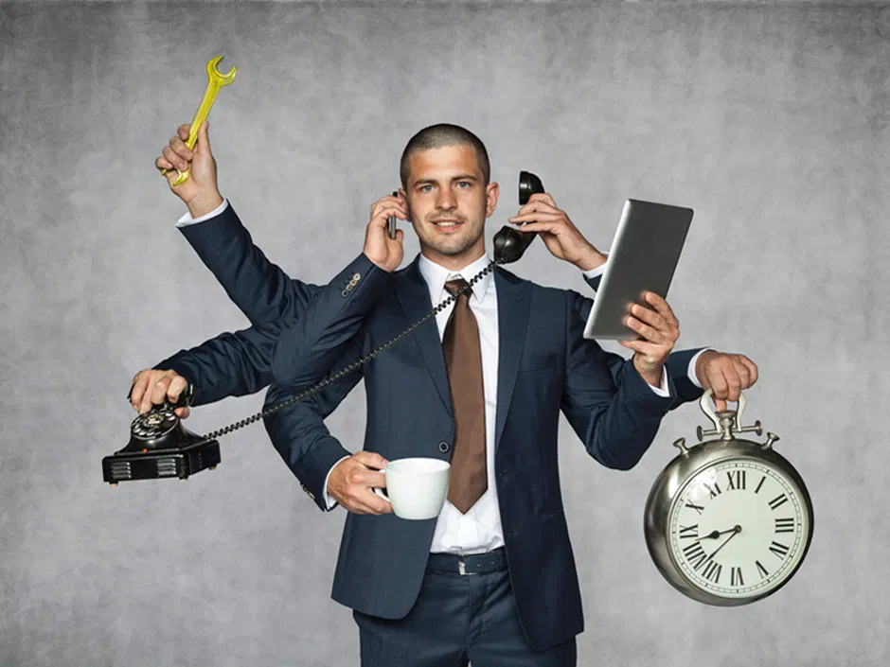
I Can’t Do It Alone
No one does
Prepare for Greatness
The mountain echo

Slide 30
Mirror, Mirror, On the Wall………..
Find the best in others
Be honest with yourself
Greatness mantra…..I can…..

Slide 31
Lean on Me
Share hard things
We all struggle
Your time is now

Slide 32
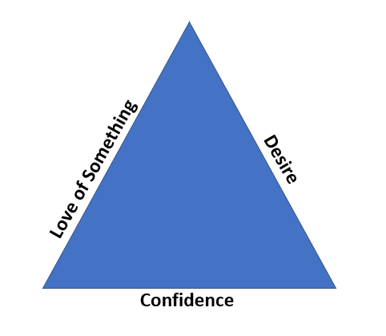
Greatness Triangle

Slide 33
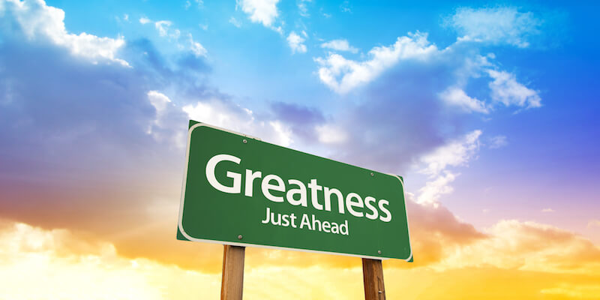
Life Lessons: Foundations for Greatness
Loving parents
No excuse, sir
I can
Daily mass
Taps
Pain
Kindness, support

Slide 34
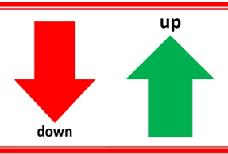
Opposites
Failure/Success
No/Yes
Hate/Love

Slide 35
What If?
Medical diagnosis
Took a chance
No led to Greatness
Your last day was coming
You knew you could do more
Burn the ships

Slide 36
Ask
For what you want

Slide 37
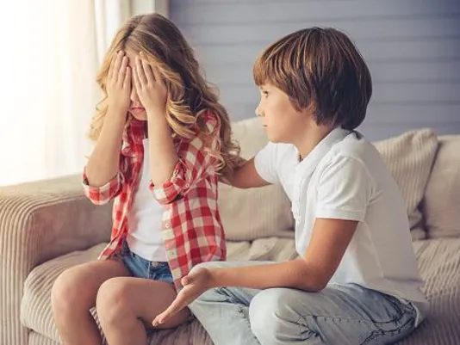
Apologize and Forgive
I am sorry
I forgive you
Learn to live each day as if it were your last….. Someday it will be.

Slide 38
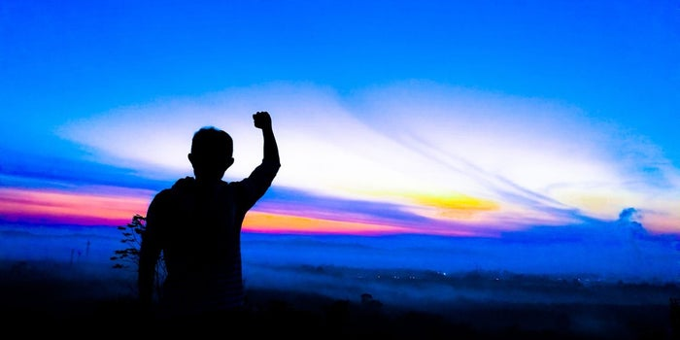
Greatness Barriers
Darkness inside
Use your talent
Ignore someone’s opinion of you
Do not let the past consume you. Be great today and in the future.

Slide 39
11G Stories
Wanda, the nun
My sister, Allison
The batting cage

Slide 40
Effort Matters
What are you willing to do?

Slide 41
In Closing

Slide 42
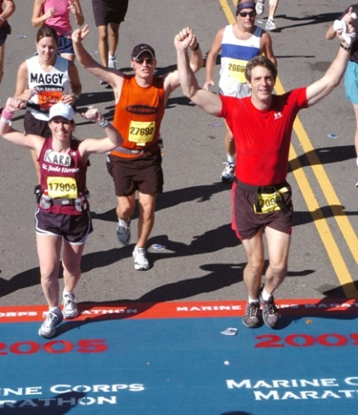
11G - Be Great!
You don’t have to be great to start,
but you have to start to be great.
Joe Sabah

