Slide 1
The Power of You: Think and Grow Rich

Slide 2
The First Step
DESIRE
All achievement, no matter what may be its
nature or its purpose, must begin with an
intense, burning desire for something definite.

Slide 3
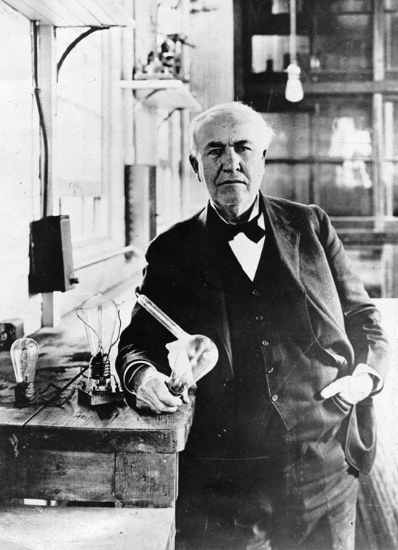
Thomas Edison dreamed of a lamp that could be operated by electricity.
Despite more than ten thousand failures, his dream became a reality.
Practical dreamers do not quit.

Slide 4
Task 1: Exact Amount of Money
How did you decide on that particular amount? What will that money be used for?
Pay off debt, pay off the mortgage, cover college fund, peace of mind, security?

Slide 5
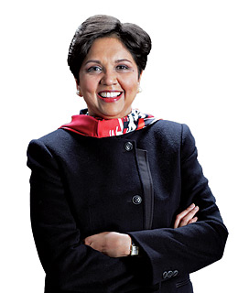
Task 2: Intention to Give
Why do you choose that particular way to give?
Examples: I’ve always wanted to work with children/homeless/the needy; It makes me feel like I’m part of a community; It makes me feel generous; It makes me feel like I have something to give.

Slide 6
Task 3: A Definite Date
Why that date? What is its significance?
Examples: It corresponds to a national day of independence or thanksgiving that you want to claim for yourself; It is any anniversary of an important date in your life, etc…

Slide 7
Inspiration for Success
If you think you are beaten, you are,
If you think you dare not, you don’t,
If you like to win, but you think you can’t,
It is almost certain you won’t.
If you think you’ll lose, you’re lost,
For out of the world we find,
Success begins with a fellow’s will-
It’s all in the state of mind.
If you think you are out casted, you are,
You’ve got to think high to rise,
You’ve got to be sure of yourself before
You can ever win a prize.
Life’s battles don’t always go
To the stronger or faster men
But sooner or later the man who wins
Is the man who thinks he can.

Slide 8
Task 4: A Definite Plan
Create a definite plan for carrying out your desire and begin at once.
Put this plan into action, whether you are ready or not.
You can never have riches in great quantities without a white heat desire for money, and a belief you will possess it.

Slide 9
Task 5: Statement of Desire
Write out a clear, concise statement of the amount of money you intend to acquire, name the time limit for its acquisition, state what you intend to give in return for the money, and describe clearly the plan through which you intend to accumulate it.

Slide 10
Task 6: Read Your Statement Aloud Twice Daily
All who have accumulated great fortunes were dreamers first.
There is a difference between wishing for a thing and being ready to receive it.
No one is ready for a thing until he believes he can acquire it.

Slide 11
The Second Step
FAITH
Faith is a state of mind which may be induced or created by affirmation or repeated instructions to the subconscious mind through the principle of auto-suggestion.

Slide 12
Every man is what he is because of the dominating thoughts which he permits to occupy his mind.

Slide 13
Any idea, plan, or purpose may be placed in the mind through repetition of thought.
Thoughts mixed with emotions constitute a magnetic force which attracts other similar or related thoughts.

Slide 14
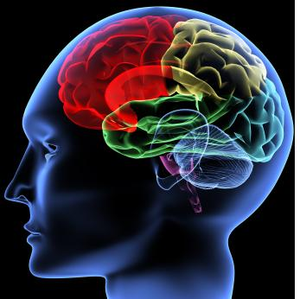
The subconscious mind will transmute into its physical equivalent, by the most direct and practical media available, any order which is given to it in a state of belief or faith that the order will be carried out.

Slide 15
Like the wind which carries one ship east and another west, the law of auto-suggestion will lift you up to pull you down according to the way you set your sails of thought.

Slide 16
The Third Step
Auto-Suggestion
Auto-suggestion is a self-suggestion.
Communicate the object of your desire directly to your subconscious mind in a spirit of absolute faith.
Repetition creates habits which are favorable to your efforts to transmute desire into its monetary equivalent.

Slide 17
Understanding the Subconscious Mind 1: Dominating Thoughts
What are the dominating thoughts that you carry with you day in and day out?
Examples: Life is too hard; I’m not a lucky person, I’m too old, etc…

Slide 18
2: Guarding Your Thoughts
What thoughts and beliefs do those around you hold that you need to guard against?
Examples: Life is limited; There’s not enough to go around; Be happy with what you have and don’t ask for more; Things are bad and they’re going to get worse, etc…

Slide 19
3: The Rich Garden of Your Mind
The subconscious mind is a fertile garden.
Weeds will grow abundantly if seeds of a more desirable crop are not sown.
Auto-suggestion allows you to feed your subconscious with healthy thoughts.

Slide 20
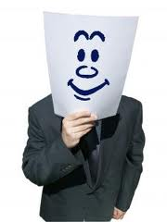
4: Emotionalizing Your Beliefs
When reading aloud the statement of your desire, you must mix emotion or feeling with your words.
Just reading the words does nothing.

Slide 21
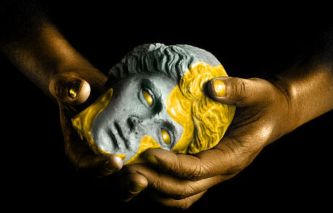
I am open to receive all of life’s riches.
I am the master of my fate, I am the captain of my soul!
Everyday, in every way, I open new doors in my life.
Day by day, in every way, I am getting better and better.
I am prosperous.
I say yes to life, and life says yes to me.
Everything I touch turns to gold.

Slide 22
The Fourth Step
Specialized Knowledge
There are two kinds of knowledge: general and specialized.
General knowledge is of little use in the accumulation of money.
Knowledge will not attract money unless it is organized and intelligently directed through practical plans of action to the definite end of accumulation of money.

Slide 23
Successful men, in all callings, never stop acquiring specialized knowledge related to their major purpose, business, or profession.

Slide 24
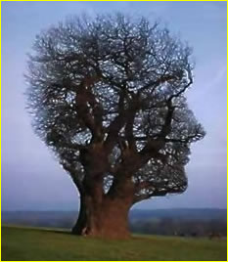
The Fifth Step
Imagination
The imagination is the workshop where all plans are created by man.
Man can create anything which he can imagine.
Man’s only limitation, within reason, lies in the development and use of his imagination.

Slide 25
Desire
Some people foolishly believe that only money can make money.
This is not true!
Money, of itself, is nothing but inert matter. It cannot move, think, or talk, but it can “hear” when a man who desires it calls it to come!

Slide 26
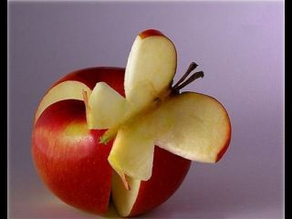
Two Forms of Imagination
There are two forms of imagination: synthetic and creative.
SYNTHEIC IMAGINATION creates nothing. It merely works with the material of experience, education, and observation with which it is fed.
In CREATIVE IMAGINATION the finite mind of man has direct communication with Infinite Intelligence. This is where all basic or new ideas are handed over to man.

Slide 27
The Sixth Step
Organized Planning
Organized planning is the crystallization of desire into action.
No individual has sufficient experience, education, native ability, and knowledge to insure the accumulation of a great fortune without the cooperation of other people.

Slide 28
Ally yourself with as many people as you may need for the creation and execution of your plan.
Decide what advantages and benefits you may offer the individual members of your group in return for their cooperation.
Meet with your group at least twice a week.
Maintain perfect harmony between yourself and your group.

Slide 29
A Quitter Never Wins,
and
A Winner Never Quits!

Slide 30
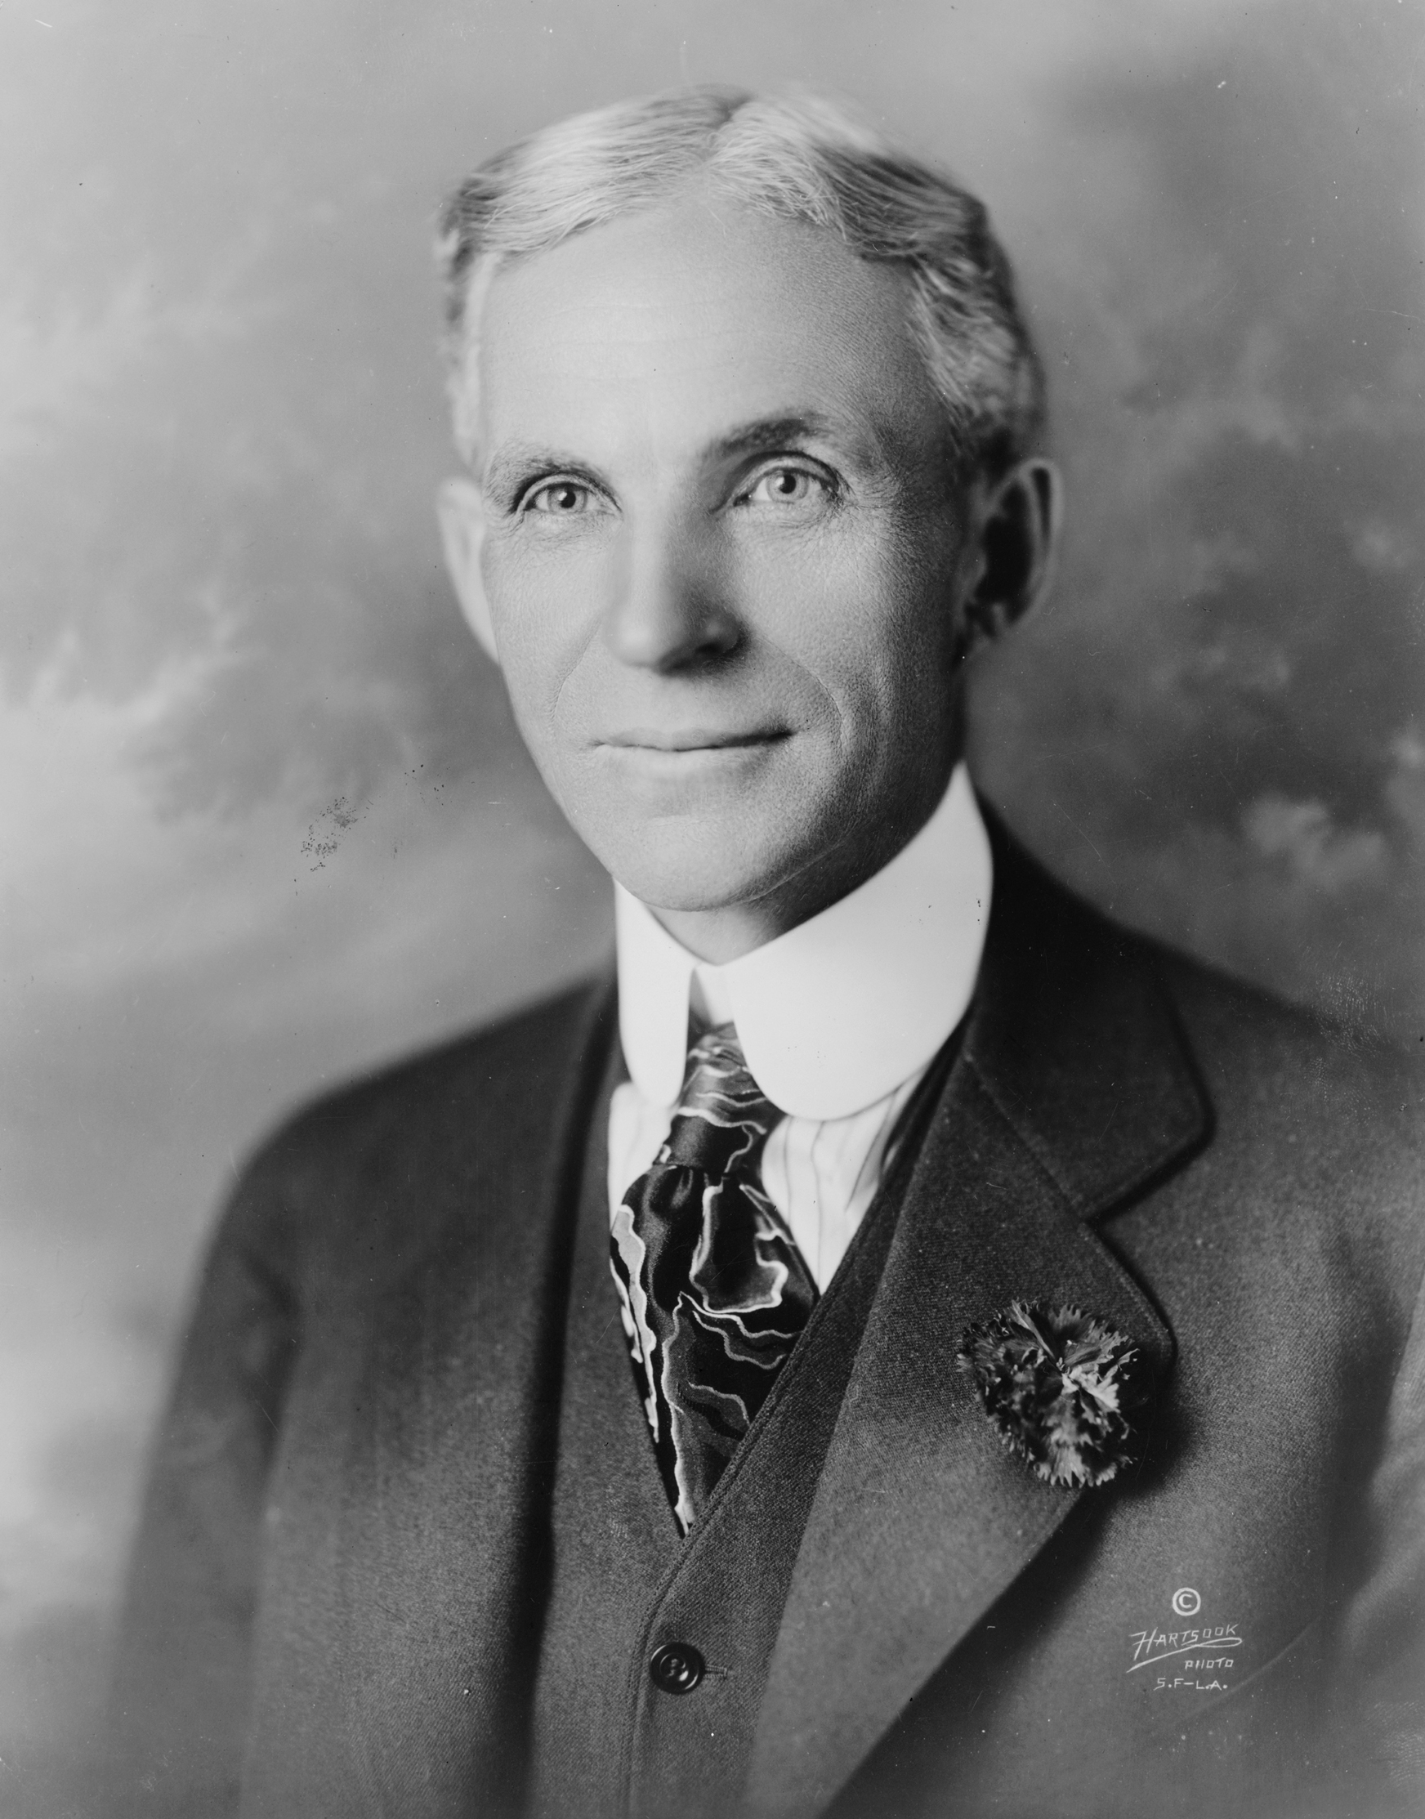
Henry Ford met with temporary defeat, not only at the beginning of his auto-mobile career, but after he had gone far to the top.
James J. Hill met with temporary defeat when he first endeavored to raise the necessary capital to build a railroad from the East to West.
Thomas A. Edison “failed” ten thousand times before he perfected the incandescent electric light bulb.
When defeat comes, accept it as a signal that your plans are not sound, rebuild those plans, and set sail once more toward our coveted goal.

Slide 31
The 30 Major Causes of Failure
Life’s greatest tragedy consists of men and women who earnestly try and fail!
You should know all of your weaknesses in order that you may bridge them or eliminate them entirely.
You can know yourself only through accurate analysis.

Slide 32
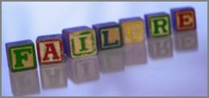
Failure Inventory
Unfavorable hereditary background
Lack of a well-defined purpose in life
Lack of ambition to aim above mediocrity
Insufficient education
Lack of self-discipline
I’ll heath
Unfavorable environmental influences during childhood
Procrastination
Lack of persistence
Negative personality
Lack of controlled sexual urge
Uncontrolled desire for “something for nothing”

Slide 33
Lack of a well-defined power of decision
One or more of the Six Basic Fears
Wrong selection of mate in marriage
Over-caution
Wrong selection of associates in business
Superstition and prejudice
Wrong selection of vocation
Lack of concentration of effort
The habit of indiscriminate spending
Lack of enthusiasm
Intolerance
Intemperance
Inability to cooperate with others

Slide 34
Possession of power that was not acquired through self-effort
Intentional dishonesty
Egotism and vanity
Guessing instead of thinking
Lack of capital

Slide 35
The Seventh Step
Decision
Those who have reached great fortunes have the habit of reaching decisions promptly and changing these decisions slowly if at all.
People who fail to accumulate money, without exception, have the habit of reaching decisions, very slowly, if at all, and changing these decisions quickly and often.

Slide 36
The majority of people who fail to accumulate money sufficient for their needs are, generally, easily influenced by the “opinions” of others.

Slide 37
Tell The World
What You Intend
To Do, But First,
Show It.

Slide 38
The Eight Step
Persistence
The basis of persistence is the power of will.
Will-power and desire, when properly combined, make an irresistible pair.
The majority of people are ready to throw their aims and purposes overboard and give up at the first sign of opposition or misfortune.

Slide 39
Definite Causes of Persistence
Persistence is a state of mind, therefore it can be cultivated. Like all states of mind, persistence is based upon definite causes, among them are:
Definiteness of purpose, desire, self-reliance, definiteness of plans, accurate knowledge, cooperation, will-power, and habit.

Slide 40
How to Develop Persistence
There are four simple steps which lead to the habit of persistence.
A definite purpose backed by burning desire for its fulfillment
A definite plan, expressed in continuous action.
A mind closed tightly against all negative and discouraging influences, including negative suggestions of relatives, friends, and acquaintances.
A friendly alliance with one or more persons who will encourage one to follow through with both plan and purpose.

Slide 41
The Ninth Step
Power of the Master Mind
Power may be defined as “organized and intelligently directed knowledge.”
Power refers to organized effort sufficient to enable an individual to transmute desire into its monetary equivalent.
Organized effort is produced through the coordination of effort of two or more people who work toward a definite end in a spirit of harmony.

Slide 42
The Sources of Knowledge
Knowledge may be acquired from any of the following sources. It may be converted into power by organizing it into definite plans and by expressing those plans in terms of action.
Infinite intelligence
Accumulated experience
Experiment and research

Slide 43
The Tenth Step
The Mystery of Sex Transmutation
Transmute means the changing or transferring of one element, or form of energy, into another.
Sex transmutation means the switching of the mind from thoughts of physical expression to thoughts of some other nature.
Sex desire is the most powerful human desire. When harnessed and redirected this may be used as a powerful creative force.

Slide 44
The Ten Mind Stimuli
The human mind responds to stimuli which bring it to high rates of vibration. The stimuli to which the mind responds most freely are:
1. The desire for sex expression.
2. Love.
3. A burning desire for fame, power, or
financial gain.
4. Music.

Slide 45
5. Friendship between either those of the same sex or those of the opposite sex.
6. A master mind alliance based upon harmony of two or more people who ally themselves for spiritual or temporal advancement.
7. Mutual suffering, such as that experienced by people who are persecuted.

Slide 46
8. Auto-suggestion.
9. Fear.
10. Narcotics and alcohol.

Slide 47
The Eleventh Step
The Subconscious Mind
The subconscious mind consists of a field of consciousness in which every impulse of thought that reaches the objective mind through any of the five senses is classified and recorded.
Thoughts may be recalled or withdrawn as letters may be taken from a filing cabinet.
The subconscious acts first on the dominating desires which have been mixed with emotional feelings, such as faith.

Slide 48
The Seven Major Positive Emotions
The emotion of DESIRE
The emotion of FAITH
The emotion of LOVE
The emotion of SEX
The emotion of ENTHUSIASM
The emotion of ROMANCE
The emotion of HOPE

Slide 49
The Seven Major Negative Emotions (to be avoided)
The emotion of FEAR
The emotion of JEALOUSY
The emotion of HATRED
The emotion of REVENGE
The emotion of GREED
The emotion of SUPERSTITION
The emotion of ANGER

Slide 50
Filling Your Mind with Positive Emotions
Everything which man creates begins in the form of a thought impulse.
Man can create nothing which he does not first conceive in thought.
You cannot entirely control your subconscious mind, but you can voluntarily hand over to it any plan, desire, or purpose which you wish transformed into concrete form.

Slide 51
Positive Statements To Feed Your Thoughts
Today, I choose to believe_________________
Starting now, I will_______________________
What I most desire is_____________________
I enthusiastically will_____________________
I am grateful for_________________________
I positively believe_______________________

Slide 52
The Twelfth Step
The Brain
Every human brain is both a broadcasting and receiving station for the vibrations of thought.
Every human brain is capable of picking up vibrations of thought which are being released by other brains.

Slide 53
The Thirteenth Step
The Sixth Sense
The sixth sense is that portion of the subconscious mind which has been referred to as the creative imagination.
It has also been referred to as the “receiving set” through which ideas, plans, and thoughts flash into the mind.
The “flashes” are sometimes called “hunches” or “inspirations.”

Slide 54
In parting, I would remind you that…
Life is a checkerboard, and the player opposite you is time. If you hesitate before moving, or neglect to move promptly, your men will be wiped off the board by time. You are playing against a partner who will not tolerate indecision.
Previously, you may have had a logical excuse for not having forced Life to come through with whatever you asked, but that alibi is now obsolete because you are in possession of the Master Key that unlocks the door to Life’s bountiful riches.

